Slide 1
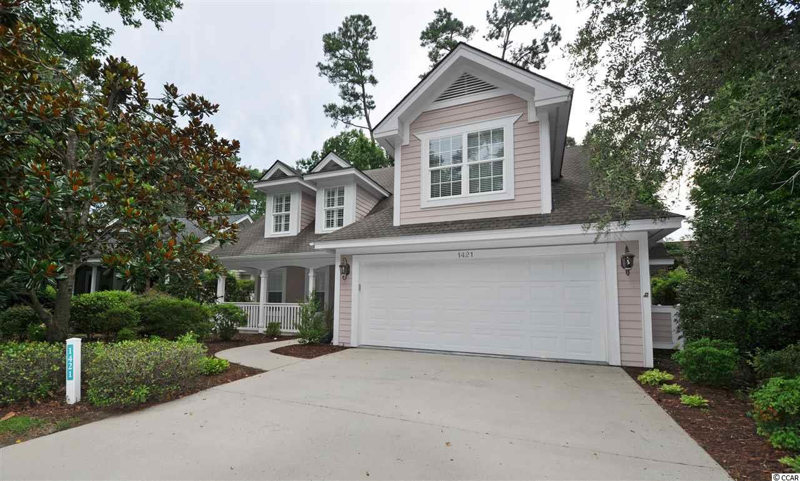
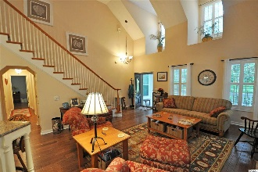
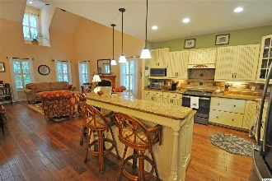
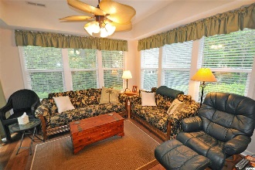
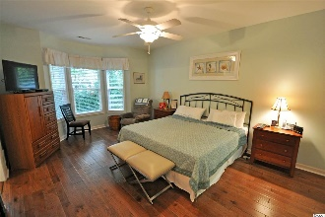
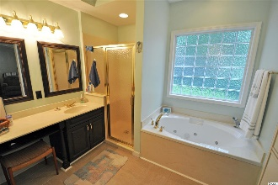
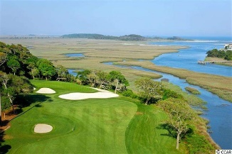
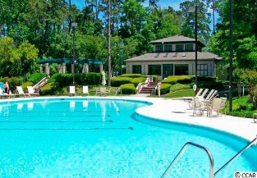
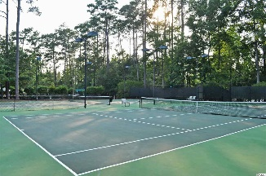
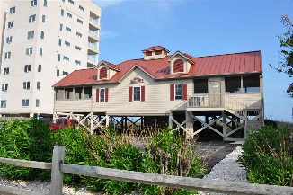


1421 Lighthouse Dr
Tidewater Plantation ~ North Myrtle Beach, SC 29582
MLS# 1917779 ~ $349,000
Unique & wonderful upscale details enhance this well-loved cottage-like home, surprisingly spacious with 3 - 4 bedrooms with over-sized master on the main level, along with one full en-suite-bath and a powder room for guests. This beautifully upgraded, charming, cozy and comfortable low-country-inspired home is in one of the signature Tidewater Plantation neighborhoods on iconic Lighthouse Drive. It is BIG luxury wrapped in a wonderfully livable, about 2,500 heated square feet of planned function space on one-living level and a thoughtful, generous upstairs bonus room/with 2 spacious bedrooms & a large full bath in a split-bedroom floor plan. A BIG wide drive leads to a double-car garage and to a great Southern-style porch with welcoming entry. Linger there with a front view of the 7th hole of world-class Tidewater Golf Course, or come on in to the heart of the home: breathtaking high-tech floors, large great-room with cathedral ceiling and FIREPLACE, lots of light and an adjoining magnificent kitchen and casual dining-gathering area, fun for a family or for entertaining. The layout is just perfect, too, kitchen to the left and laundry to the right toward the garage egress; sitting-area and morning room straight ahead; and split-bedroom, master-bedroom-private-enclave space past entry closets and guest bath to the right. The kitchen has a work island with breakfast bar and lots of cabinets and storage, including pantry. This Charleston-style house is kinetic and interesting, featuring a seamless transition from living/kitchen/dining-gathering space to the morning-Carolina-room and exit outside to the relaxing patio. The yard is nicely landscaped & manageable. The landscaping is robust -- indigenous flowers bloom front and back, ready for that secret garden. Come back inside, though, and check out ceilings, walls, shelving, sinks and doors. Surprises will astound you. The master suite has a spacious, customized closet, double sink vanity, tub, tray ceiling, large walk-in shower and pretty protected backyard view. There is even opportunity for a hot tub or soaking pool in the rear yard. Inside, airy fans, specialized touches and the unexpected in design and decor delight. Do not miss a thing! This popular 3-4bd/2 1/2ba home lives on a single level but with that unexpected guest/family huge bonus area upstairs! Most appliances are newer; none the less, a full 12 months of coverage is offered with the top-of-the line Old Republic Platinum Home Warranty Plan with HVAC. The best of easy but luxurious beach living, this house is a rare find! With the proven value of Tidewater, this home is appealing for a permanent residence, vacation home or investment property. Amenity-rich Tidewater is on a tree-lined road to oceanfront Anne Tilghman Boyce Coastal Reserve, a nature conservancy, including Waties Island, with access for managed recreational use. Tidewater itself is on an elevated peninsula of live oaks and southern pines between the ICW and the Cherry Grove Inlet to the Atlantic Ocean. The plantation also preserves the singular look of its own historic origins. It is minutes from the beach, shopping, medical services, entertainment and access to major highways. Amenities include the jewel in the crown, an oceanfront beach cabana for owners' use with open/screened porches, bathrooms, showers, and kitchen. Residents enjoy the use of several pools/hot tubs. Other amenities include a driving range, golf shop, clubhouse with bar/dining and event facilities, clay and hard surface tennis courts, pickle ball court, fitness center overlooking a pool, bocce courts and amenity center for events. Tidewater is manned, gated & has a gated storage yard for boats, jet skis, motorcycles, and kayaks. Tidewater Resort reflects the luxury and comfort of a beach/golf lifestyle. And, in Tidewater, Big value often comes in surprising packages as well, such as this unforgettable cozy yet desirable cottage at one of the lowest prices in the community.
Deborah Collins
843-424-9013
dctidewater@yahoo.com
Connie Ross-Karl
702-306-2643
conniesross@aol.com
NEW WAY PROPERTIES MYRTLE BEACH

