Slide 1
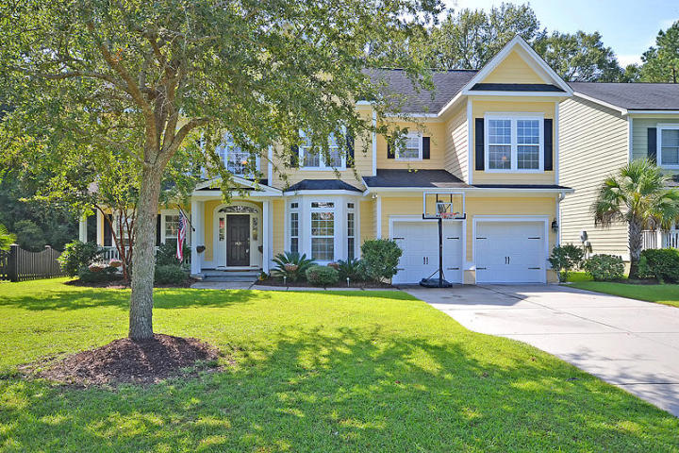
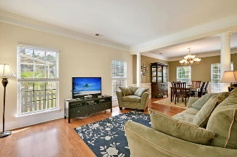
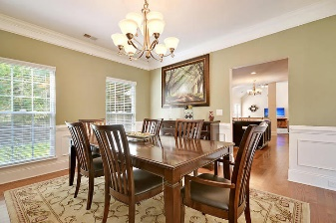
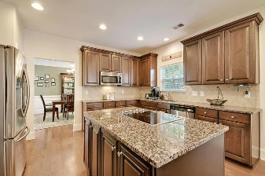
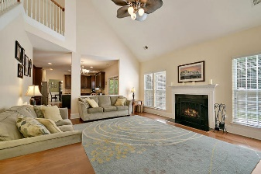
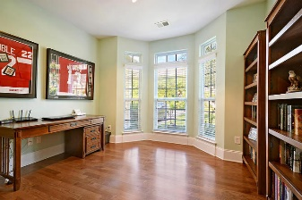
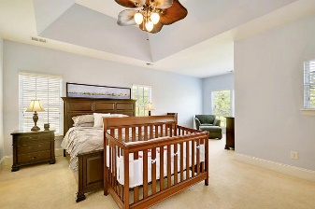
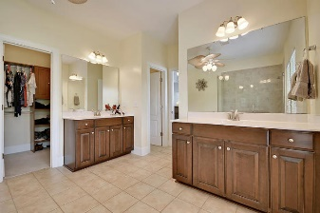
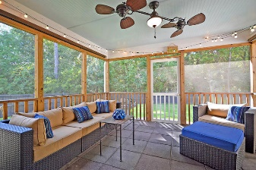
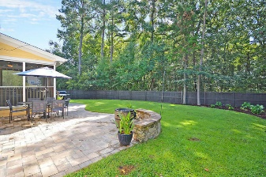
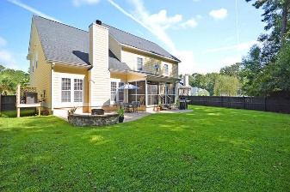



1421 Saint Hubert Way Hunt Club Charleston, SC 29414 MLS# 17024116 $399,900 4 Bedrooms | 2½ Baths | 3,058 sf
Price Improvement!
This is it! Located in a quiet section of the neighborhood, set back off the street & backing to protected wetlands! Popular & open Bluffton floor plan with over 3,000 sq/ft! Front & back staircases, impressive 2 story foyer & large room sizes + all 4 upper level bedrooms have walk in closets!
Main level has a separate office & hardwoods throughout! You'll love the kitchen: 42'' cabinets w/crown molding, center island, double ovens, granite, loads of storage & counter space. A great space for entertaining & with a screened porch off the kitchen + paver patio/hardscape. Master w/sitting room & luxury bath. This home is better than new! Why? Larger lot, larger home and less $ per sq/ft. Yard is already fenced, windows all have 2'' blinds & an alarm system is already installed!
5 ceiling fans inside plus 1 on the screened porch to keep you cool. Windows abound in this home that was built in 2009. **Cooktop can be moved to under microwave (electric already there). Mud room has a laundry tub! Carpets just cleaned, house power washed - move right in! Neighborhood pool and play area, great social committee to keep it fun in Hunt Club! Charleston style look and feel, close to shopping! Flood insurance optional!
Ashley Melton
(843) 670-2333
ashley.melton@agentowned.com
www. CharlestonPalmettoHomes.com
Lauren Zurilla
O (843) 884-7300 | M (843) 991-9149
laurenismyrealtor@gmail.com
www.LaurenZurilla.com
AgentOwned Realty Co. Premier Group, Inc. | 824 Johnnie Dodds Blvd | Mt Pleasant, SC 29464

