Slide 1

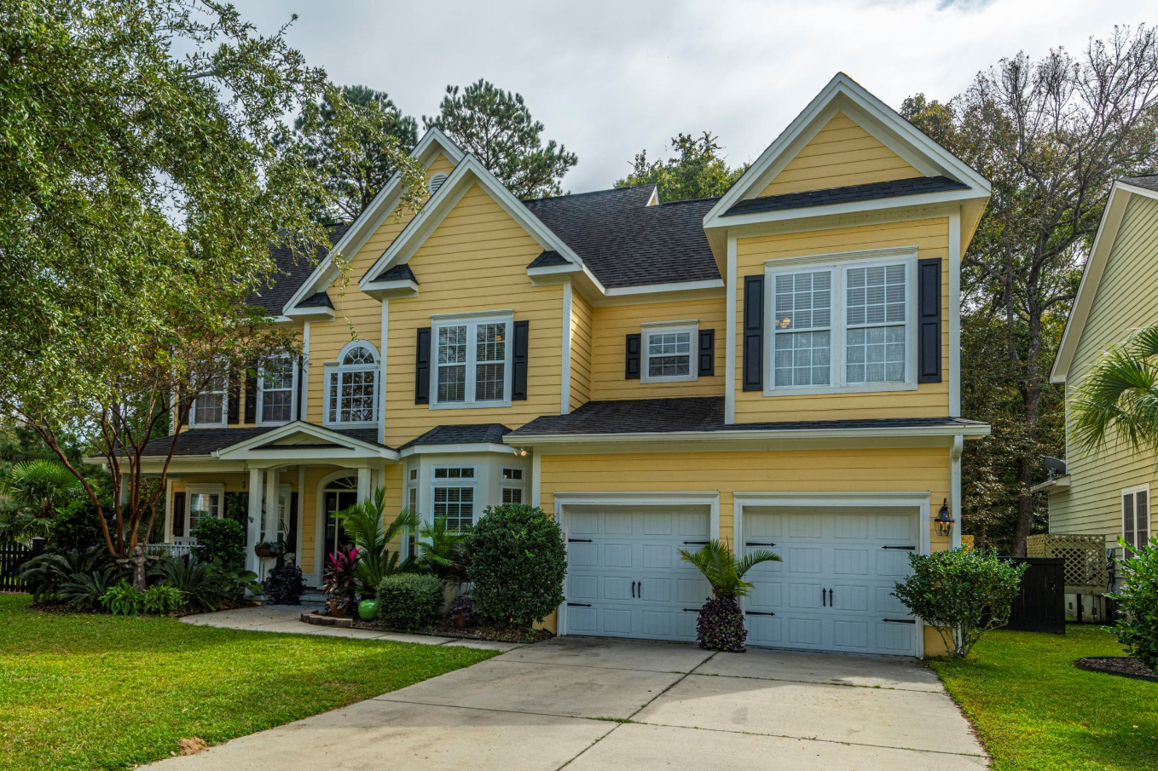
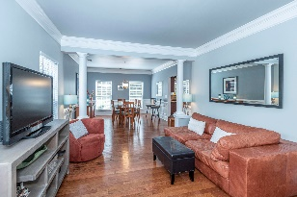
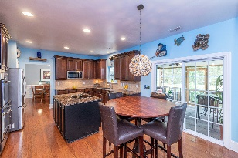
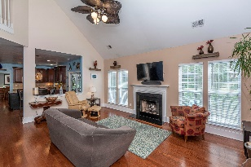
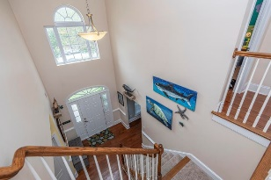
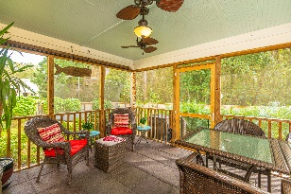


A Must See!
1421 Saint Hubert Way
Hunt Club ~ Charleston ~ MLS# 20029450 ~ $454,900
This Executive style home in the desirable Hunt Club neighborhood will truly impress you!! From the moment you arrive and view the mature trees and beautiful landscaping you know you are about to view a unique home. Enter the grand 2 story foyer which allows space to greet many. To the right you will find the study complete with French doors for privacy yet lots of light for productivity. The half bath is beside study. To the left of entrance find the second living area/library/casual space which connects to the formal dining room for larger parties. Gleaming hardwood flooring flows throughout the downstairs. Crown molding, chair rail, wainscoting...the quality and detail throughout are impressive! The spacious kitchen is the heart of the home. Family will spend many hours together for meal preparation and casual time. The counter space is expansive, and cabinets are more than adequate for your cookware. Double ovens, granite, tile backsplash & 42'' cabinets with crown, make this a dream kitchen! Located off the kitchen to extend your entertaining area is the spacious screen porch and the paver patio. The fenced in yard backing to wetlands allows for privacy and quiet. There are also fruit trees! Back inside you can relax in the family room. This is the perfect gathering area for families to catch up on the days activities, spacious and comfortable with fireplace and a back stairway for private access to the bedrooms. Upstairs you will find the bedrooms. Hardwood flows throughout the hall and the bedrooms, no carpet here. The master is huge with a sitting room. Master bathroom has oversized tile shower, a garden tub, dual vanities, water closet and walk-in closet. Down the hall find 3 nice size bedrooms with walk-in closets, a linen closet and the full bath. There is a separate entrance to the bath from one of the bedrooms. Pull down stairs were added for convenience to attic. Laundry is located on first floor and has a laundry tub. There are numerous extras, including the electrical system being wired for two generators(a 30 and a 50 amp), which could run entire house including A/C. Upgraded light fixtures and ceiling fans. Extra storage is above the garage doors, to name a few. Hunt Club is conveniently located off Bees Ferry, has a neighborhood pool, play area and lots of ponds and green space. This is not your typical cookie cutter neighborhood! Call today for a private showing and additional details.
Laurie Loparo
(843) 442-1290 | laurieloparo@gmail.com
www.lauriesellscharleston.com
Carolina One Real Estate | 873 Orleans Road, Ste 102 | Charleston, SC 29407-5753

