Slide 1
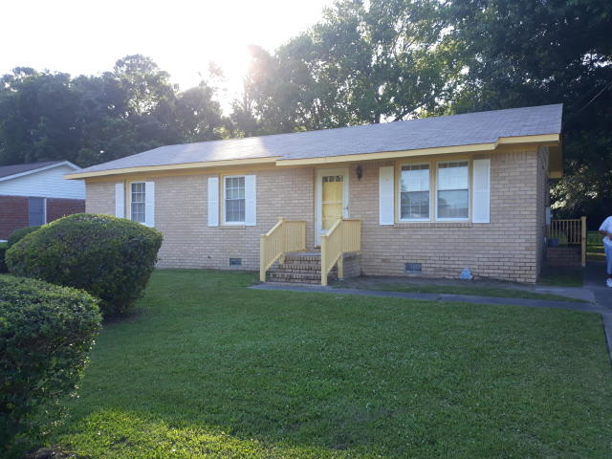
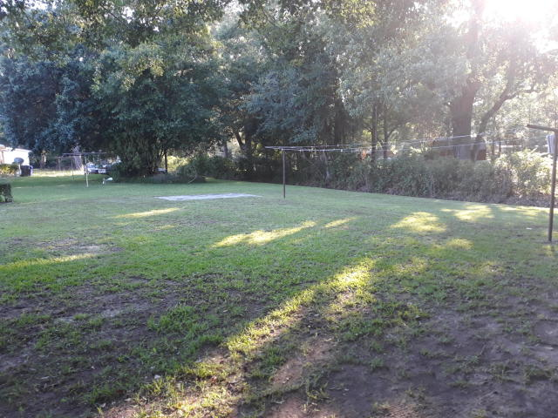
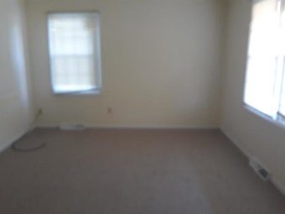
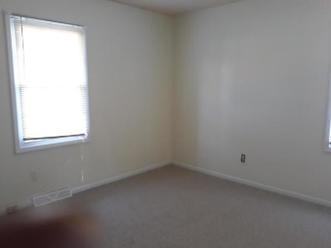
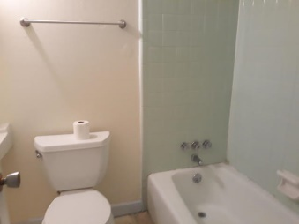
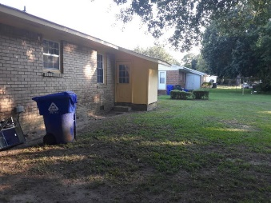

$10,000 Price Drop ~ Hurry Before It’s Gone!
Starbucks card to first 10 agents
1421 Westwood Dr
Westchester :: Charleston :: MLS# 20017088 :: $259,000
Very nice home in a great location.
Very close to Folly Beach.
Home requires a little updating but well worth the investment.
Come and see … you will be happy you did!
Geraldine Sands
(843) 224-1911
gw.sands67@gmail.com
AgentOwned Charleston Group | 902 Savannah Hwy | Charleston, SC 29407-7802

