Slide 1
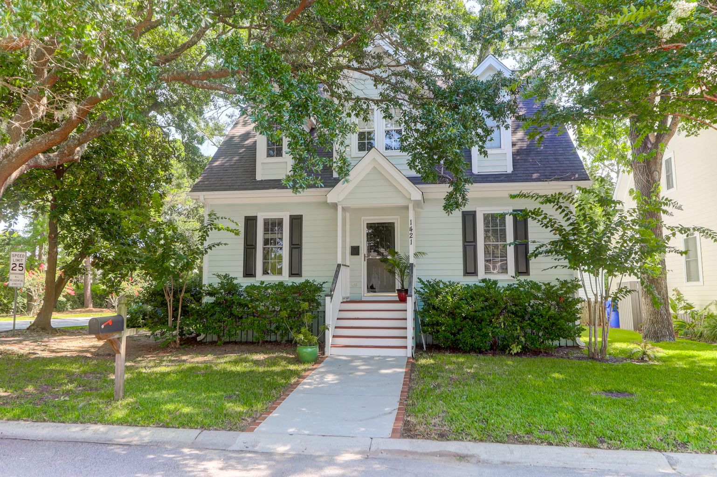
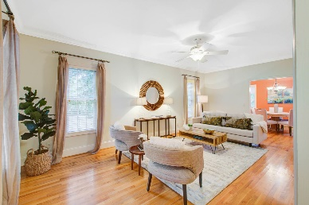
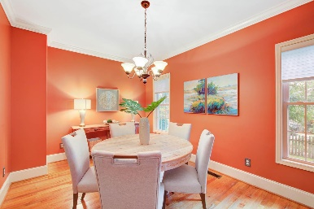
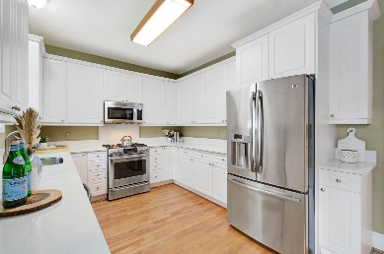
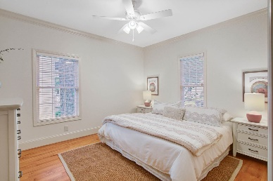


1421 North Point Court North Point | Mount Pleasant, SC 29464 | MLS# 21018067 | $725,000
Walk or Bike to Sullivans Island
Possible Short-term Rental
Must See!
Rare opportunity to purchase a charming home in the North Point neighborhood of Mount Pleasant. Only a bike ride or a walk to Sullivan's Island! Close to shopping and the beaches. Great floor plan, wood floors downstairs, formal dining room, Great room, Master bedroom on first floor. Kitchen features newer stainless steel refrigerator and dual energy stove gas stovetop with electric oven. Beautiful oak trees grace this extraordinary Lowcountry neighborhood!
Darlene Smith Office - (843) 886-8110
Mobile - (843) 696-7824
darlenesmith@carolinaone.com
DarleneSmithTeam.com
Carolina One Real Estate
1503 Palm Blvd Ste
Isle of Palms, SC 29451

