Slide 1
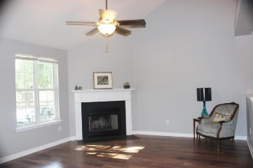
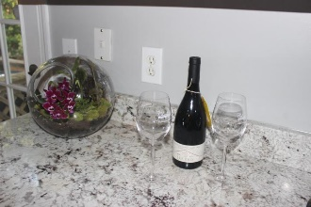
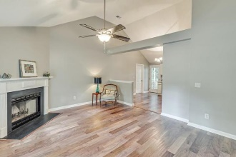
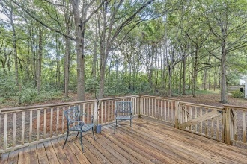
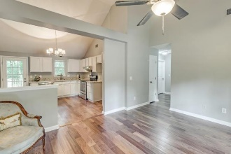
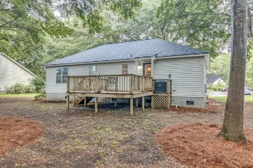
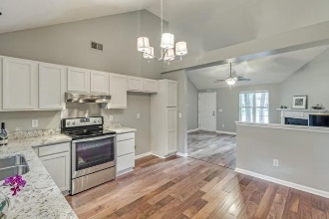
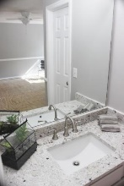
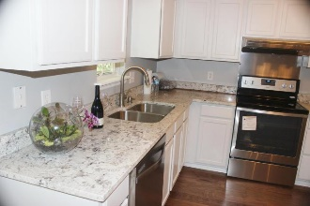
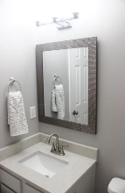
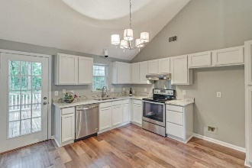
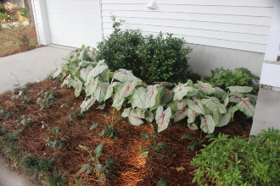


1422 Battery Wagner Road Stonefield ~ Charleston, SC 29412 ~ MLS# 16021531 ~ $294,900
OPEN HOUSE
Wednesday, August 17th, 11-2
Quality, Stylish & Charm
With this Charleston cottage, enjoy the open floor plan with the comfort and security of the massive invest in renovations and upgrades.
New Summer 2016
New roof
New wood flooring in Family room, Kitchen, Hall
New carpeting in three bedrooms including large Master walk-in closet
New flooring in two bathrooms
New sinks, faucets and plumbing for the upgraded granite countertops for the Kitchen
New sinks, faucets and plumbing for the upgraded granite countertops for two baths
New stainless dishwasher
New stainless range with new exhaust hood
New paint throughout entire interior including vaulted ceiling in Family/Kitchen, garage
New light fixtures throughout Family Room, Kitchen, bedrooms, baths, hall
New Summer of 2015
New air conditioning and heating system
Come see this cheerful home!
Kay Kennerty MBA, ABR, CRS, GRI
843-345-5011
KKennerty@aol.com www.KayKennertyHomes.com
The AgentOwned Realty Company
824 Johnnie Dodds Blvd, Mt. Pleasant, SC 29464

