Slide 1
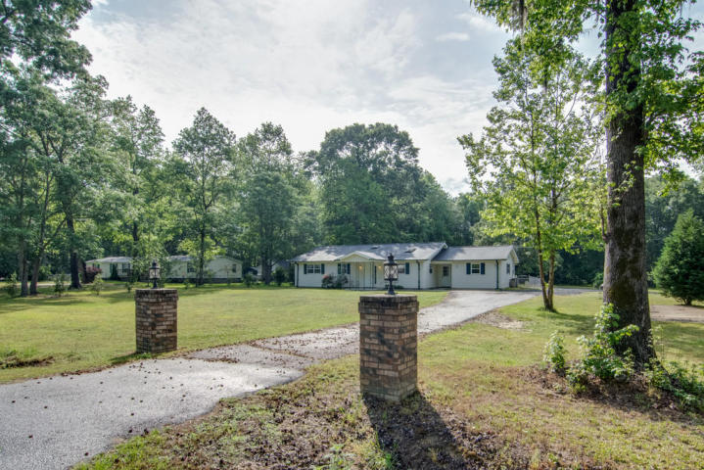
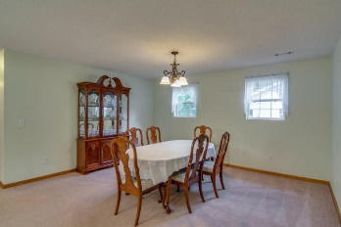
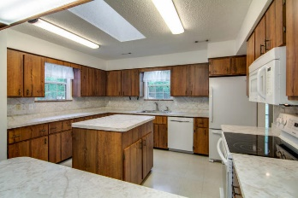
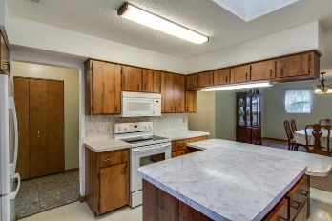
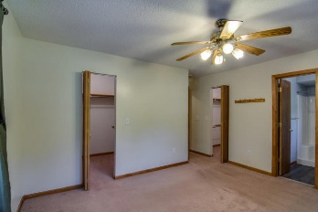
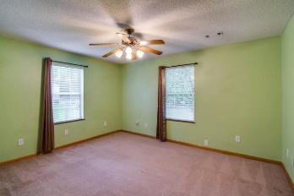
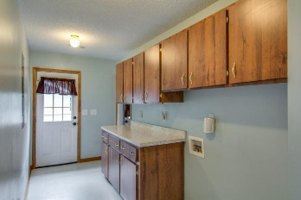
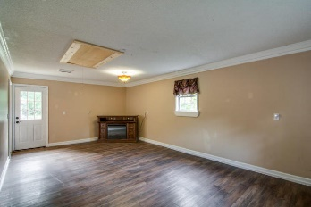
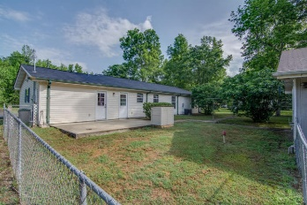
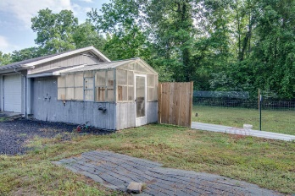
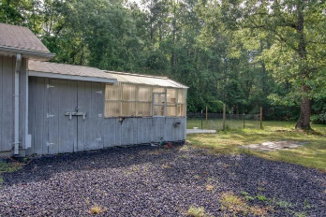


1422 Peirce
Cottageville, SC 29435
MLS# 16011446 ~ $159,000
Charming &
Comfortable Living
Available
Nov 1st!
This well maintained home is the total package. The beautiful grounds (2 acres) and well laid out floorplan of the house would be hard to beat at this price. The garage has been converted to a family room. From the family room you pass through a laundry area with a folding area and cabinets above and below. Then, the kitchen - huge - a must see to appreciate. Off the kitchen is either a large dining room or another living space, and finally the three large bedrooms. Be sure to check out the dual closets in the master. Outside is a large workshop (570 sq. ft.) that can hold a car or two, an extra storage area and a greenhouse! Behind the house is a fenced area with fig trees. Roof replaced in 2016, appliances are only 2 years old so there is nothing to do but move in.
Liz & Bob Simonds
843-437-9696
lizandbob@agentowned.com
AGENTOWNED REALTY CO. PREMIER GROUP, INC.
141-A N. MAIN STREET
SUMMERVILLE, SC 29483

