Slide 1
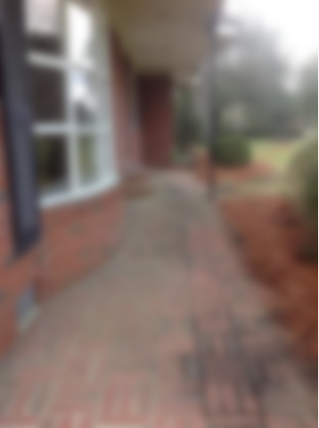
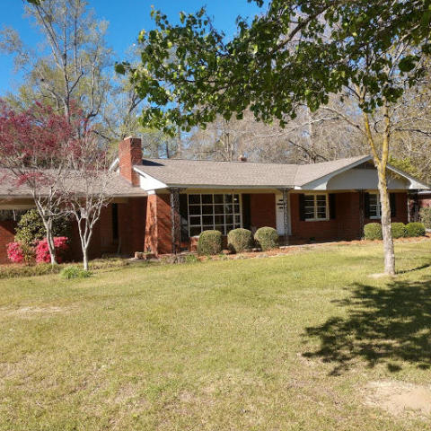
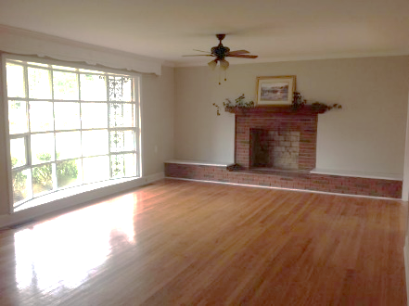
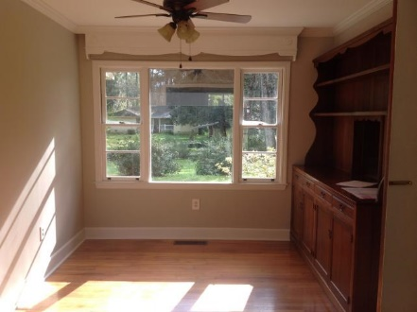
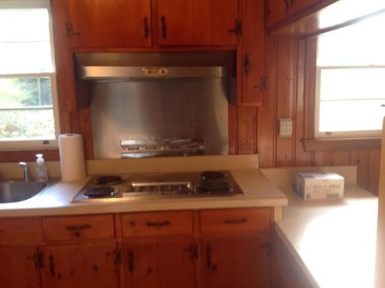
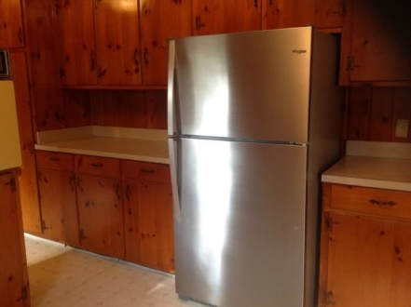
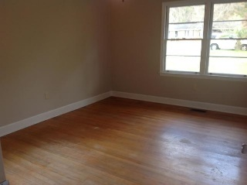
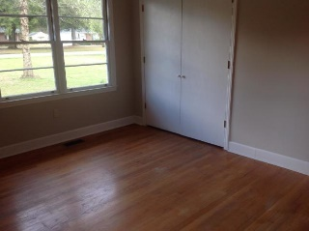
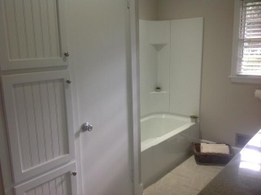
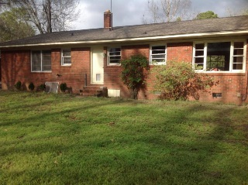
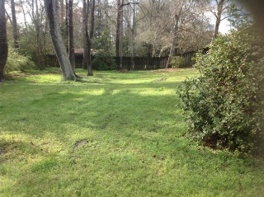

Won't Last Long!
Take A Look Today!
1423 Bennett Circle
Holly Hill, SC 29059
MLS# 19006481 | $159,000
Well taken care of older home in desirable neighborhood. The large living area boasts hardwood floors, an open fireplace, and a beautiful stained wood mantle. Freshly painted through out and has three bedrooms with hardwood floors also. One completely remodeled bathroom with tile floors and plenty of cabinets. Kitchen has brand new side by side stainless steel refrigerator and beautiful pine cabinets that are almost maintenance free!! Wonderful home for the new couple or great for empty nesters!
Karen Brown
(843) 709-4029
karenbrown22@gmail.com
AgentOwned Premiere Group
141 A N. Main Street
Summerville, SC 29483

