Slide 1
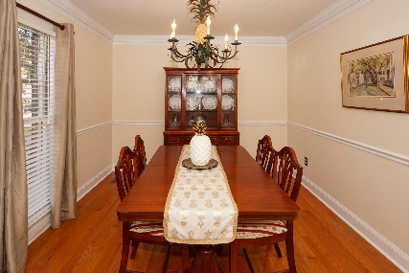
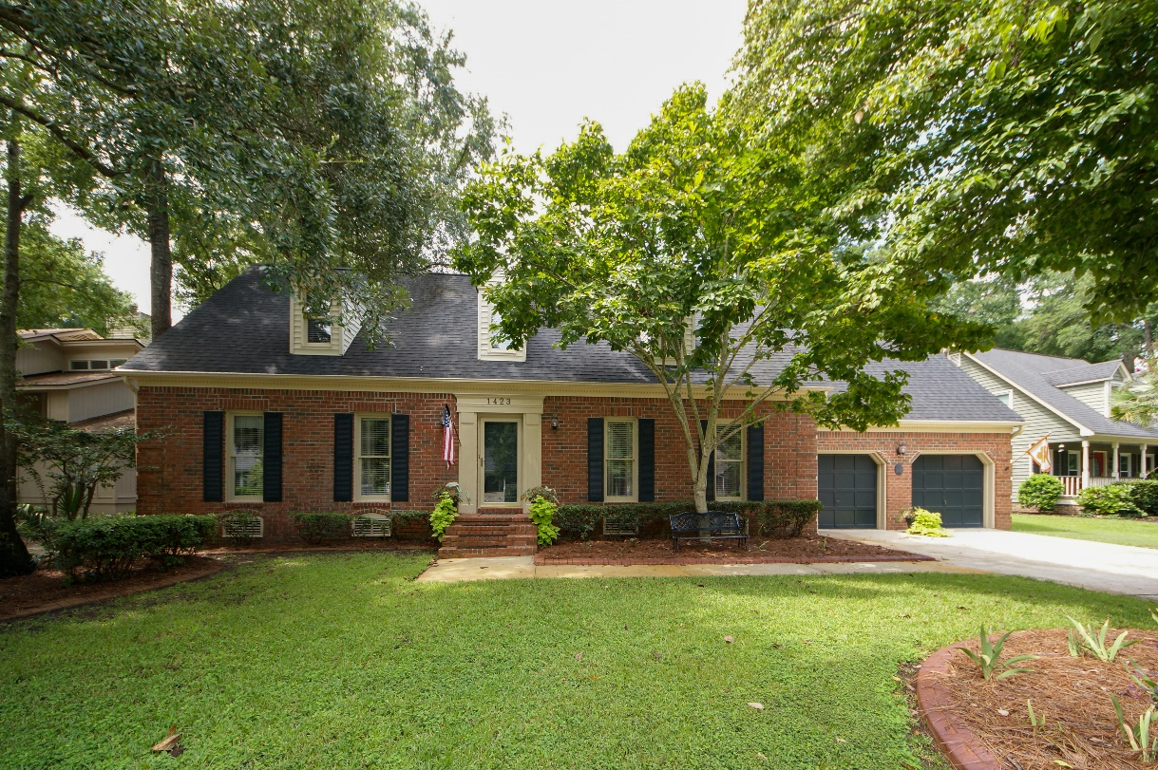
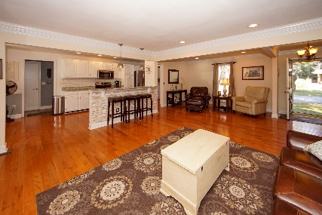
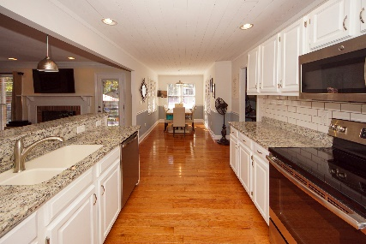
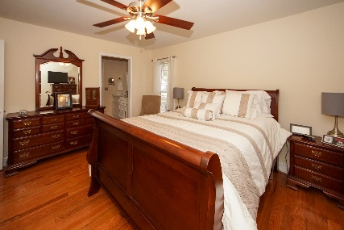
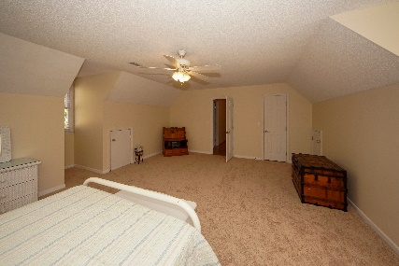
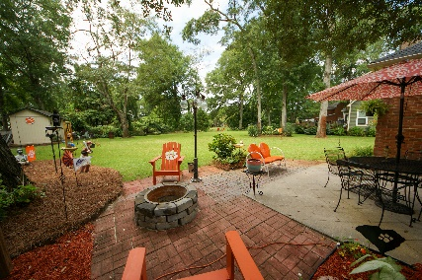
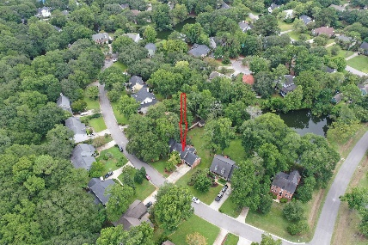


1423 Inland Creek Way Oakhaven Plantation ~ Mount Pleasant, SC 29464 MLS# 19023978 ~ $599,900
$1K bonus, Quick Close, Zoned for Whitesides Elementary
New Stainless appliances, freshly painted cabinets, updated master bath, and new carpets in bedrooms! This beautiful, well maintained home with open floor plan is on a pond and conveniently located close to shopping, beaches, open spaces and schools. The family room with a cozy fireplace is 25' x 16 and there is a connected half bath so there is great space for entertaining. There are oodles of cabinets, a pantry, granite countertops and a breakfast bar in the kitchen that overlooks the family room. There is also a bright eat-in area trimmed in bead board. All bedrooms are of considerable size with great closet space. The master suite on the first floor has two closets, including a walk-in. The additional bedrooms are upstairs with multiple dormers and a second full bath.
A great bonus is the room over the garage with perfect access to attic storage. In fact there is great storage throughout the home.
My favorite part of this property is the incredibly private backyard on a pond that is a perfect space for family gatherings or afternoon relaxation. The owners have taken great care to enhance the back and front yards with attractive landscaping and curb concrete edging. The neighborhood has a pool and tennis courts for the use of homeowners.
Open House previously scheduled for 9/15/16 Has been rescheduled due to bad weather
Cheryll Woods-Flowers
ABR, e-Certified, SHS
(843) 442-2219
www.woodsflowers.com

