Slide 1
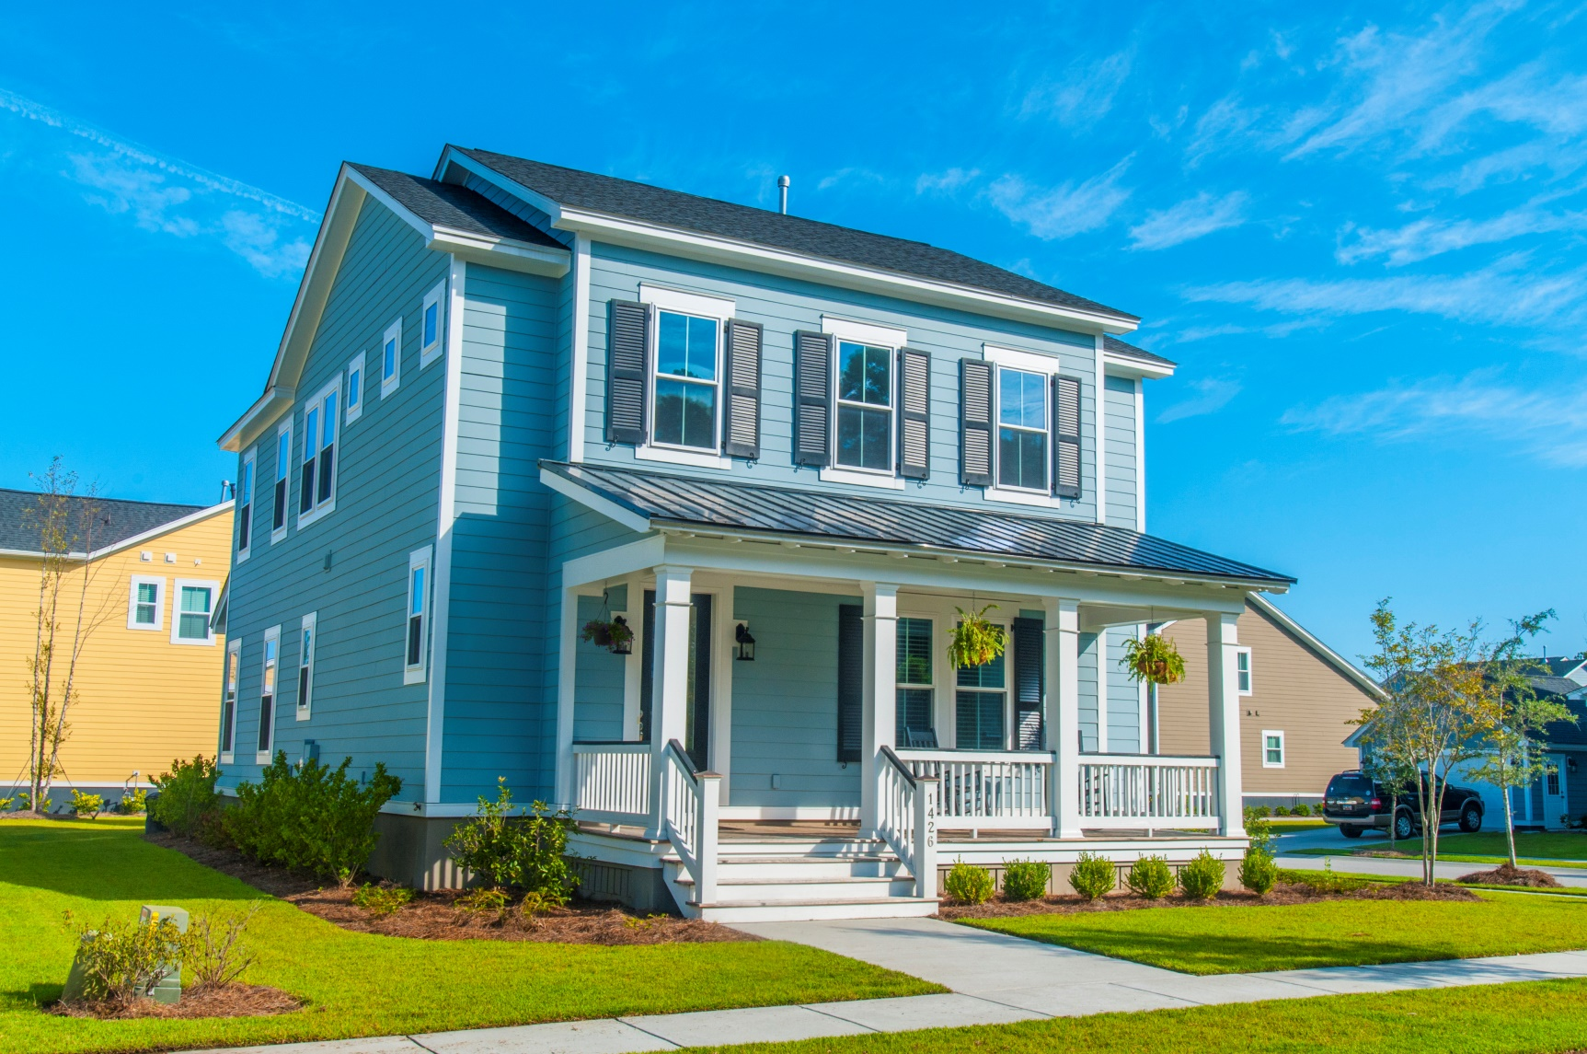
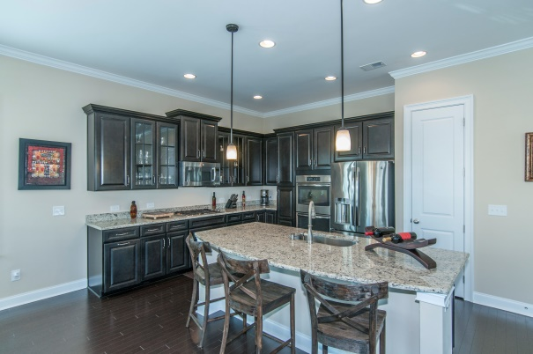
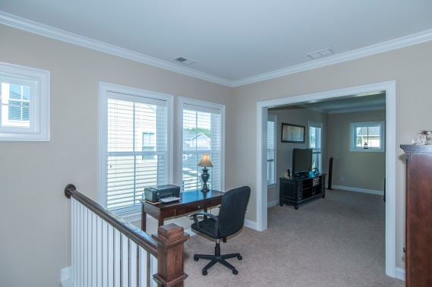
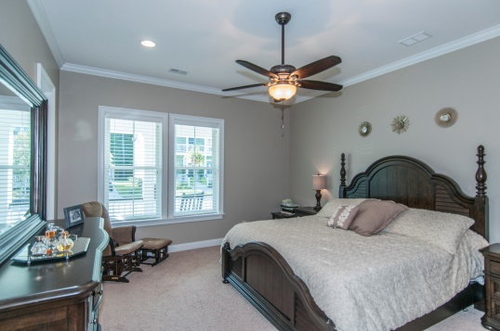
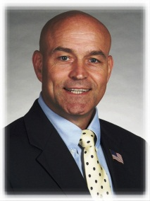

“Premier Carolina Park neighborhood, schools…”
1426 Crane Creek Dr
Mt Pleasant, SC 29466
Mid $400s
$4K closing costs w/preferred lender
Agent bonus – graduated scale, so time is of the essence
$449,500
Wonderful Carolina Park, a favorite floor plan, upgraded
kitchen, MBR down, loft & bonus space…..
Nice flowing, functional floor plan
Gourmet kitchen package
Corner lot, side load garage
Efficient design for loft and bonus room
Have you seen the pool at Carolina Park?!
Some of the kids can walk to school
STEVE ROWE
,Realtor®
Retired Military. Active Agent.
(843) 303-7438
srowe@carolinaone.com
www.SteveRoweHomes.com

