Slide 1

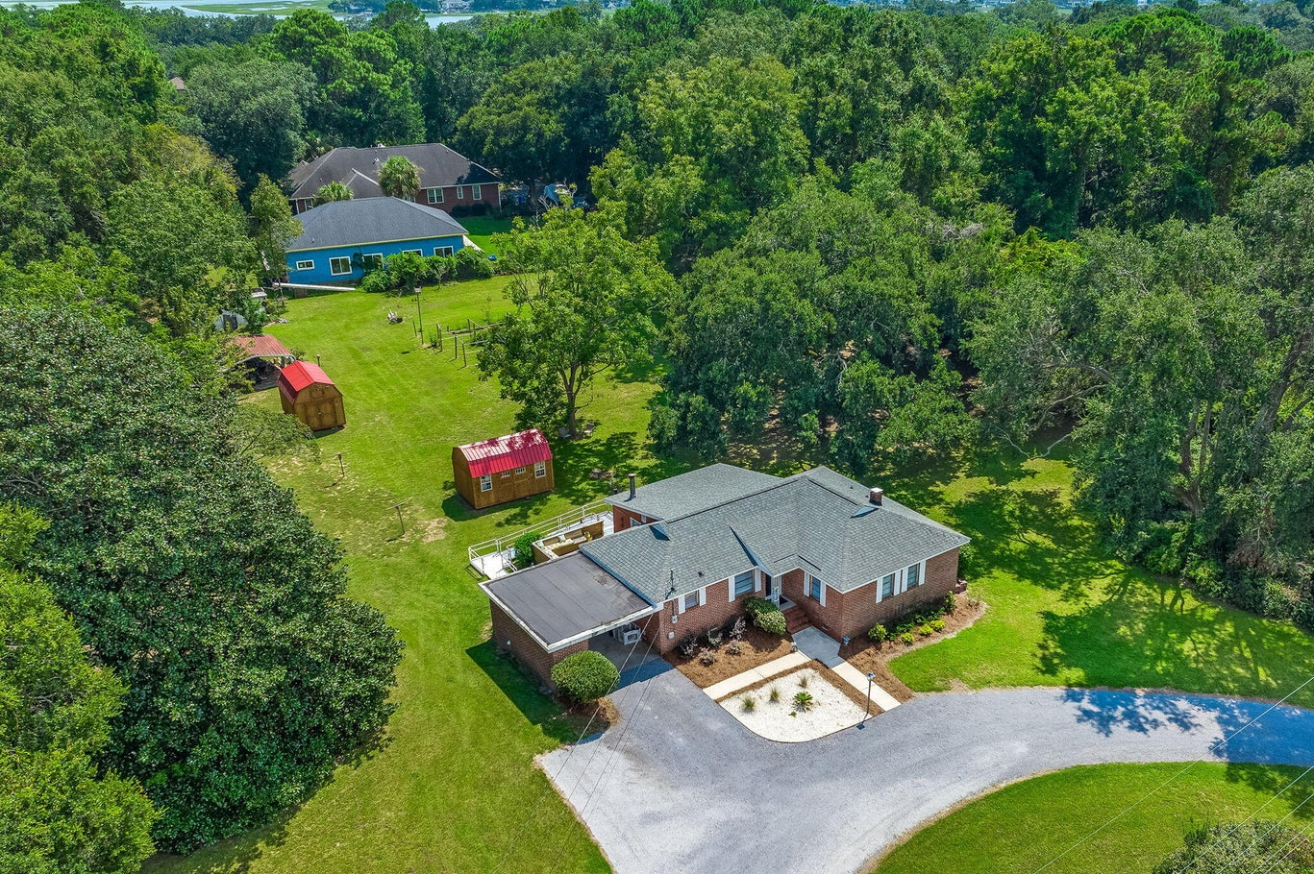
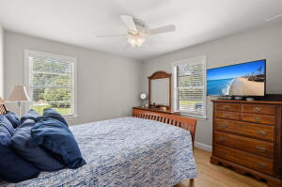
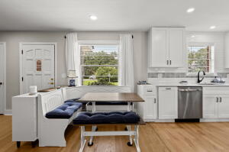
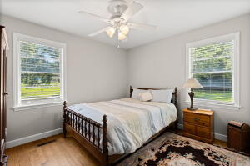
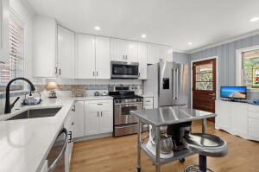
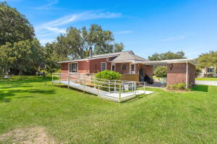
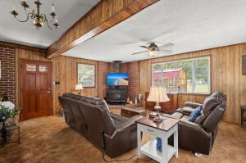
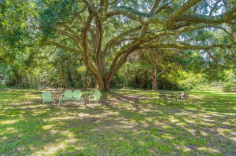
Incredible James Island Property – 1.43 Acres
1427 FORT LAMAR ROAD
James Island| MLS# 23020777 | $875,000
3 BEDS, 1 BATH ∙ 1,541 SQ. FT
A rare James Island gem! 1.43 beautiful, open acres with majestic live oaks tucked away on a peaceful street in one of the most sought-after communities in Charleston. This lovely 1956 ranch home, owned by the same family since it was built, has been lovingly maintained and updated. Original hardwoods, updated kitchen and open, flowing floor plan make this home a unique find, offering what few James Island homes can offer...space! The vintage tile in the bathroom and wood stove add charm to the serenity and peacefulness of this beautiful property. The park-like grounds are perfect for gardening, throwing the football or even working on your short game! Schedule a showing today to see how you can make this rare find yours!
Enjoy this video tour!
Caleb Elledge
caleb.richterco@gmail.com | 843-896-3416 | www.calebelledge.com
Brand Name Real Estate | 4 Carriage Lane, Suite 106 | Charleston, SC 29407

