Slide 1
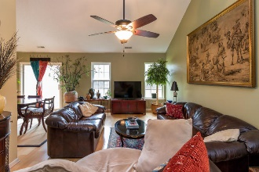
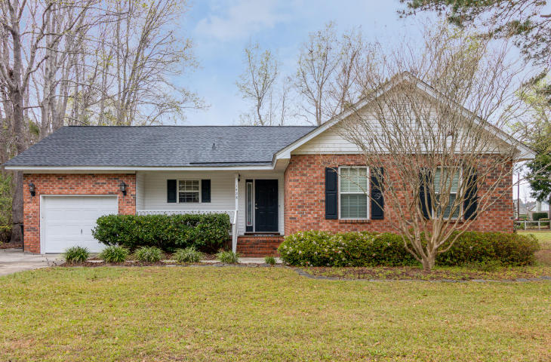
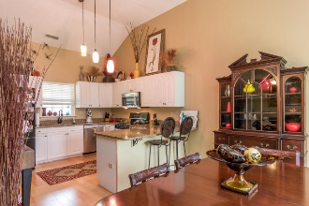
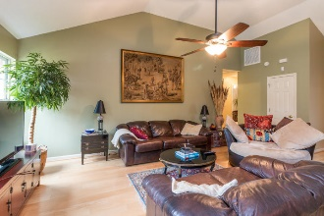
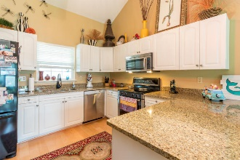
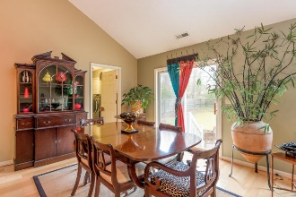
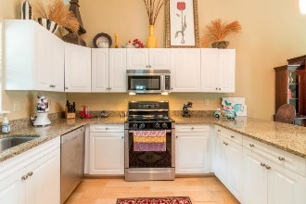
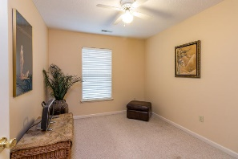
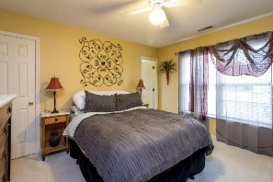
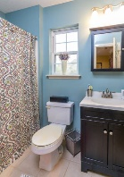
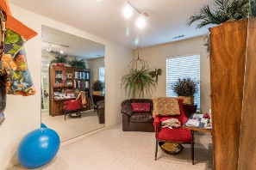
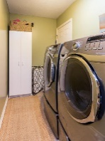
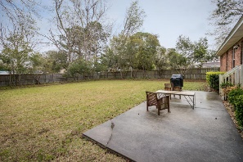
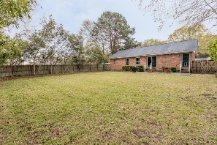


Great James Island Location
Brick Home With Many Upgrades!
1428 Bur Clare Drive
Bur Clare ~ Charleston, SC 29412
MLS# 17007142 ~ $310,000
Absolutely beautiful brick home with huge yard. Kitchen is gorgeous with granite counters, stainless appliances, farm sink, upgraded faucet, upgraded light fixtures, beautiful wood floors. Vaulted ceiling in family room, dining room, and kitchen. HVAC, roof and hot water heater all replaced within last five years. Large fenced back yard with patio and privacy fence. One car garage. Laundry room. This home shows beautifully. Minutes to Folly Beach and to downtown. Flood insurance is not required currently located in X zone.
Sherrie Lindberg, Realtor
843-532-2002
lindbergsherrie@gmail.com
www.erawilderrealty.com
ERA Wilder Realty, 125-F Wappoo Creek Dr, Charleston, SC 29412

