Slide 1
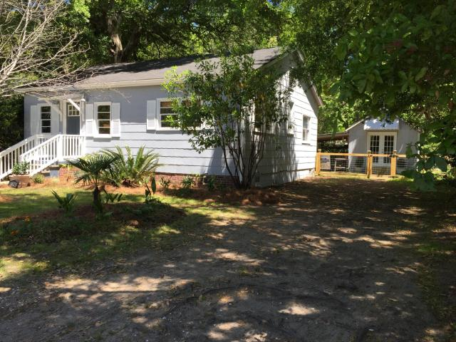
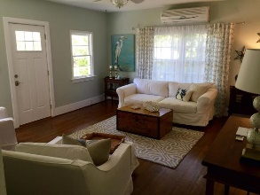
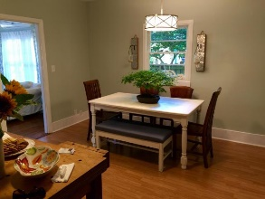
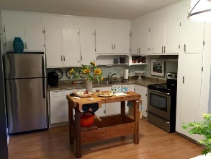
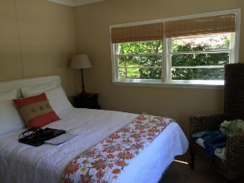
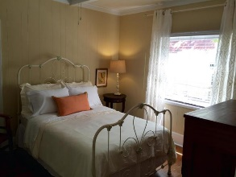
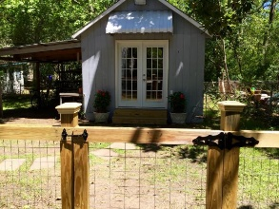
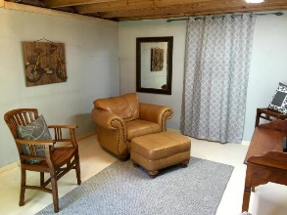
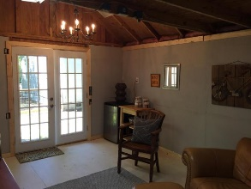
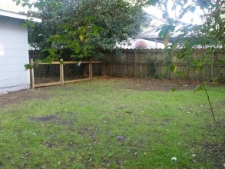

1428 Moultrie Street
Old Mt Pleasant | Mount Pleasant
MLS# 16010036 | $439,000
Absolutely Charming Old Village Cottage inside and out!
Loaded with Updates
Near the heart of the Old Village on a desirable quiet dead end street. This home lives much larger than it looks from the outside.
Spacious living room, and large kitchen and dining area with 3 bedrooms and 1 bath, multiple closets in bedrooms; 3rd bedroom and separate laundry room were previously added across the back of the home; Beautiful hardwoods, SS appliances, new tile floors in bath, interior has been completely refreshed!
Attractive accessory building with additional 180+ sf of flexible living space, currently being used as a media room. Includes electrical and AC, could be up-fitted easily for full bath addition for potential rental income. Seller is Motivated!
1 year home warranty provided. No Flood Insurance required!
Stan Huff
843-670-2835
stan.huff@agentowned.com
Jill Marcacci
843-297-5590
jill@agentowned.com
www.agentownedrealty.com
AgentOwned Realty Co. Preferred Group, Inc. | 824 Johnnie Dodds Blvd | Mt Pleasant, SC 29464

