Slide 1
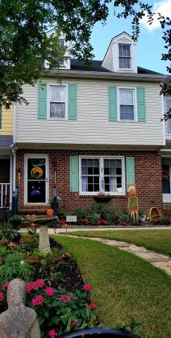
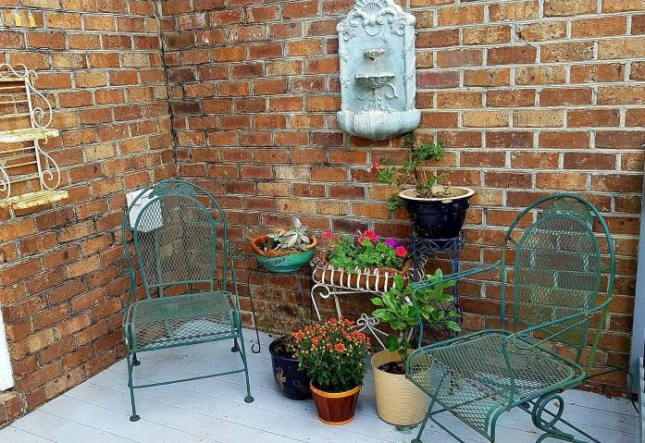
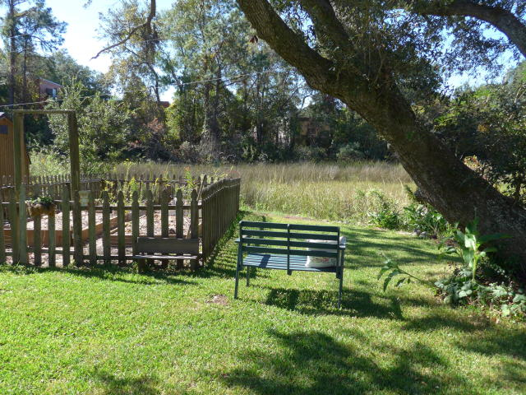
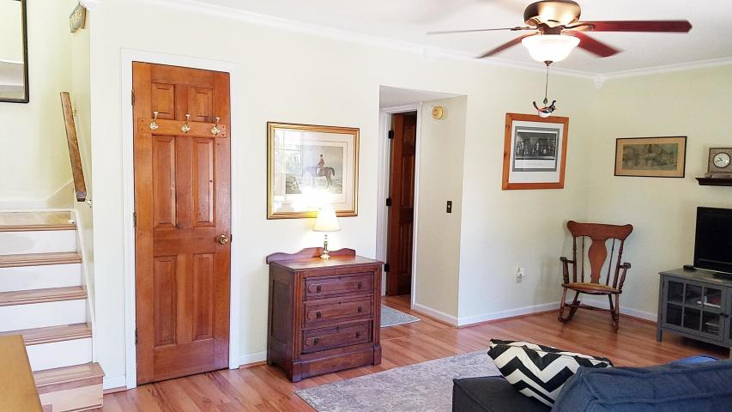
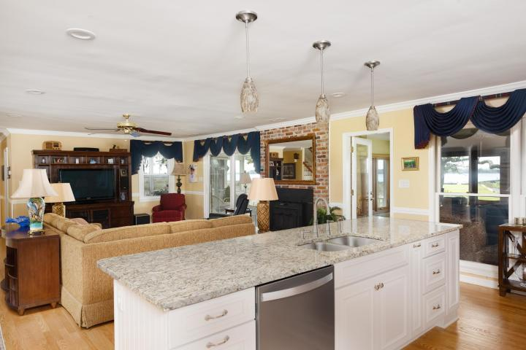
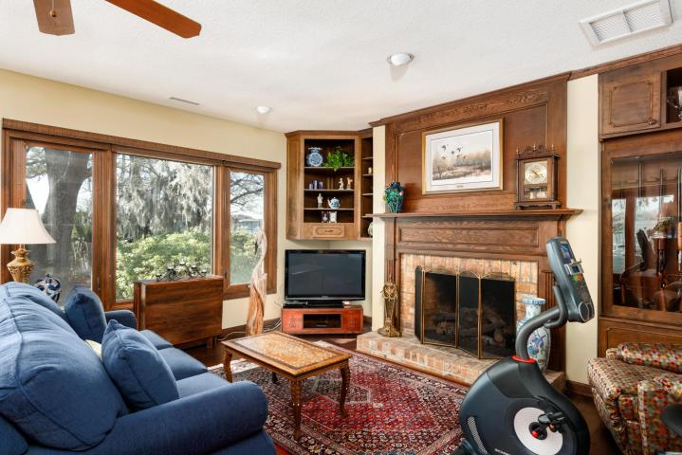
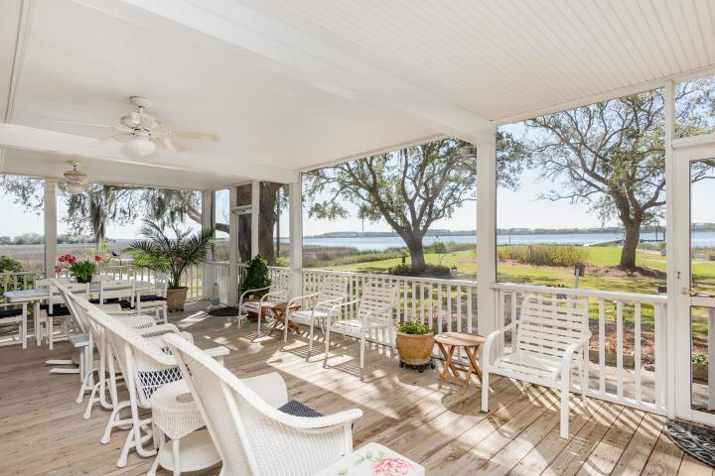
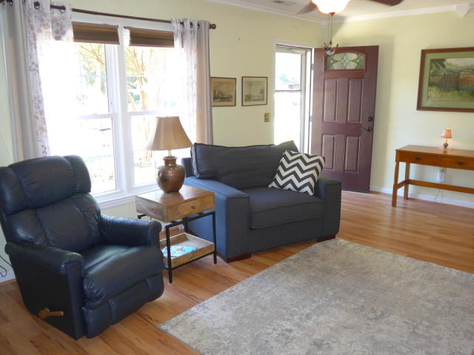
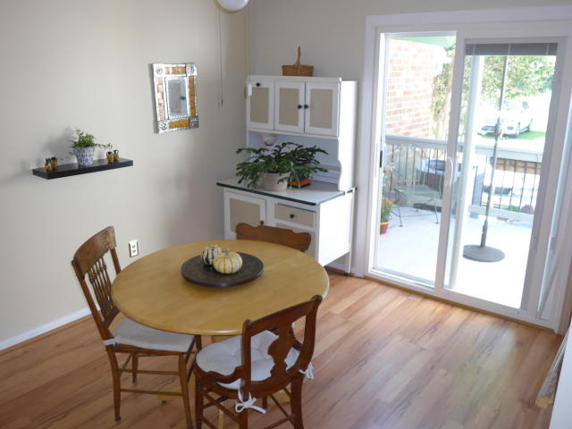
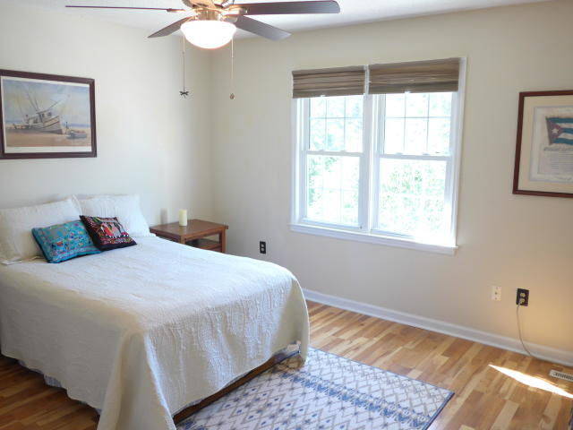
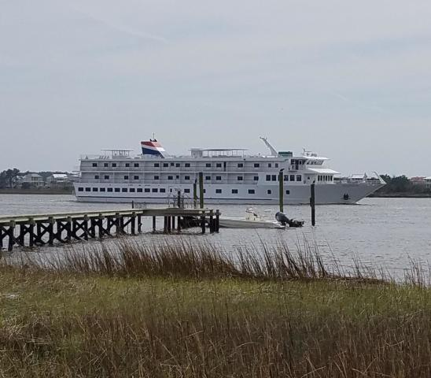
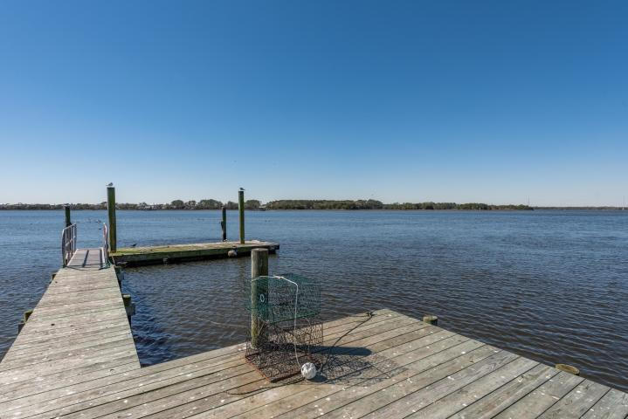
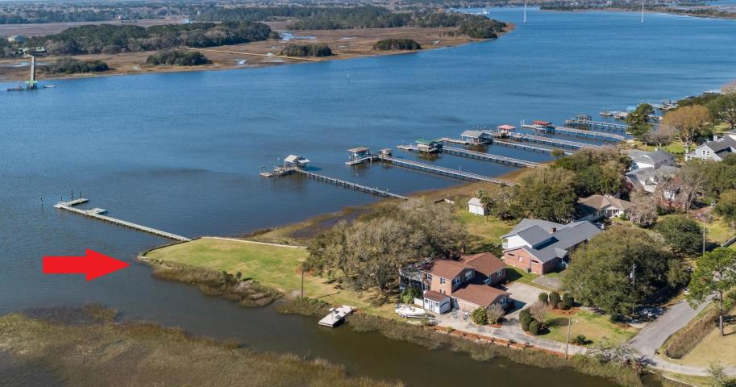


3BR James Island Marsh Front Town Home
Perfect For Professionals or as a Second Home
REDUCED!!
REDUCED!!
1429 Brockman Circle
The Willows | Charleston, SC 29412
MLS# 19029088 | $235,000
Amazing 3 Bedroom MARSH FRONT town home on James Island with NO HOA or regime fees, and SO convenient to Folly Beach and Downtown Charleston!!! Want to grow veggies, herbs, flowers? You can garden or just relax on the bench overlooking the TIDAL CREEK at the edge of your own back yard...Beautiful home has quality real wood interior doors and newer laminate flooring. Tile flooring in upstairs bath & in laundry room. Gorgeous COPPER FARM SINK in the kitchen has brand new faucet. Bubbling fountain on the deck & the storage shed convey. Back decking only 2-3 yrs old. Great storage with kitchen pantry, outside storage room, lots of closets & a big attic with pull-down stairs. Super JAMES ISLAND SCHOOLS too!!! EASY LIVING in this wonderful, peaceful neighborhood. High & Dry Lot too!!!!
Barbara Harper
843-224-5759
Barbara.Harper@agentownedrealty
www.ISellCharleston.com
The AgentOwned Realty Co. • 902 Savannah Hwy. • Charleston, SC 29407
Real Estate • Mortgage • Insurance

