Slide 1
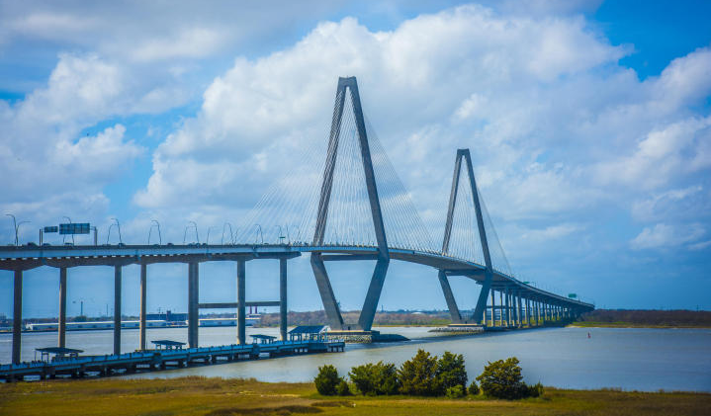
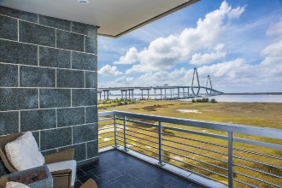
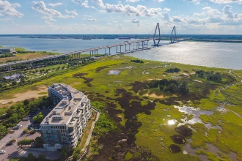
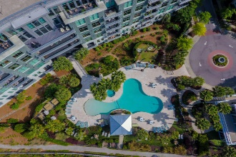
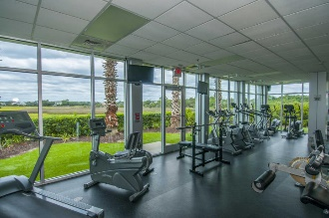
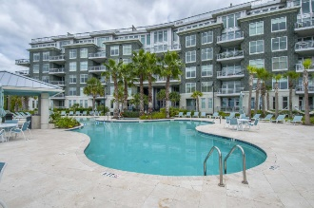
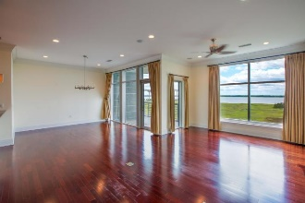
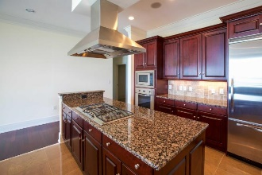
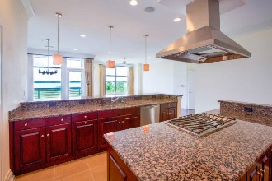
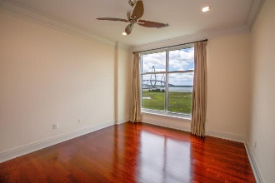
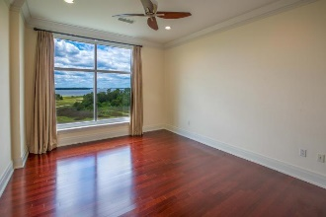

Best Views Available At Tides!
142 Cooper River Drive
Tides Condominiums
Mount Pleasant
MLS# 16006453
$1,289,000
4th Floor well kept spacious 2 BR/2.5 Bath luxury at it's finest! Direct secure elevator access opens into large foyer. Open Floorpan with with large Kitchen island that offers all Viking appliances including gas cooktop, custom cabinetry, granite countertops & walk in pantry. Entertain with ease & enjoy the Lowcountry views of the Charleston Harbour and marsh landscape. Living & Dining areas are combined, and open off the kitchen all with focus of the gorgeous scenery & incredible sunsets! Beautiful Brazilian Cherry Floors, 10 Ft. ceilings, and extensive molding. Master Bath has large step in Shower, double vanity & air jet jacuzzi. Balcony offers peaceful serenity and opportunity for private garden with drainage & water access. This home is wired for sound, & CAT-5, cable & sound proofing & hurricane proof windows.
The Harbor House Amenity Center has Rooftop Terrace, Fitness Center with State of the Art equipment, Steam Room & sauna. Slope entry Carribean style Pool & you can even relax in the jacuzzi or Hammock! Walking trails surround the property giving easy access to the Mount Pleasant Waterfront Park & Patriots Point.
Secure parking garage with designated spot as well as outdoor spaces allowed. Location, Location, Location! Minutes to Downtown Charleston, Sullivan's Island & Isle of Palms, not to mention local Mount Pleasant cinemas and Dining options galore! This is Lowcountry Living at it's finest!
Patty Scott
REALTOR
(843) 814-2400
pattyscottsellscharlestonhomes@gmail.com
LifeTree Real Estate, LLC
3094 Hwy 17 North
Mt. Pleasant, SC 29466
www.lifetreerealestate.com

