Slide 1
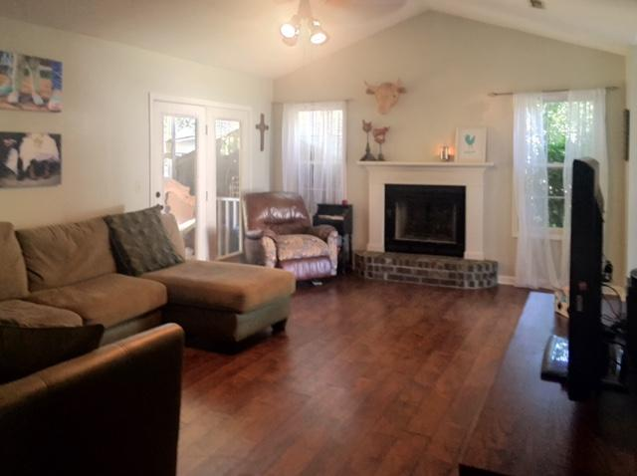
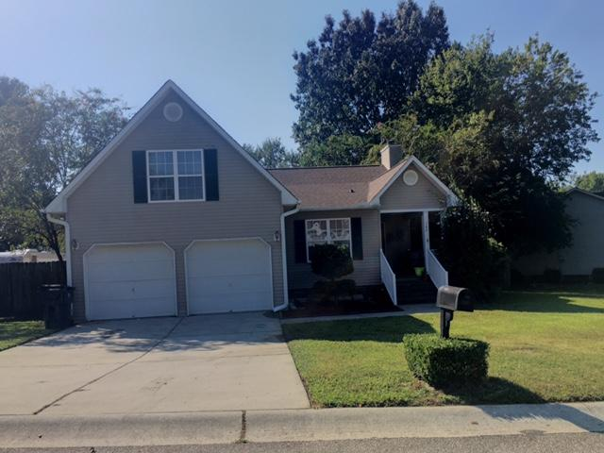
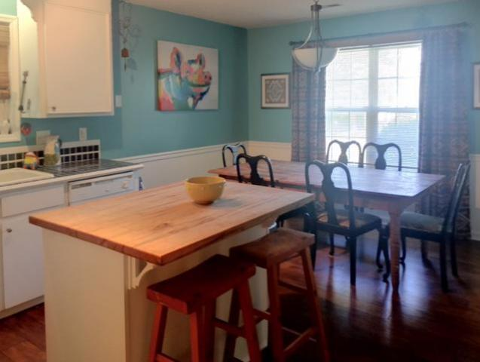
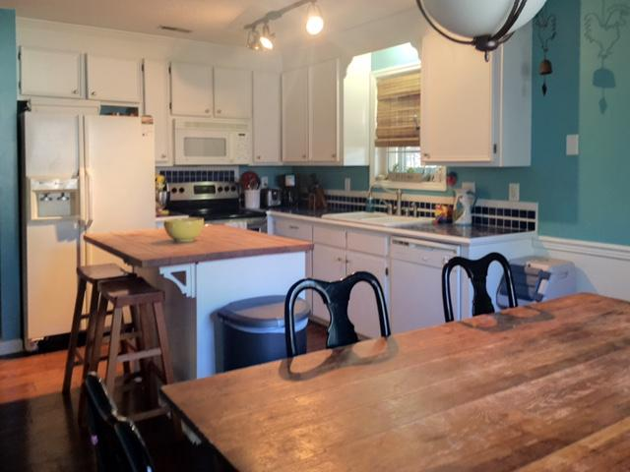
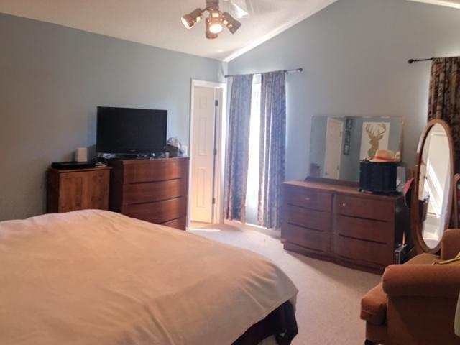
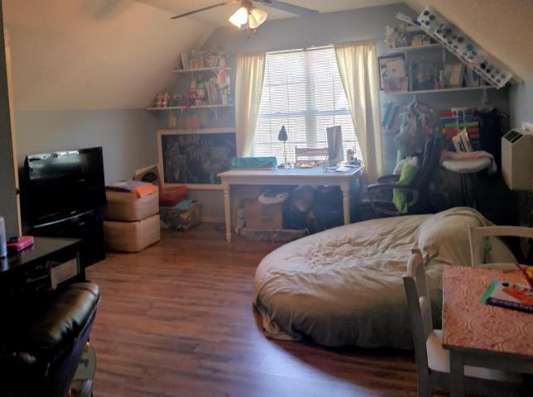
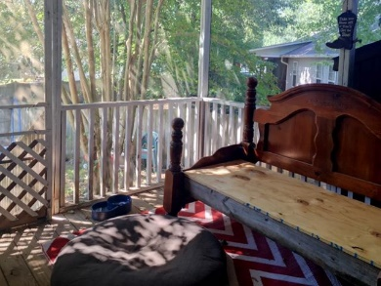
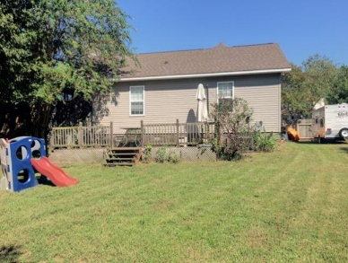


142 Kingsbridge Drive
Devon Forest ~ Goose Creek
MLS# 16023784 ~ $187,500
This One Won't Last Long!!!
Wonderful home with tons of character just waiting to become your own!!! Step inside from the covered porch and immediately notice the gorgeous dark laminate hardwood floors, vaulted ceilings and brick fireplace. The kitchen includes trendy tile counters and a beautiful wooden center island. The breakfast area is the perfect size for a large farm table! This home has a great floorplan with the opportunity to have 4 bedrooms! Down the hall are two bedrooms with a study/office that is currently used as the third bedroom. The FROG is spacious and makes for an excellent bedroom, play room, game room, or office space. The large master bedroom includes vaulted ceilings and an ensuite master bath with separate garden tub and shower. The screened-in porch connects to the family room and takes you out into a nice sized backyard. There is a large deck as well that is fantastic for grilling out and get-togethers with family or friends! The firepit adds to the coziness of this home. And who could forget the 240 sq ft building in the back that has A/C AND electricity? This building makes for a perfect Man-Cave/She-Shed or Workshop! This home is a MUST SEE!!!
Devon Jones
(843) 452-6063
devon@agentowned.com
www.agentowned.com
The AgentOwned Realty Company | 824 Johnnie Dodds Blvd | Mt. Pleasant, SC 29464

