Slide 1
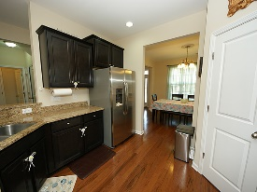
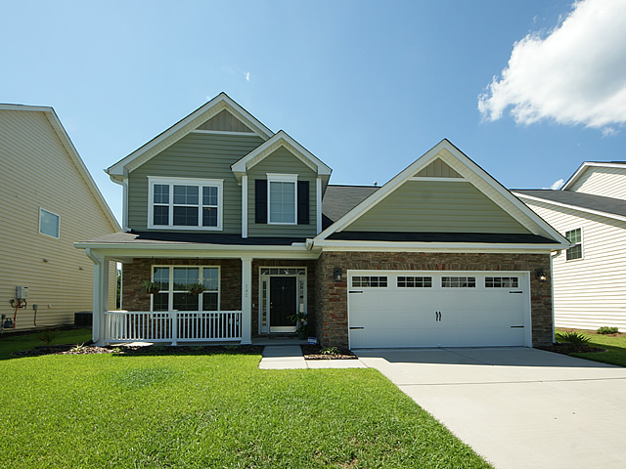
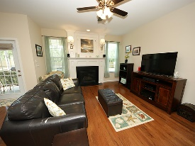
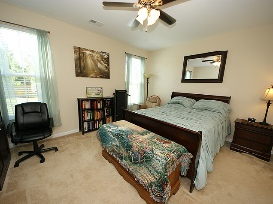
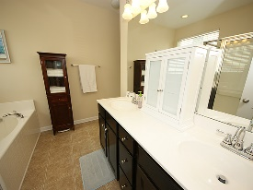
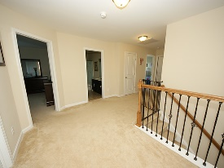
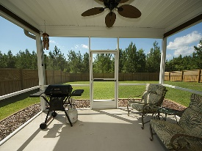
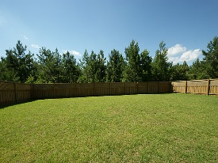


Master Down Stairs
142 Royal Star Road
Cane Bay Plantation
Summerville, SC 29483
Open House Canceled!
Under Contract In 3 Days!
MLS# 16015464 | $249,000
5 Bed / 2½ Baths
Like new construction, this 5 bedroom home is the best value in Cane Bay! Built 2013 this gorgeous home boasts high end upgrades with a low listing price! Hardwood floors, granite counter tops, stainless appliances, upgraded cabinets, decorative fire place, and decorative spindles on the stair case. The list goes on with an upgraded front elevation, decorative garage door and the sellers have installed a beautiful wooden privacy fence to enclose a large private back yard. Curb appeal, elegance and a desirable location at a lower price than new construction!
Connie White, Broker
C: 843-532-3356
conniesyouragent@gmail.com
Charleston Homes
111 Spring Hall Dr
Goose Creek, SC 29445

