Slide 1
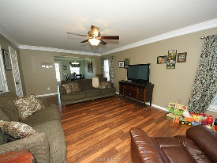
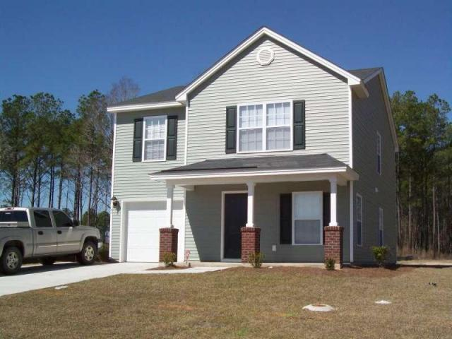
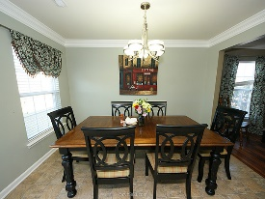
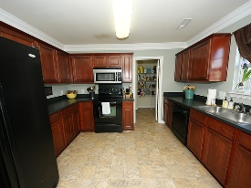
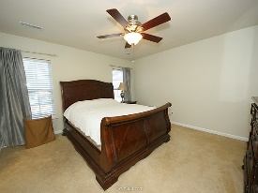
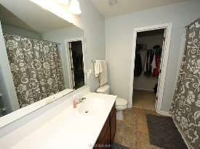
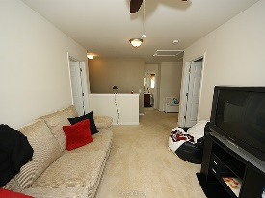
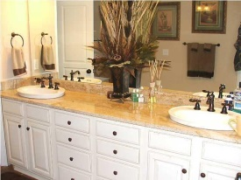
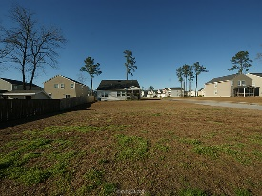
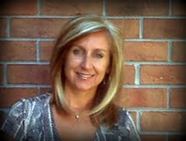

Open House Sunday ~ 12:30 to 3:30
142 Salem Creek Dr
Liberty Hall Plantation
Goose Creek, SC 29445
Open House Canceled!
Under Contract In 3 Days!
MLS# 16001049 | $173,900
3 Bed / 2½ Baths
Prettiest home in Liberty Hall Plantation!
Seller has added the perfect upgrades to this charming floor plan! Custom paint colors, upgraded laminate wood floors and crown molding are just the start to this 3 bedroom home with a loft on the second floor. Kitchen is spacious with rich cherry cabinets and oversized pantry. This home sits on a corner lot for extra space.
Seller is motivated and ready for an offer!
Connie White, Broker
C: 843-532-3356
conniesyouragent@gmail.com
Charleston Homes
111 Spring Hall Dr
Goose Creek, SC 29445

