Slide 1
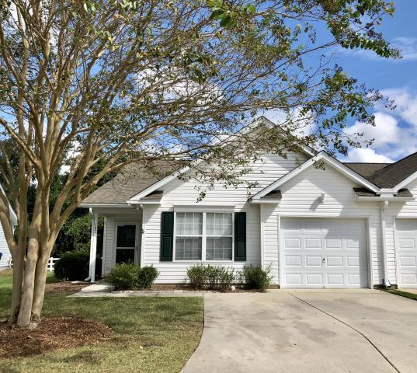
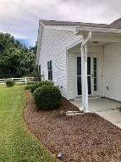
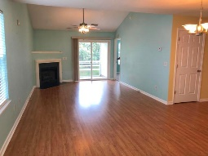
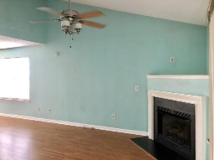
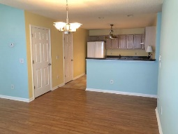
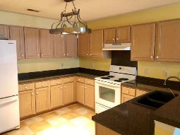
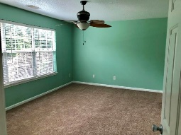
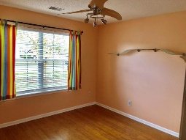
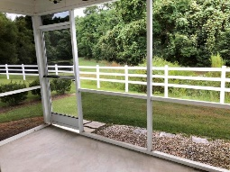
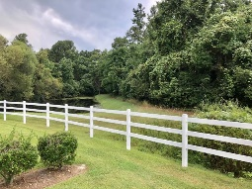


Summerville One Story-Yard Maintenance Included!!
142 Townsend Way
Village On Central
Summerville, SC 29483
MLS# 18025420
$155,000
2 Bedrooms | 2 Baths | 1,192 sf
Get ready to live the good life! Low maintenance living at its best just three miles from downtown Summerville! Upon entering the home, you'll notice the lovely wood floors. Through the foyer, you'll enter the dining room/living room combination. This a great space offering plenty of room for entertaining. The living room even has a gas fireplace! The kitchen overlooks the dining area and has a breakfast bar, tons of cabinet space as well as a large pantry. Off the kitchen is the laundry room as well. Bedroom #1 is a great size and has a full bath located out in the hall. The large master bedroom is located in the rear of the home and has a walk in closet as well as its own full bath with dual vanities and large linen closet.
Back out to the living room, you have access to the screened in porch that offers peaceful wooded views, as well as pond views! The HOA fees covers yard work as well as maintenance of the common areas of the neighborhood. Shopping is just one mile away! This home will not last! Come see it today!
Larry & Kathy Mazalatis
Larry Cell 843-693-0529
Kathy Cell 843-693-0159
Office 843-871-9133
AGENTOWNED PREMIERE GROUP | 1800 TROLLEY RD | SUMMERVILLE, SC 29485

