Slide 1
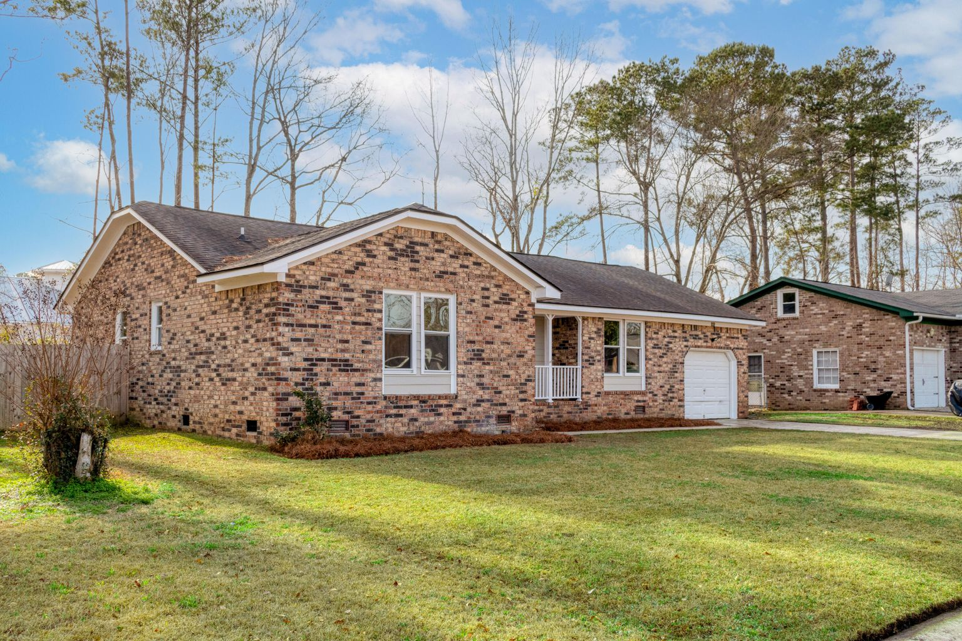
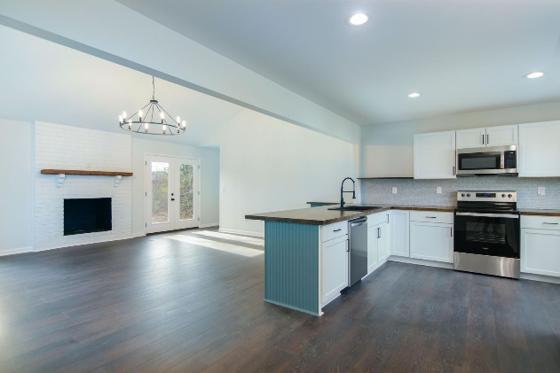
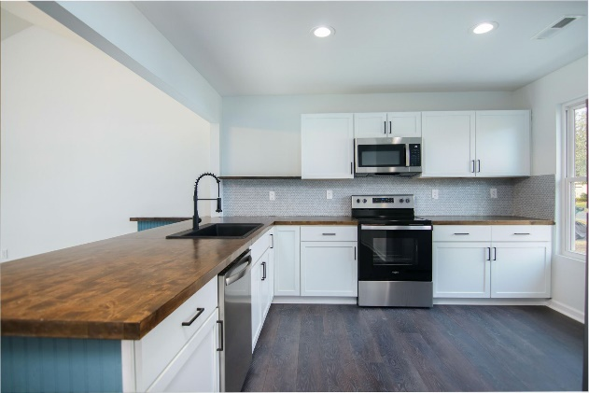
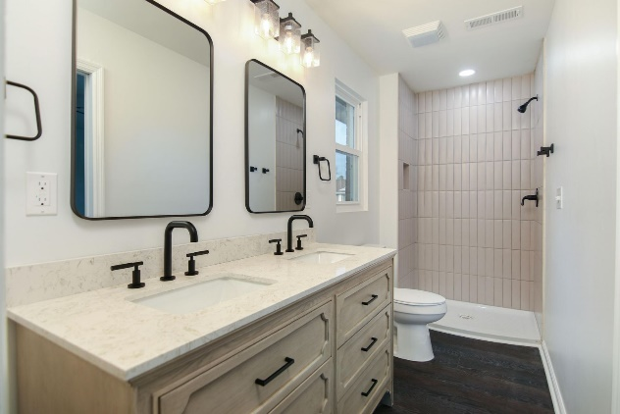


Renovated and Budget Friendly Home!
142 Ponderosa Drive
Tall Pines | Ladson, SC 29456
MLS# 23001257 | $314,750
Tons of updates in this truly move in ready brick ranch. You don't see many homes at this price point with these features. Well established neighborhood convenient to everything. Book your showing today, just listed.
Justin Natale
843-437-9739 | jnatale1982@gmail.com
www.theblvdcompany.com
The Boulevard Company, LLC | 806 Johnnie Dodds Blvd Ste 100 | Mt Pleasant, SC 29464

