Slide 1
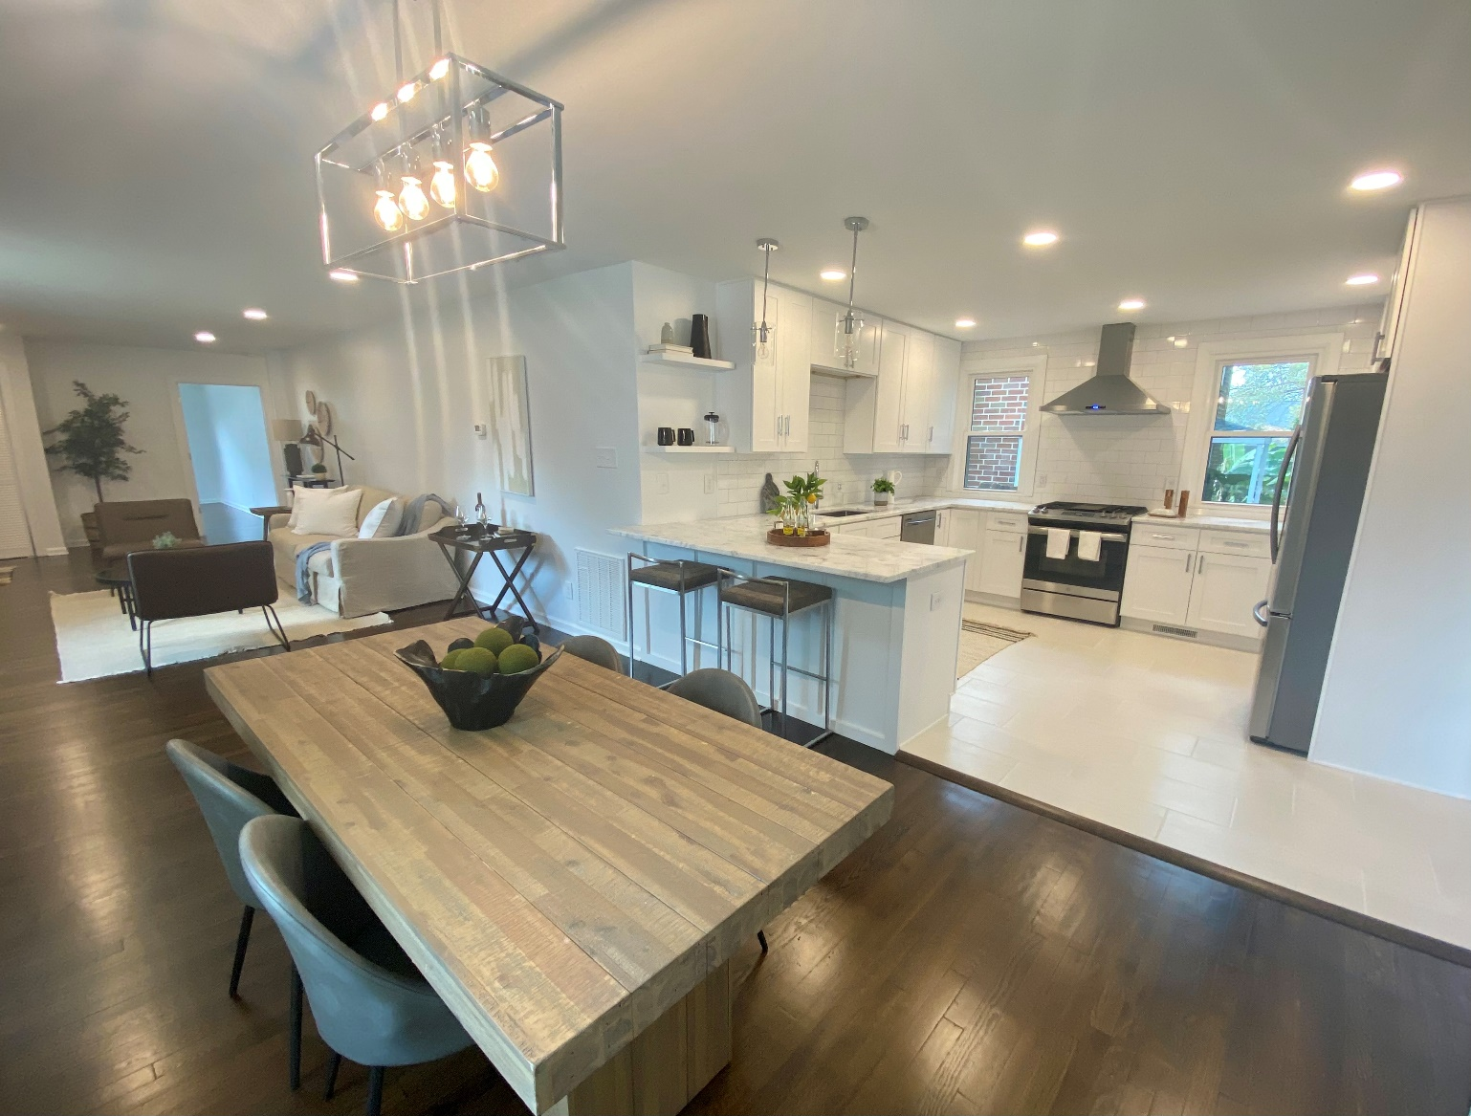
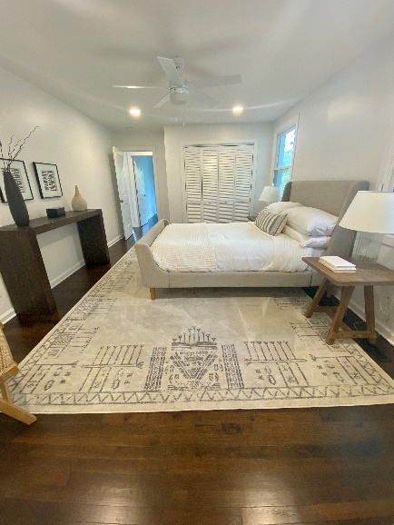
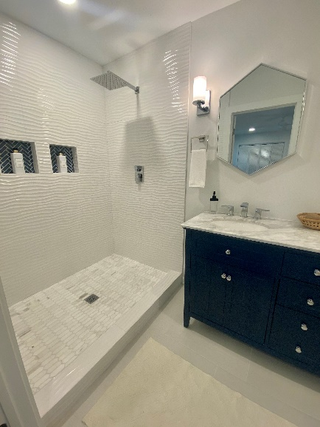


Wagener Terrace SFD with ALL the Upgrades!
142 Saint Margaret Street
Wagener Terrace
Charleston, SC 29403
$628,350
Listing Today! Beautiful updated 3/2 a little over 1500 sq ft, goes live midafternoon! Tons of updates; huge bedrooms, gorgeous new kitchen and baths, giant new deck, and walking distance to so much downtown has to offer.
Justin Natale
843-437-9739 | jnatale1982@gmail.com
www.theblvdcompany.com
The Boulevard Company, LLC | 806 Johnnie Dodds Blvd Ste 100 | Mt Pleasant, SC 29464

