Slide 1
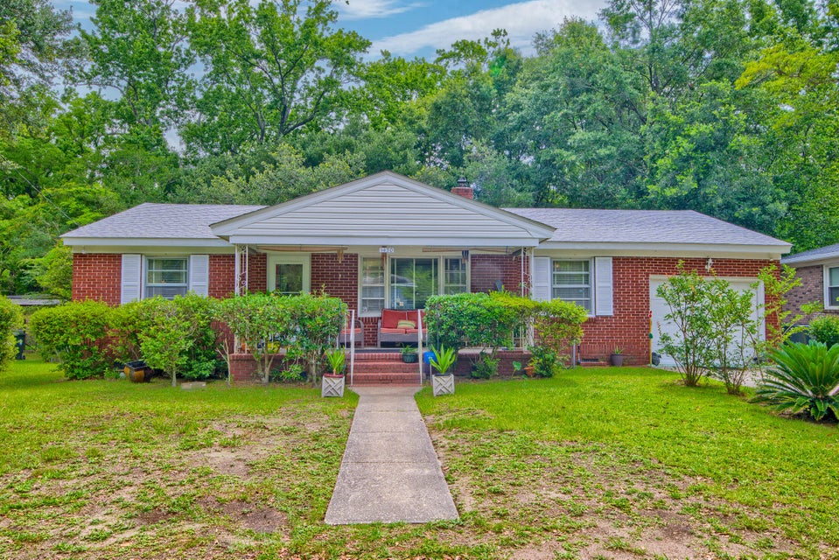



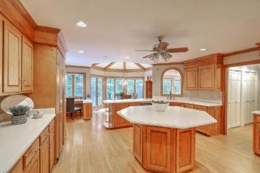
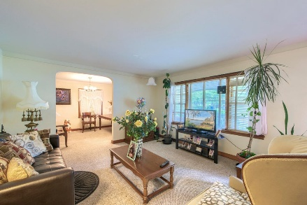



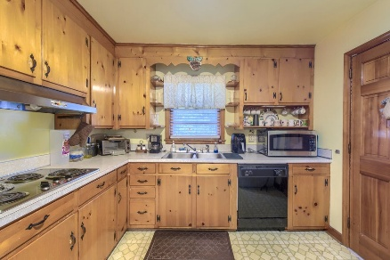

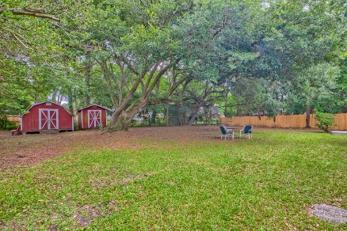
Parkshore Marshfront
Price Improvement
1430 Brian Road
Heathwood | Charleston, SC 29407 | MLS# 25016559 | $474,999
Ask about the possibility of receiving 1% reduction in interest rate and free refi.
Situated on a spacious lot in West Ashley, this charming ranch-style home offers comfort, convenience, and character. A welcoming front porch and attractive curb appeal set the tone as you approach the property. Inside, the living room features a large picture window that fills the space with natural light and flows seamlessly into the formal dining room. The functional kitchen showcases classic pine cabinetry and provides a warm, inviting space for meal prep and gatherings. The primary bedroom includes a private en suite half bath, while two additional bedrooms and a full bathroom offer ample accommodations.
A new roof was installed in 2022, a new water heater was installed in 2023, and there are hardwood floors under the existing carpet. Ideally located just 1.7 miles from Avondale, 2.2 miles from I-526, 3.5 miles from I-26, and 3.7 miles from downtown Charleston, this home places you close to all the Lowcountry has to offer. Don't miss the opportunity to make this West Ashley gem your own.
Megan Merchant | mmerchant@mattoneillteam.com | 843-575-8816

