Slide 1
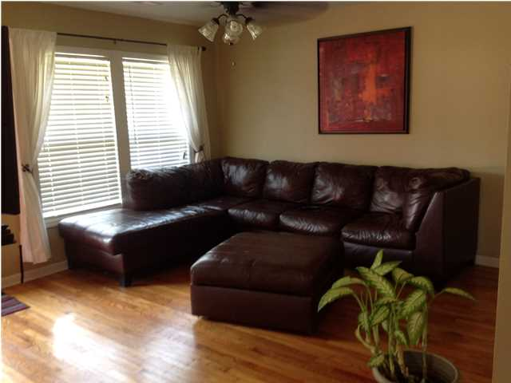
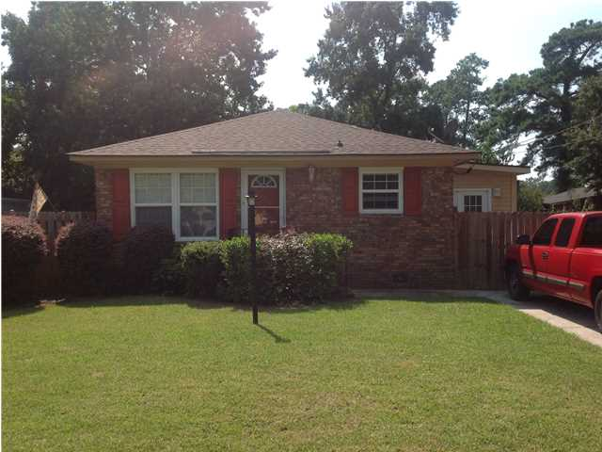
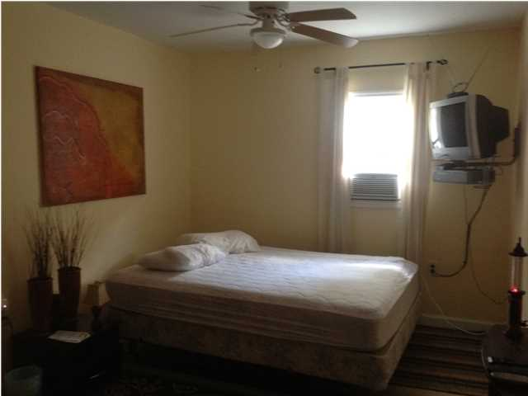
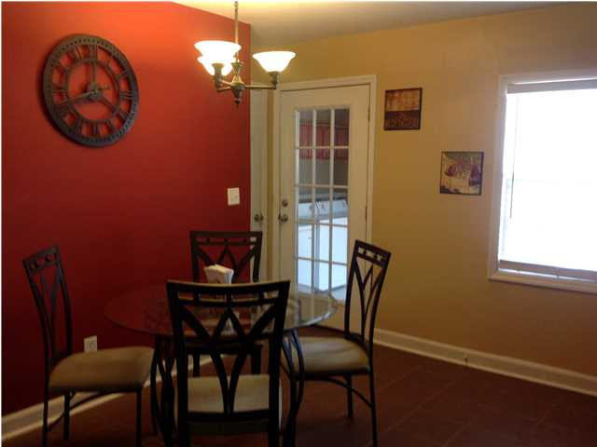
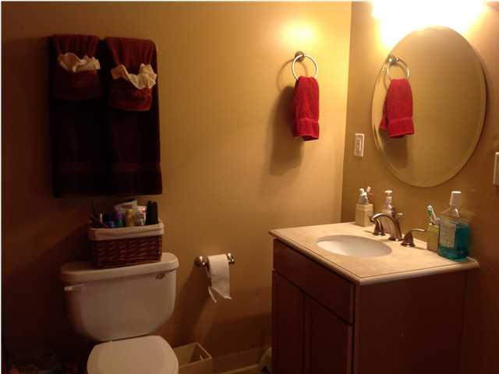
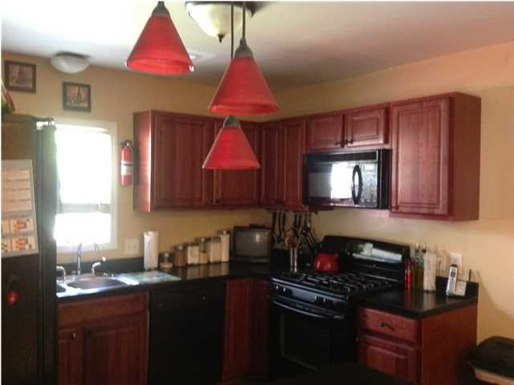
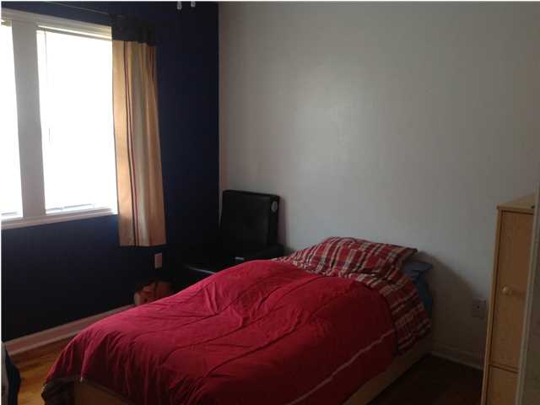
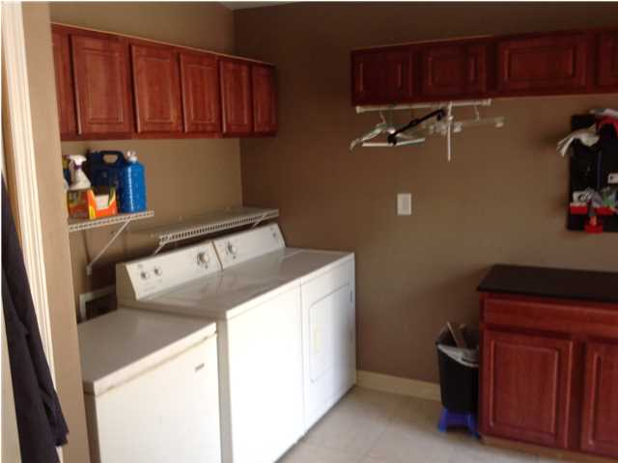
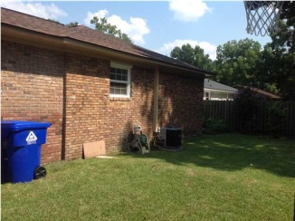
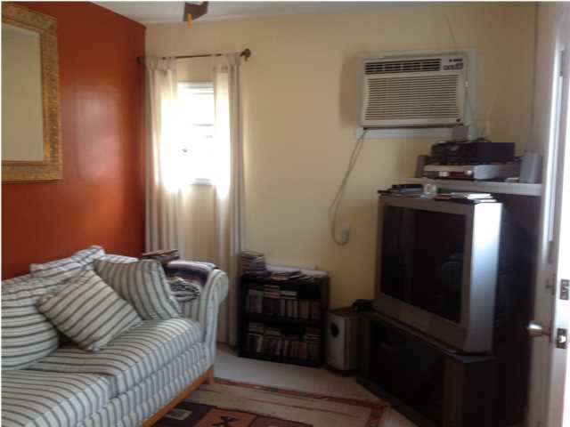
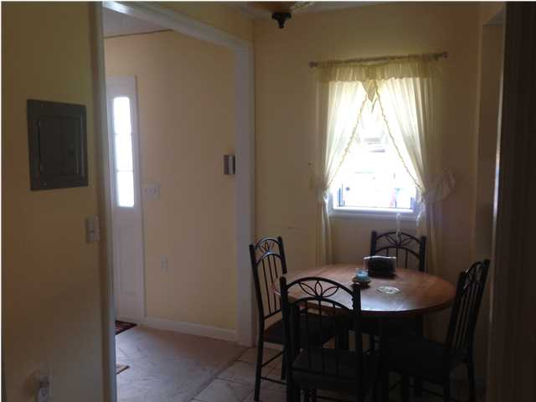
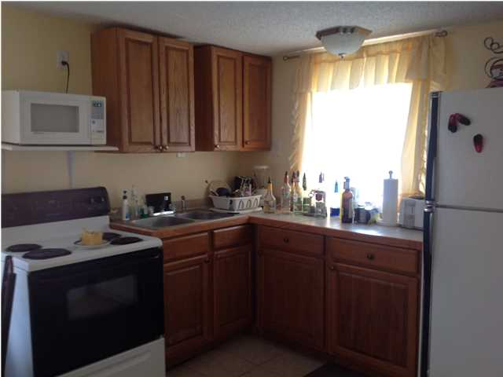

REDUCED!
1431 Hazel Rd
Move-in Ready!
West Park ~ Charleston ~ MLS# 1422217 ~ $174,999
LOCATION...LOCATION...LOCATION! This property in W. Ashley is minutes from shopping, schools, the highway and close proximity to downtown Charleston. Schedule an appointment today to see the MOVE IN READY modernized ranch style home. This property boasts 3 bedrooms and 2 FULL bathrooms and is TURN KEY! This property has been completely renovated recently to include a new architectural shingled roof and new HVAC installed in 2013 and updated bathrooms. Fresh paint throughout, ceramic tile and original hardwoods are in excellent condition. Eat-in kitchen, nice size laundry room, storage shed, and a fully fenced rear yard. In addition, there's a HIDDEN GEM behind the house! In the rear yard is a fully equipped unit that can be used for a Mother-n-law suite, Owner's Retreat or as an apartment for residual income. In this unit you will find a fully functional kitchen, full bathroom, small living room area for entertaining and a nice size bedroom. Add this property to your list of MUST SEE homes. If square footage is important - MEASURE!!
Sharee’ Washington
(843) 475-0399
Sharee@shareewashington.com
Carolina Elite Real Estate
1081 East Montague Ave
N Charleston, SC 29405

