Slide 1
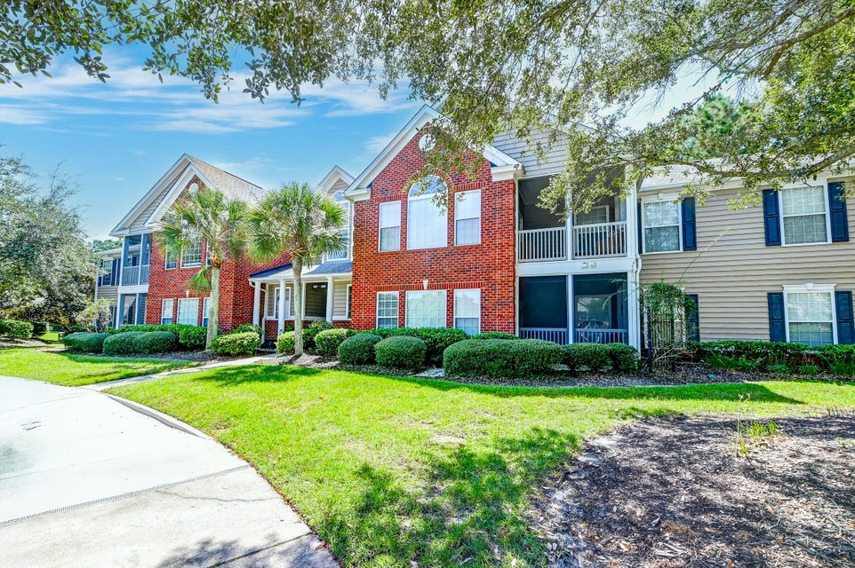



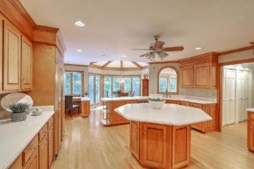
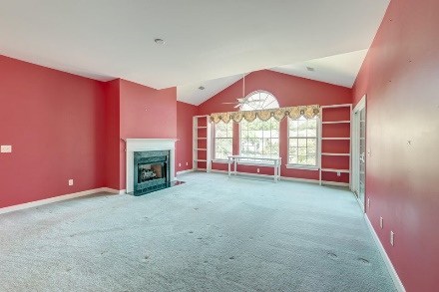



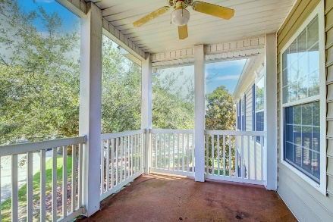

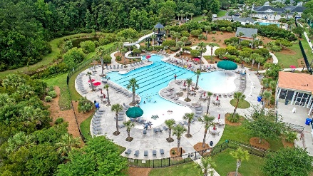
Parkshore Marshfront
Comfort & Convenience at Dunes West
1431 Belcourt Lane
Dunes West | Mount Pleasant, SC 29466 | MLS# 24025855 | $395,868
Nestled in the desirable Ellington Woods community at Dunes West, this spacious second-floor condo offers both comfort and convenience. As you ascend the private interior staircase, you're welcomed by an open and airy family room featuring a cozy fireplace and vaulted ceilings that enhance the sense of space and allow for abundant natural light. The layout flows effortlessly to a screened porch, where you can relax and take in the tranquil views. The dining area seamlessly connects to a kitchen outfitted with white cabinets and a breakfast bar, ideal for casual meals. Retreat to the expansive owner's suite, complete with a tray ceiling, a cozy sitting area, and an en-suite with a soaking tub, step-in shower, dual vanities, and a generous walk-in closet. A second bedroom, full bath, and laundry room add to the functional yet elegant design of the home.
Positioned just 6.6 miles from Mt. Pleasant Towne Centre, 9.9 miles from the pristine beaches of Isle of Palms, and 13.6 miles from the heart of downtown Charleston, this condo places you near the best of Lowcountry living. Don't miss this opportunity!
Caroline Treece ctreece@mattoneillteam.com 843-754-0050

