Slide 1
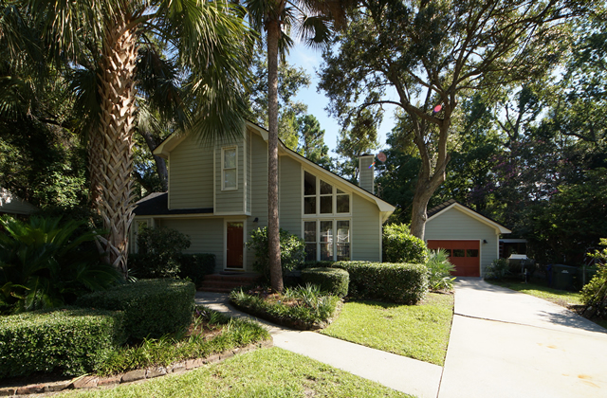
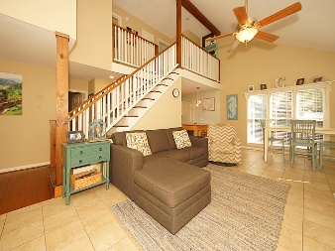
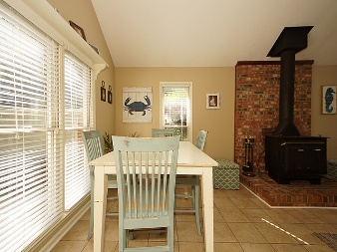
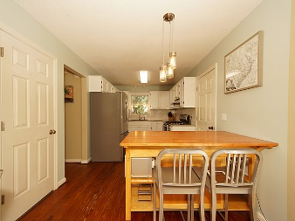
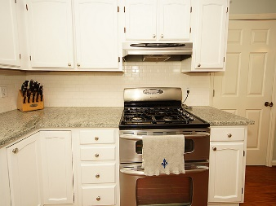
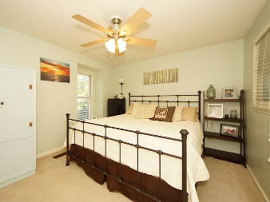
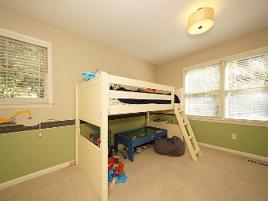
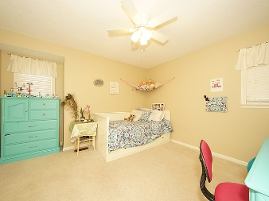
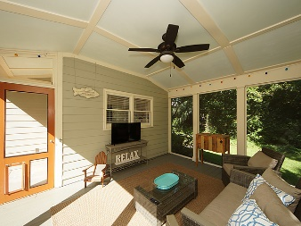
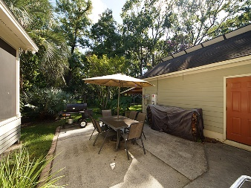
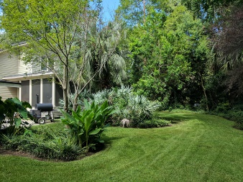



1432 Brian Road
Heathwood
Charleston, SC 29407
MLS# 17021750
$345,000
3 Bedrooms | 2 Baths | 1,392 sf
$20K Solar Upgrades & More Included!
Remarkable home meticulously cared for inside and out. $20K Solar Upgrade resulting in major monthly savings, stainless appliances, granite counter tops, gas stove, tankless water heater and more! Minutes from downtown Charleston, dining, shopping, entertainment, fishing, boating, bike paths, county parks and more! As you pull up to this home you'll notice immediately some of the features like the cement plank siding, extended driveway, detached garage, beautiful mature landscaping and secluded fenced backyard that separate this home from others making it a true one-of-a-kind gem. The interior of the home boast heart pine wood and tile flooring, downstairs master, floor-to-ceiling windows, a wood burning fire place with thermostat/blower, ceiling fans, and modern fixtures.
The updated kitchen offers plenty of cabinet space, stainless steel appliances with gas stove and double oven all accented with beautiful Kashmere White Granite Counter Tops and subway tile backsplash. As you go up the staircase you'll notice the exposed beam and vaulted ceiling that add to the design and appeal on the interior of this home. The carpeted upstairs features two additional bedrooms, a bathroom, computer desk nook, and pull down staircase to the attic offering additional storage. At the rear of the home is a large tiled mudroom with washer/dryer hook-up and exterior door leading to a backyard oasis. You'll definitely spend quality time relaxing on the large screened-in porch which connects to the 24x14 patio creating a "courtyard" setting to enjoy the peaceful surroundings or entertain guests. This home has so much to offer and with the tankless water heater, LED Lighting throughout, insulated attic and crawl space, plus solar power you'll save money each month enjoying it all!
Stephen Kugelman
(843) 330-0403
steve@agentowned.com
www.kugelmanrealestate.com
Ashley Melton
(843) 670-2333
ashley.melton@agentowned.com
www. CharlestonPalmettoHomes.com
AgentOwned Realty Co. Premier Group, Inc. | 824 Johnnie Dodds Blvd | Mt Pleasant, SC 29464

