Slide 1
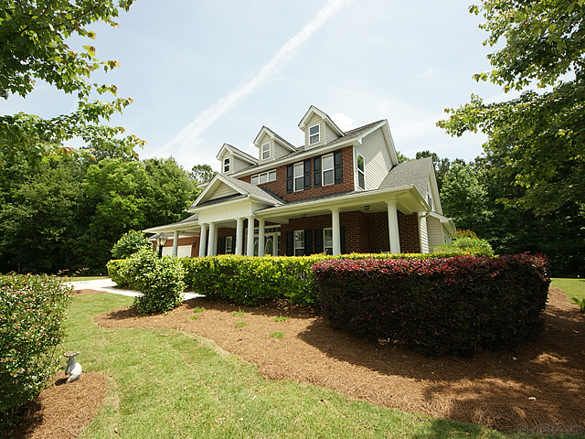
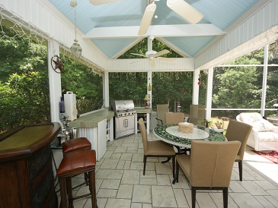
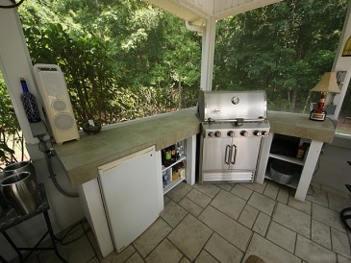
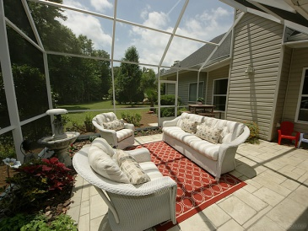
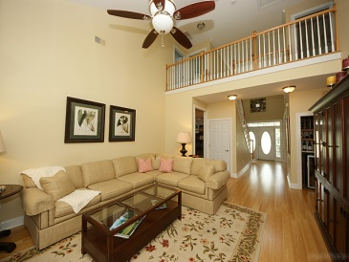
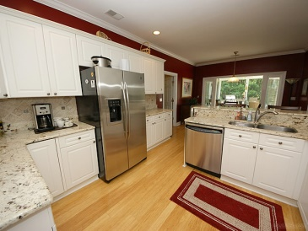
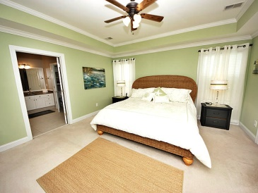
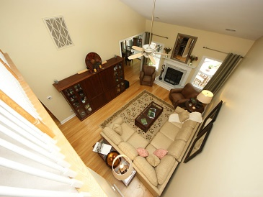

One of a Kind Screened Porch...Loads of Upgrades!!!
1432 Deer Walk Ct
Dunes West
Mt Pleasant, SC
MLS# 1413655
$529,000
$1,555 Bonus to Agent with Ratified Contract by July 25th, 2014
Welcome to the Private Gated Community of Dunes West! The best of everything in this completely updated home. Almost a full acre of land with new landscaping! The 2 story foyer and family room is spectacular with an overlooking hallway from the second floor. Bamboo flooring, granite kitchen countertops, marble and stone master bath are a few of the many extras. HVAC is not yet 1 year old. Crown molding , tinted windows, new glass storm doors and updated bathrooms!!! The outdoor lanai is 1½ stories and adds an extra 600 sq ft of enjoyment. All you have to do is move in! The community has 3 pools, 9 tennis courts, semi- private golf course, boat ramp, boat storage and walking and biking trails. Don't miss the opportunity to see this house. It won't last.
Kerri Leonard
843-408-3304
kerri.leonard01@gmail.com
Brand Name Real Estate
4 Carriage Lane Suite 106
Charleston, SC 29407
www.brandnamerealestate.info

