Slide 1
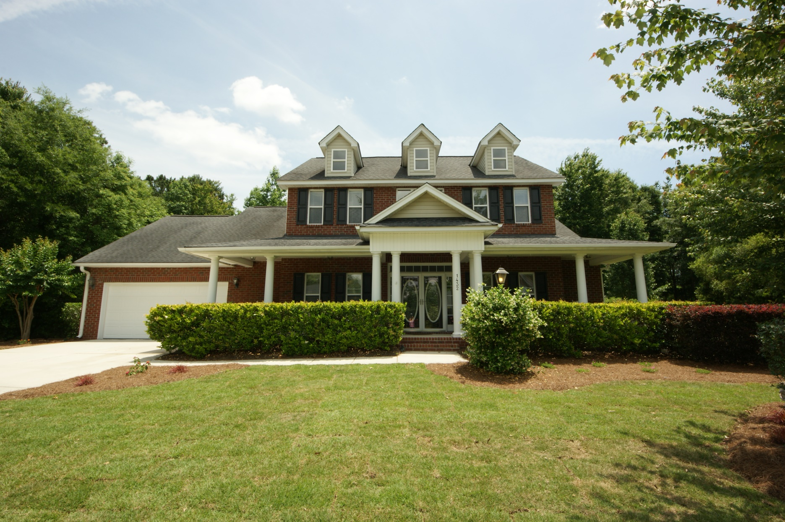
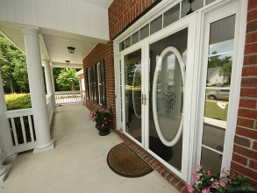
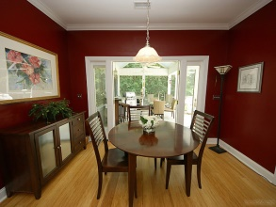
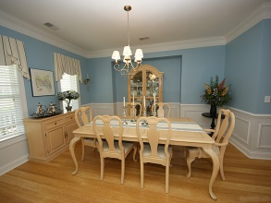
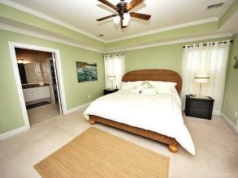
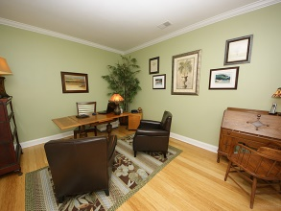
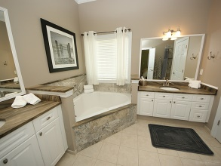
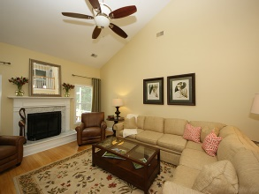
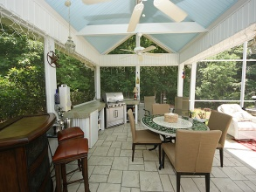
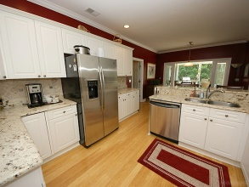
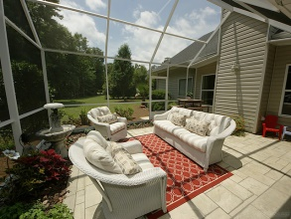
Just Reduced!
1432 Deer Walk Ct
Dunes West
Mt Pleasant
MLS# 1413655
$514,400
TOTAL PRIVACY IN A NEIGHBORHOOD SETTING!!!
LOTS OF STORAGE
BAMBOO HARDWOOD FLOORS
GRANITE COUNTERTOPS
2 NEW HVAC UNITS
UPGRADED MASTER BATH
NEW LANDSCAPING
STORAGE
FIRST FLOOR MASTER
FANTASTIC LANAI WITH OUTDOOR GRILL
MOVE IN CONDITION IN GATED DUNES WEST
David Carroll
843-564-3308 | tristr33@aol.com
Brand Name Real Estate | 207 East Bay Street Ste 311 | Charleston, SC 29401

