Slide 1
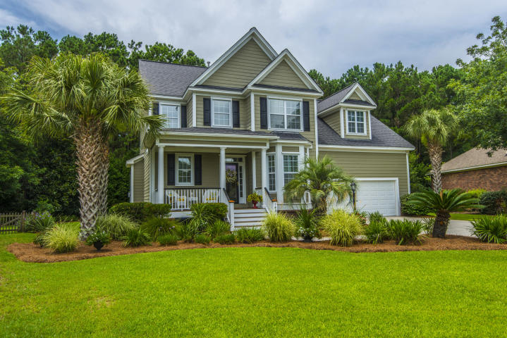
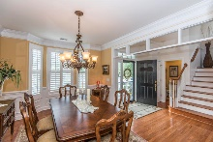
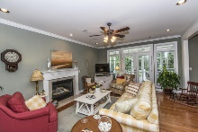
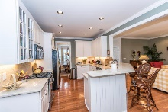
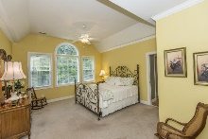
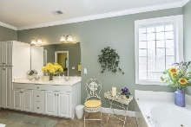
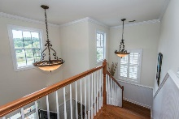
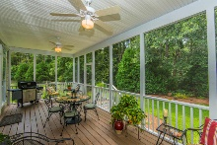
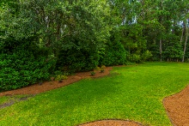

1432 Lagoon Park Circle Hamlin Plantation :: Mount Pleasant, SC 29466 MLS# 17019062 :: $622,777
Move in Ready!
Move in ready home in great location in Hamlin Plantation. Master bedroom on the first floor. Front of the home overlooks wonderful pond with island and bridge. Grand two story foyer w/ crown molding. Formal dining room w/ crown molding and wainscotting. Kitchen with beautiful new counter tops, stainless appliances and gas stove. Separate breakfast area. Kitchen and breakfast area open to the family room with gas fire place. Large private backyard. Master bedroom has access to screened back porch. The master bath has walk-in closet, dual vanities, linen closet, jaccuzi tub. The HOA includes access to the pool, clubhouse, fitness center and tennis courts.
Greg Hughes
843-884-1800 - O
843-708-4734 – C
ghughes@carolinaone.com
Carolina One Real Estate
Mt Pleasant Office 195 W Coleman Blvd Mt Pleasant, SC 29464

