Slide 1
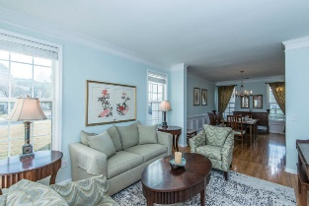
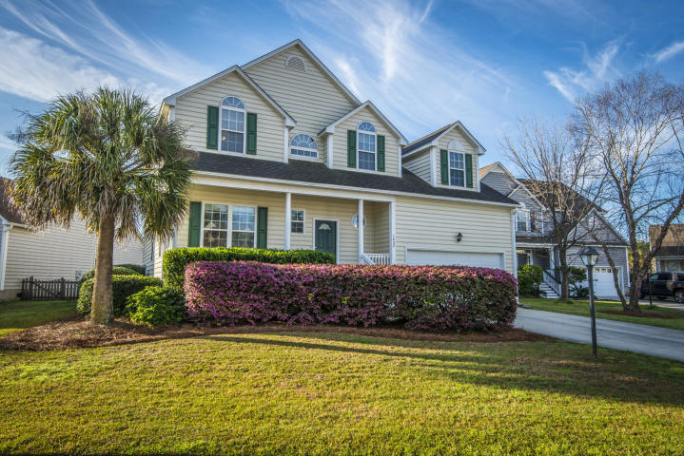
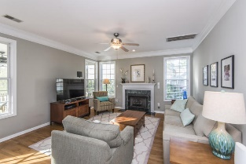
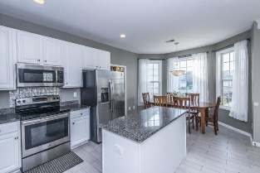
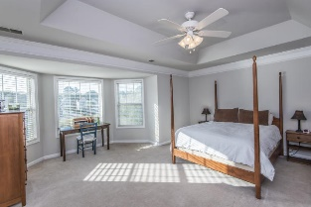
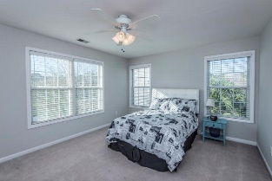
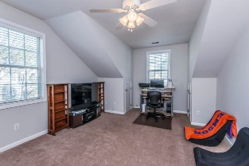
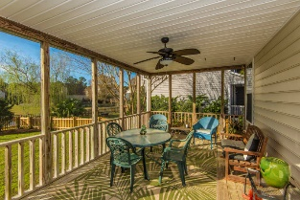
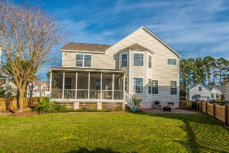
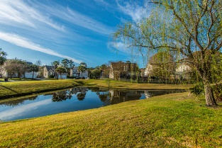


1432 Thayer Place Mount Pleasant ~ MLS# 19007719 ~ $429,000
Priced to Sell in Park West!
Beautiful and well maintained 5 bedroom home on a quiet cul-de-sac in Churchill Park section of Park West. The newly updated kitchen, which overlooks the family room with fireplace, features white cabinets, new matching stainless steel appliances, granite counter tops, and tile flooring. Also on the first floor there is a separate formal dining room and a living room/bonus area. Upstairs, there is a large master suite and four additional freshly painted bedrooms. Outside, a large screened porch and fenced yard is framed by a scenic pond. Churchill Park is within walking distance to the recreation fields, Laurel Hill Park trails, and the Park West elementary and middle schools.
A $1500 lender credit is available and will be applied towards the buyer's closing costs if the buyer chooses the seller's preferred lender. This credit is in addition to any other negotiated seller concessions.
Kristin Schatmeyer
Cell - (843) 697-7370
kristin.schatmeyer@carolinaone.com
www.KristinSchatmeyer.com
Carolina One Real Estate
2713 Highway 17 North
Mt. Pleasant, SC 29466

