Slide 1
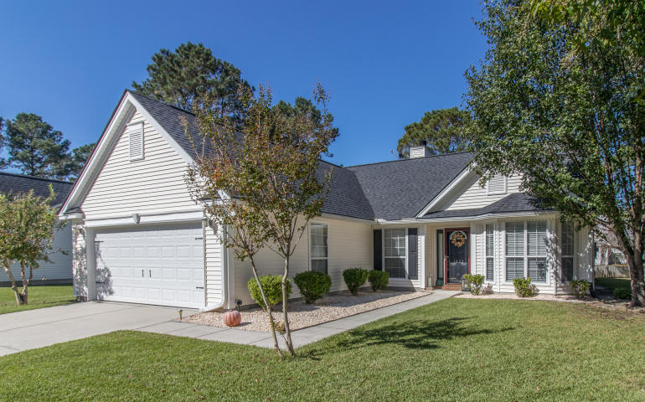
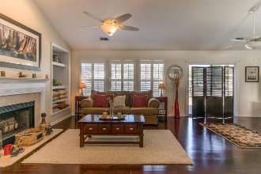
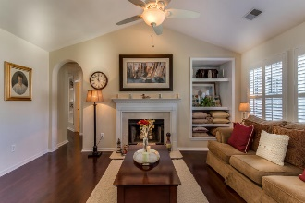
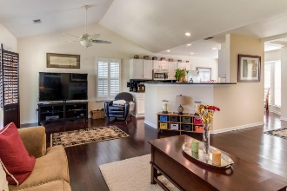
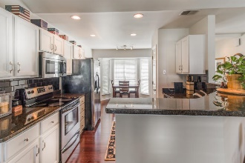
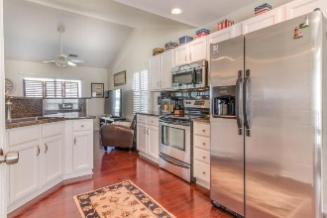

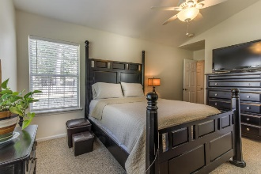
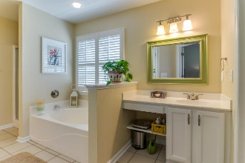
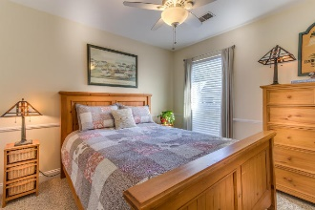
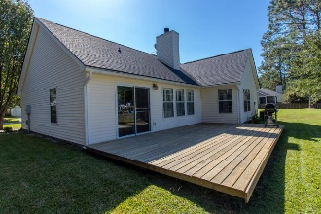
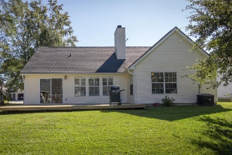

1432 Water Oak Cut Dunes West ~ Mount Pleasant ~ MLS# 16027219 ~ $324,000
Move In Ready ~ Turn Key ~ Great Curb Appeal Home!
This lovely home is located in the heart of Mt. Pleasant in the premier subdivision of Dunes West. This 3 bedroom/2 bath home is the epitome of curb appeal and charm; it is turnkey and move-in ready. Upon entering, the front foyer expands into your open floor plan living area. The 3 bedrooms of admirable size are privately tucked away. This home has been well maintained, has many upgrades & new household items within the last 3 years; garage door, hot water heater, plantation shutters, paint, carpet, gutters, underground downspouts, deck, toilets, shower door, lighting, sod, and a new roof in 2016. Terminx bond, subject to a transfer fee.
Carolyn Dubrofsky
843-324-9645 M
cdubrofsky@comcast.net
The MarshallWalker.com Group
582 Rutledge Ave Charleston, SC 29403

