Slide 1
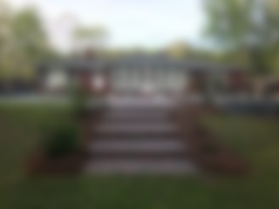
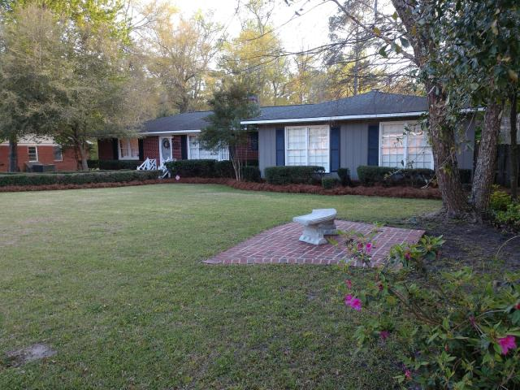
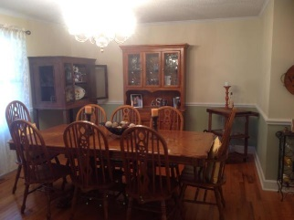
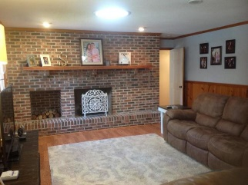
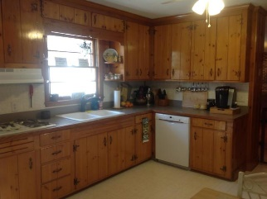
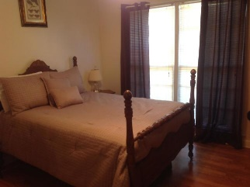
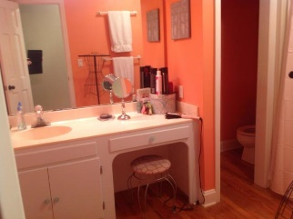
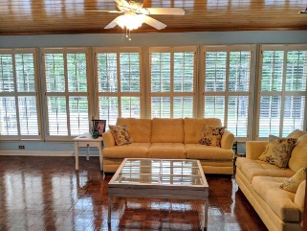
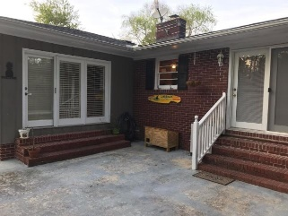
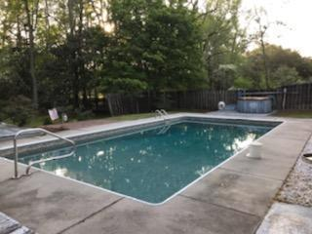
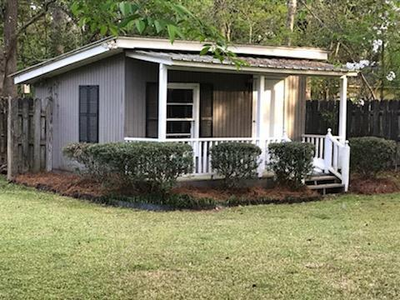


Welcome Home!!!
1433 Bennett Circle
Holly Hill, SC 29059
MLS# 19009855 | $234,900
This well built charming home in well established neighborhood in friendly small town. Three bedrooms, three bath home with beautiful in ground pool. This pool is maintained weekly by local pool company and liner was replaced May 2018. The Florida room with parquet floors overlooks the pool and patio. The home has hardwood floors in the living room and dining room. There is plenty of closet space for storage. Lots of shade in the back yard with beautiful landscaping. One and half car garage for additional storage. Two fireplaces - one is propane gas logs and one is natural gas. Separate structure at the back of the property that would be a great space for an office or when a child's playhouse. Buyer and Buyers agent please verify all information of importance.
Karen Brown
(843) 709-4029
karenbrown22@gmail.com
AgentOwned Premiere Group
141 A N. Main Street
Summerville, SC 29483

