Slide 1

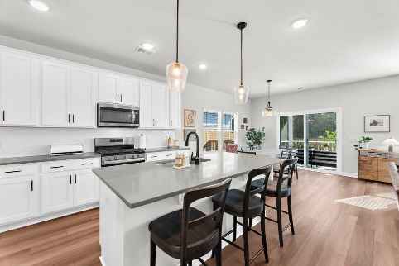
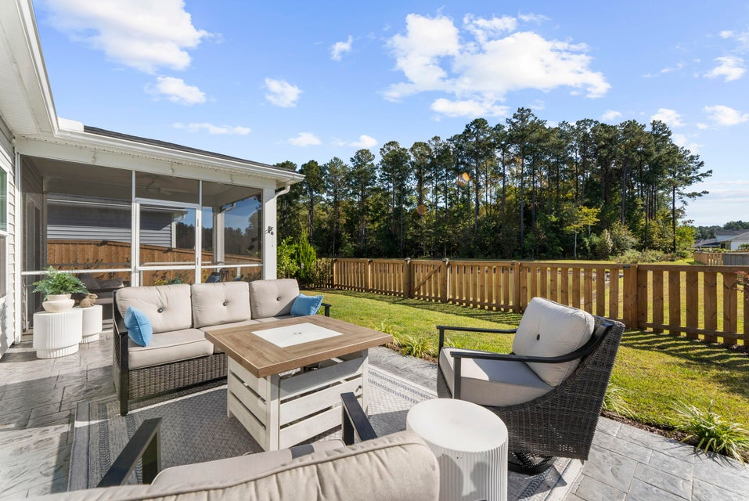
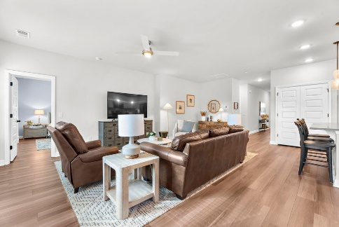
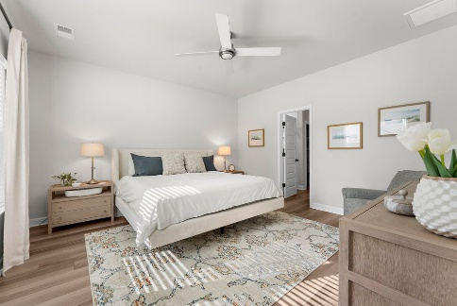
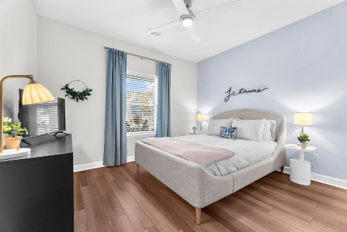
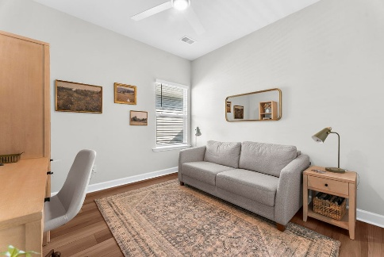
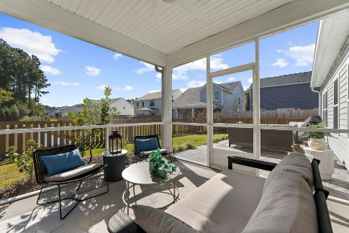


1434 Arabella Street The Pointe at Rhodes Crossing Charleston, SC 29414 · MLS# 26005923 · $530,000
New Price!
SHOWS LIKE A MODEL GORGEOUS!
Welcome home!! What a find. Beautifully maintained single level living on a gorgeous lot with pond views. Open main living highlighted by a gorgeous kitchen with stylish quartz island, Stainless gas appliances and timeless white shaker cabinets accented by a beautiful backsplash.
Stunning plank flooring leads you the spa style primary suite complete with tile shower, dual vanities and 2 great walk in closets. Two additional bedrooms for family, guests, office space or play area.
Step out back onto your 12 x 12 screened porch to the beautiful lawn with pond view. Great back yard patio area added by the owners with care. Perfect for entertaining, grilling, sunning, reading and relaxing. Back yard all fenced in Generous 2 car garage with tons of storage area. Must see to appreciate!
Saturday, May 5th At 11:00a
ANN EVANS
Carolina One Real Estate
843-452-4605
aevans@carolinaone.com
www.charlestonluxuryrealestate.com
Carolina One Real Estate
195 W Coleman Blvd
Mt Pleasant, SC 29464-3495

