Slide 1

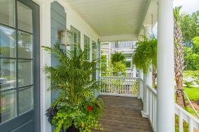
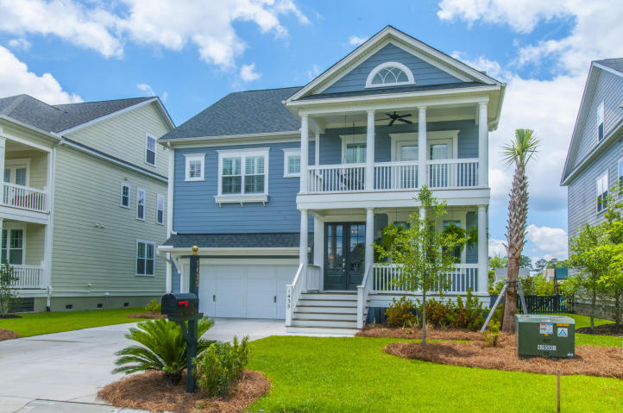
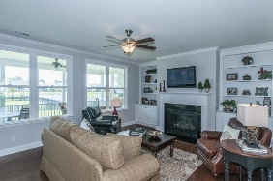
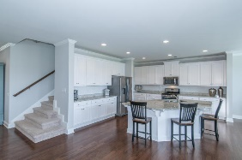
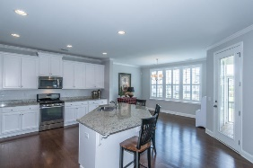
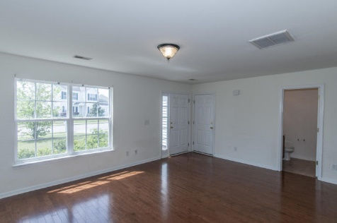
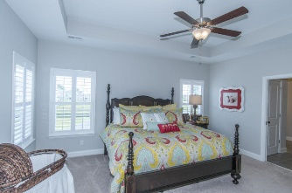
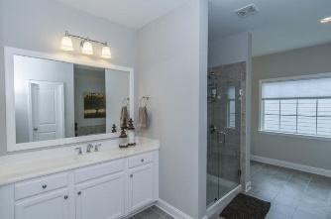
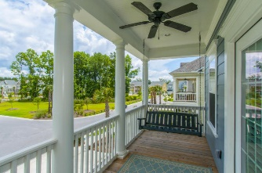
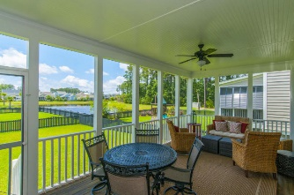
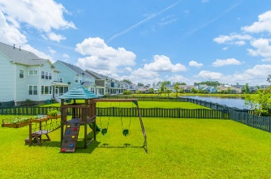
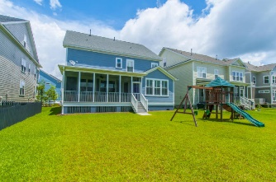


1435 Masthead Drive
Dunes West ~ Mt Pleasant
Seller Motivated!
Just Reduced!
Move-in-ready executive home. You will be welcomed with an inviting front porch and beautiful hardwood floors. The wonderful open floor plan with chef's gourmet kitchen has granite counter tops, stainless appliances, gas cooktop, large center island, pantry, and eat in dining all overlook the great room with a gas fireplace, built-ins. All overlooking a screened porch, fenced in yard overlooking a relaxing pond. A study and mudroom are also on the first floor. The owner's suite is on the second floor and includes dual walk-in closets, spa bath with soaking tub, tile shower and separate vanities. There are 3 generous secondary bedrooms and 2 baths. A relaxing upper deck for relaxing after a long day. Dunes West amenities include swim, tennis, golf, boat storage, boat ramp, and club house for dining. Conveniently locate to beaches, dining, shopping, hospitals and much more.
Asking $539,900
MLS# 16014714
3,000 SqFt
4 Bed/3½ Baths
Don Dawson
843-514-0452
ddawson@carolinaone.com
Carolina One Real Estate • 2713 Highway 17 North • Mount Pleasant, SC 29466
www.TeamDawsonSC.com

