Slide 1
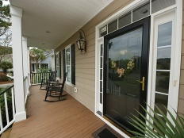
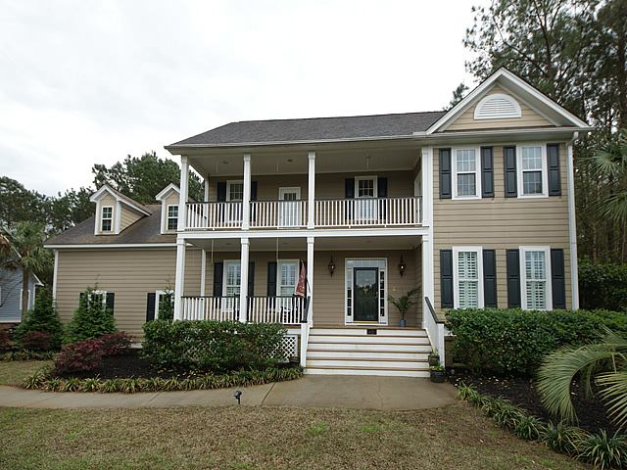
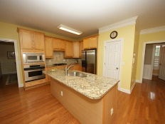
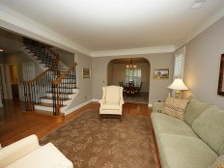
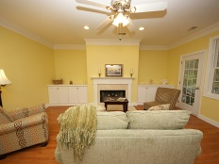
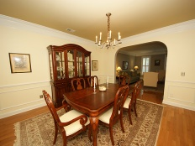
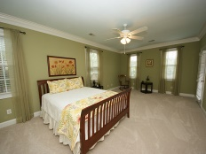
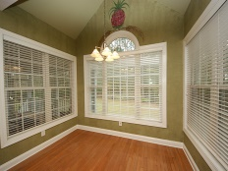
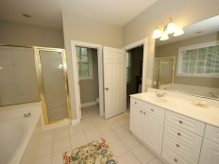
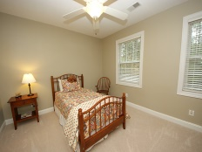
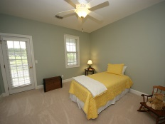
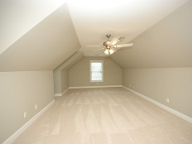
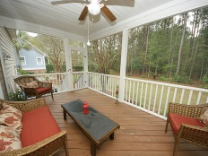
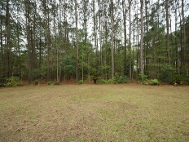
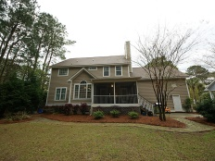
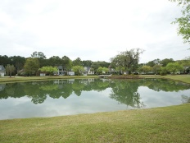


1437 Lagoon Park Circle Hamlin Plantation ~ Mount Pleasant ~ MLS# 15008695 ~ $550,000
Act now to get your own private backyard oasis!
Don't miss out on your chance to own your very own private retreat in the exclusive Village section of Hamlin Plantation. This beautiful home sits on an extremely private and large lot...close to 1/2 an acre! The double front porch looks out on a pond in front of the home, and the back and side yard are almost completely private with the wooded wetland buffer. Inside, the first floor offers an open concept kitchen with large island... all of which flows right into the family room. The kitchen offers a great entertaining space with beautiful granite countertops, tile backsplash and stainless steel appliances. Beautiful hardwood floors cover most of the downstairs including the formal living and dining room. These elegant spaces with custom crown molding and trim are the perfect addition to rounding out the indoor entertaining space. Classic plantation shutters complete these rooms and are also featured across the front of the home. Upstairs you will find fresh paint and brand new carpet. The master bedroom features crown molding, a separate sitting area, and access to the front porch. The master bath offers a jetted garden tub, separate shower and double vanity as well as a large master closest and linen closet. The front bedroom provides access to the front porch and the back bedroom offers direct access to the hall bath. Down the hall you will find the fourth bedroom which is the large bonus room over the garage. This is the perfect spot for a playroom, rec room or media room. Back outside there is so much to offer. The screened porch off the family room and kitchen is perfect for outdoor dining. This porch flows right onto the patio and then to the stone path. The landscape, which includes an irrigation system, has been well planned and maintained and makes the yard your own private sanctuary. Both HVAC units have recently been replaced (2011 and 2014) and the irrigation pump was replaced last year. Hamlin's neighborhood amenities include a swimming pool with waterslide, tennis, basketball and volleyball courts, workout facility, kids play park, boat storage, a large clubhouse and miles of walking and biking trails. Schools, shopping, doctors and more are only minutes away and it's a short 10-15 min. to the beach!
Melodie Smith (843) 408-5067 M
melodie.smith@carolinaone.com www.melodiesmithrealestate.com

