Slide 1
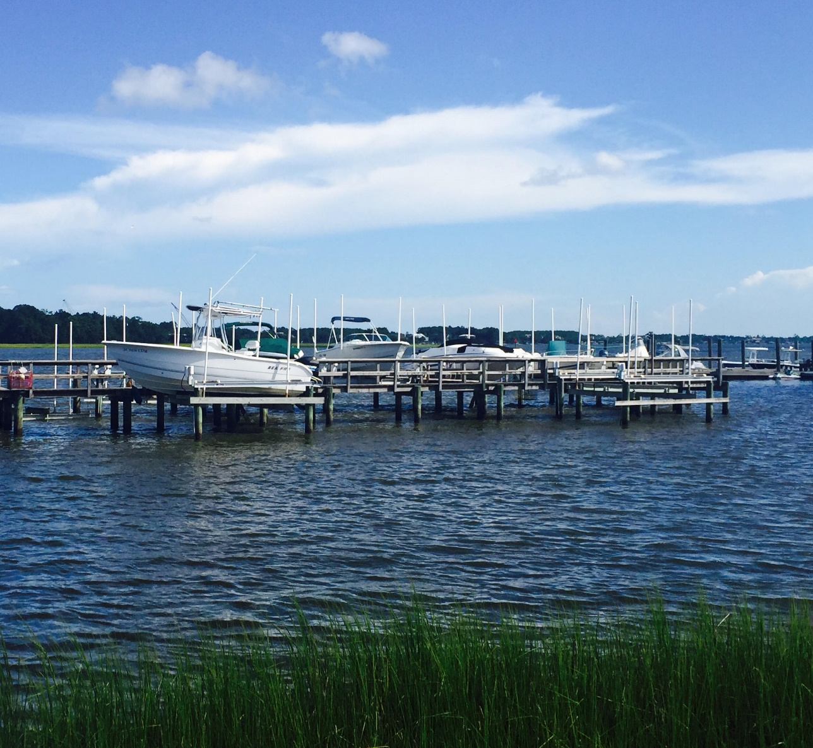
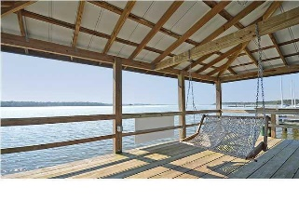
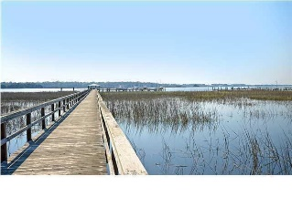

143 Wando Reach Road Wando Point · Wando, SC 29492 MLS# 16006375 · $259,000
Cleared Lot with boat slip and lift!
New LOW Price!
Loaded with Updates
Ready to build lot with deep water BOAT SLIP and LIFT in GATED COMMUNITY on the Wando River! Build your dream home and walk to community maintained dock with your own slip and lift attached. The lift with new motor in 2016 will accommodate up to a 33 foot, 12,000 lb boat. The lot is in an AE-9 flood zone and the average elevation is almost 11’. The lot has been cleared, dug out and back filled. The pad is ready to be built on. This was a $20K investment by present owner. Wando Pointe is a beautifully landscaped gated community close to shopping and grocery stores and is a short drive to downtown Charleston with 5-star restaurants and iconic history as well as a short drive to the beaches, the airport, Boeing and Daniel Island. New K-8 school coming in August and new High School August 2017! Come LOOK TODAY and BUILD TOMORROW!
Stan Huff
843-670-2835 stan.huff@agentowned.com
Jill Marcacci
843-297-5590 jill@agentowned.com
www.agentownedrealty.com
AgentOwned Realty Co. Preferred Group, Inc. | 824 Johnnie Dodds Blvd | Mt Pleasant, SC 29464

