Slide 1
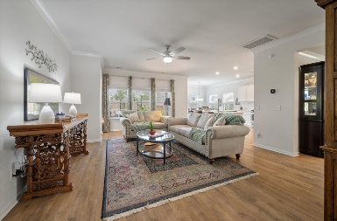
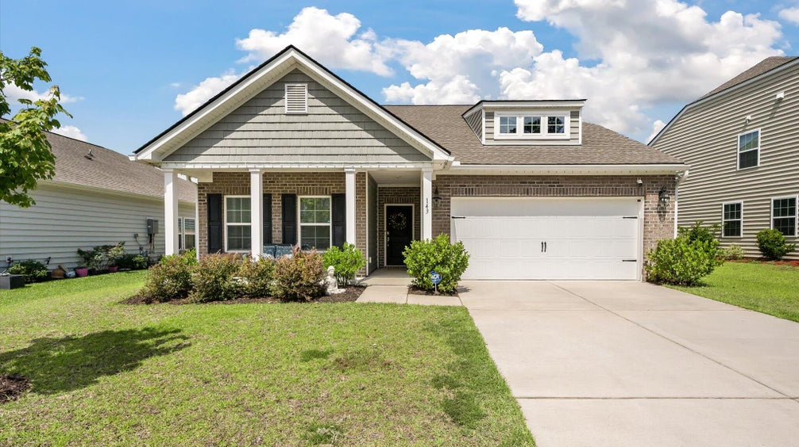
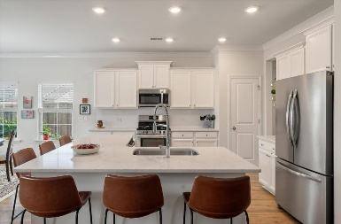
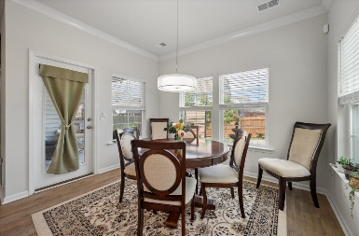
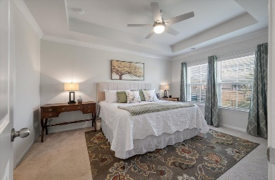
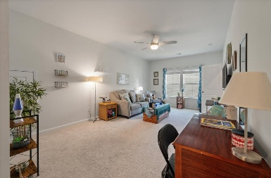
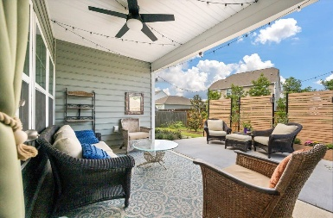
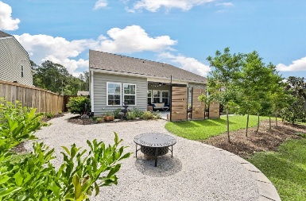


143 DANIELS CREEK CIRCLE
Liberty Village · Goose Creek, SC 29445 · MLS# 25014454 · $435,000
Open House This Sunday 1-3pm
Step into comfort and elegance with the Litchfield II floor plan, featuring a host of thoughtful upgrades and a layout designed for modern living. As you enter, a charming foyer greets you. To the left, two spacious guest bedrooms share a well-appointed full bathroom nestled between them. To the right, you'll find convenient access to the garage, a large laundry room, and a staircase leading to the upper level. Continuing toward the heart of the home, you'll find a bright and open family room seamlessly connected to a formal dining area, a breakfast nook, and a chef's kitchen. The kitchen is a standout, boasting sleek quartz countertops, stainless steel appliances, a pantry, and a generous island with seating for six—perfect for entertaining.
Just off the kitchen, the breakfast area leads to a covered patio, ideal for relaxing or entertaining. Step outside to your personal oasis: a beautifully landscaped backyard, an extended patio area, and high-end privacy screens that create a peaceful retreat.
Back inside, the spacious primary suite is privately situated off the family room. This luxurious bedroom features an expansive en suite bathroom with double vanities, a walk-in shower, and a large walk-in closet.
Upstairs, you'll find a versatile second family room - ideal as a home office, theater, gym, playroom, or game room. An additional bedroom with its own walk-in closet and en suite bathroom also opens to this upper-level living space. Ample storage is another highlight, with three large upstairs closets and easy attic access.
Located in the desirable Liberty Village, this home offers proximity to the Naval Weapons Station, Joint Base Charleston, Boeing, the Google Data Center, and more. You'll also enjoy a short 30-minute drive to beautiful area beaches and the charm of Historic Downtown Charleston.
Carey Nikonchuk
843-276-1701
cnikonchuk@gmail.com
www.brennamangroup.com

