Slide 1
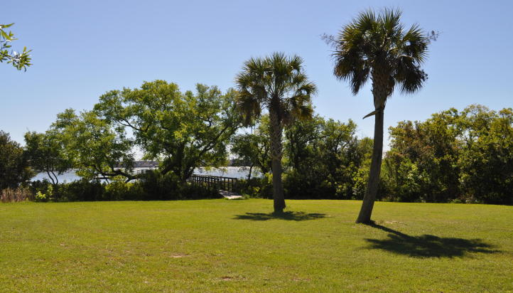
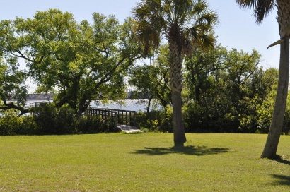
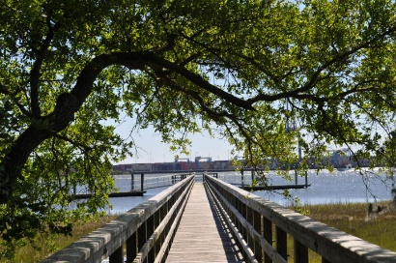
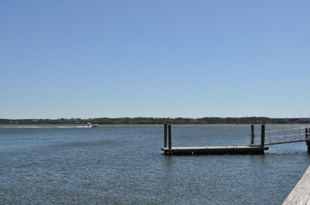
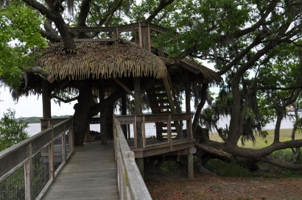

1440 Smythe Street
Smythe Park ~ Daniel Island ~ MLS# 16009526 ~ $1,050,000
Deep Water, Wando River Views, Marsh Views, Dock, & Location!!
This Daniel Island Lot Offers It All!
Build your dream home with views of the Wando River.
Private dock is in place and is shared by only one other homesite.
10-minute boat ride to the Charleston Harbor
Homesite is on a cul-de-sac in the Smythe Park neighborhood
Smythe Park is a 24 acre park with jogging, biking trails, large children's park, and Grand Oak trees everywhere.
This lot is presently the LOWEST PRICED deep water lot on Daniel Island.
Don't miss out on this wonderful opportunity!!
Donna Landry
Mobile - (225) 921-2111
donna.landry@cbunited.com
Betsy Sarsfield
Mobile - (843) 608-1048
betsysarsfield23@gmail.com
Coldwell Banker United of Charleston | 35 Broad St | Charleston, SC 29401 | www.thebestincharleston.com

