Slide 1
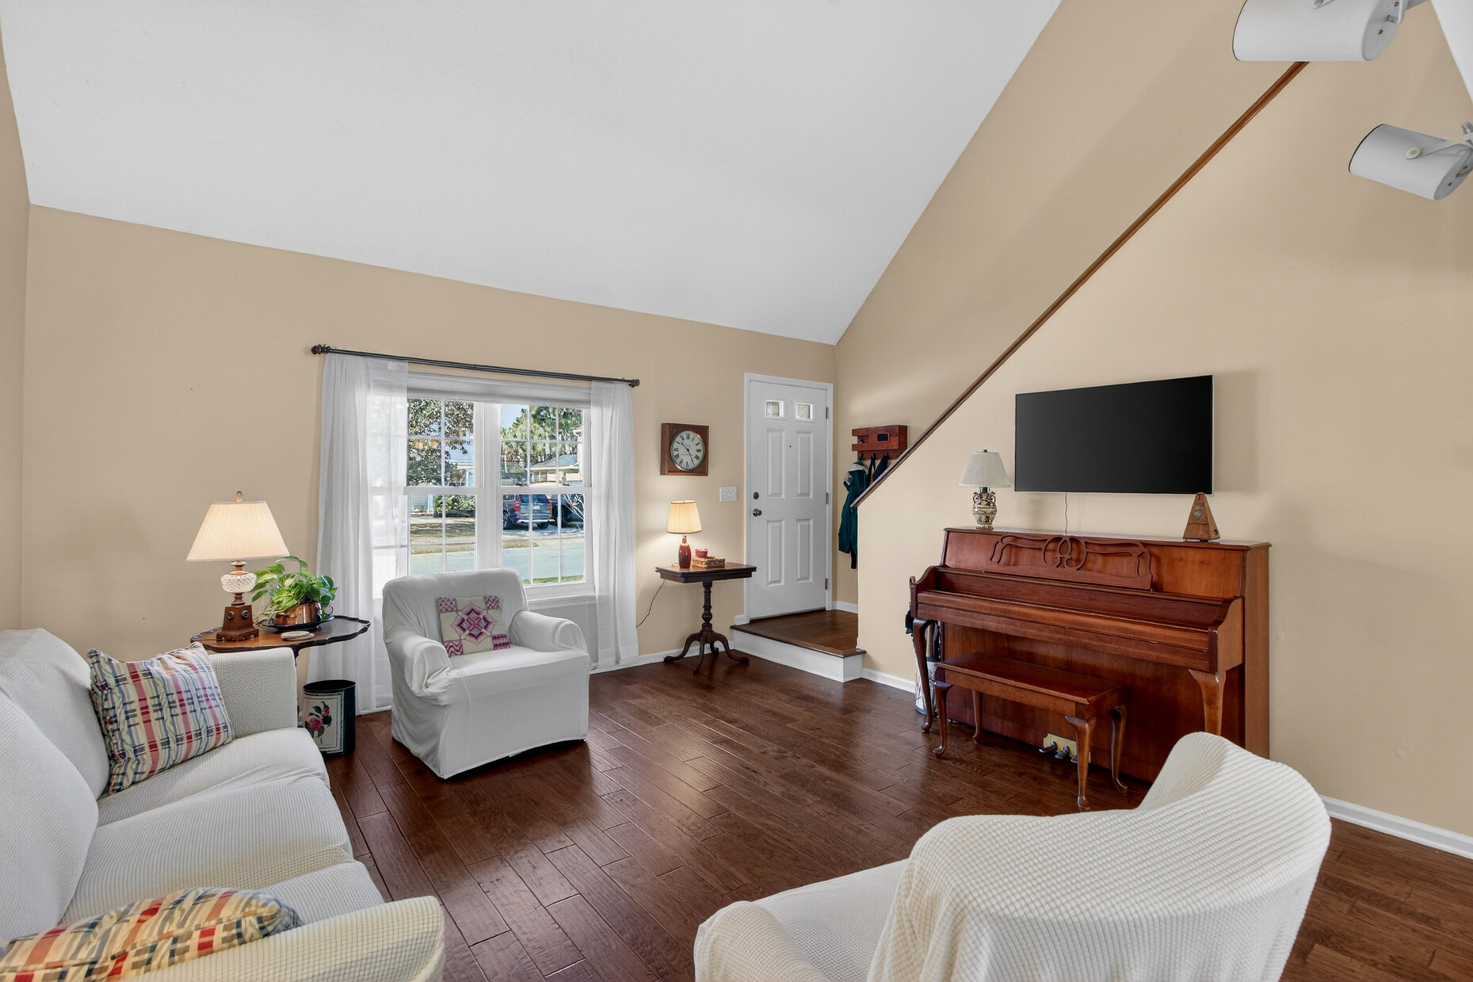
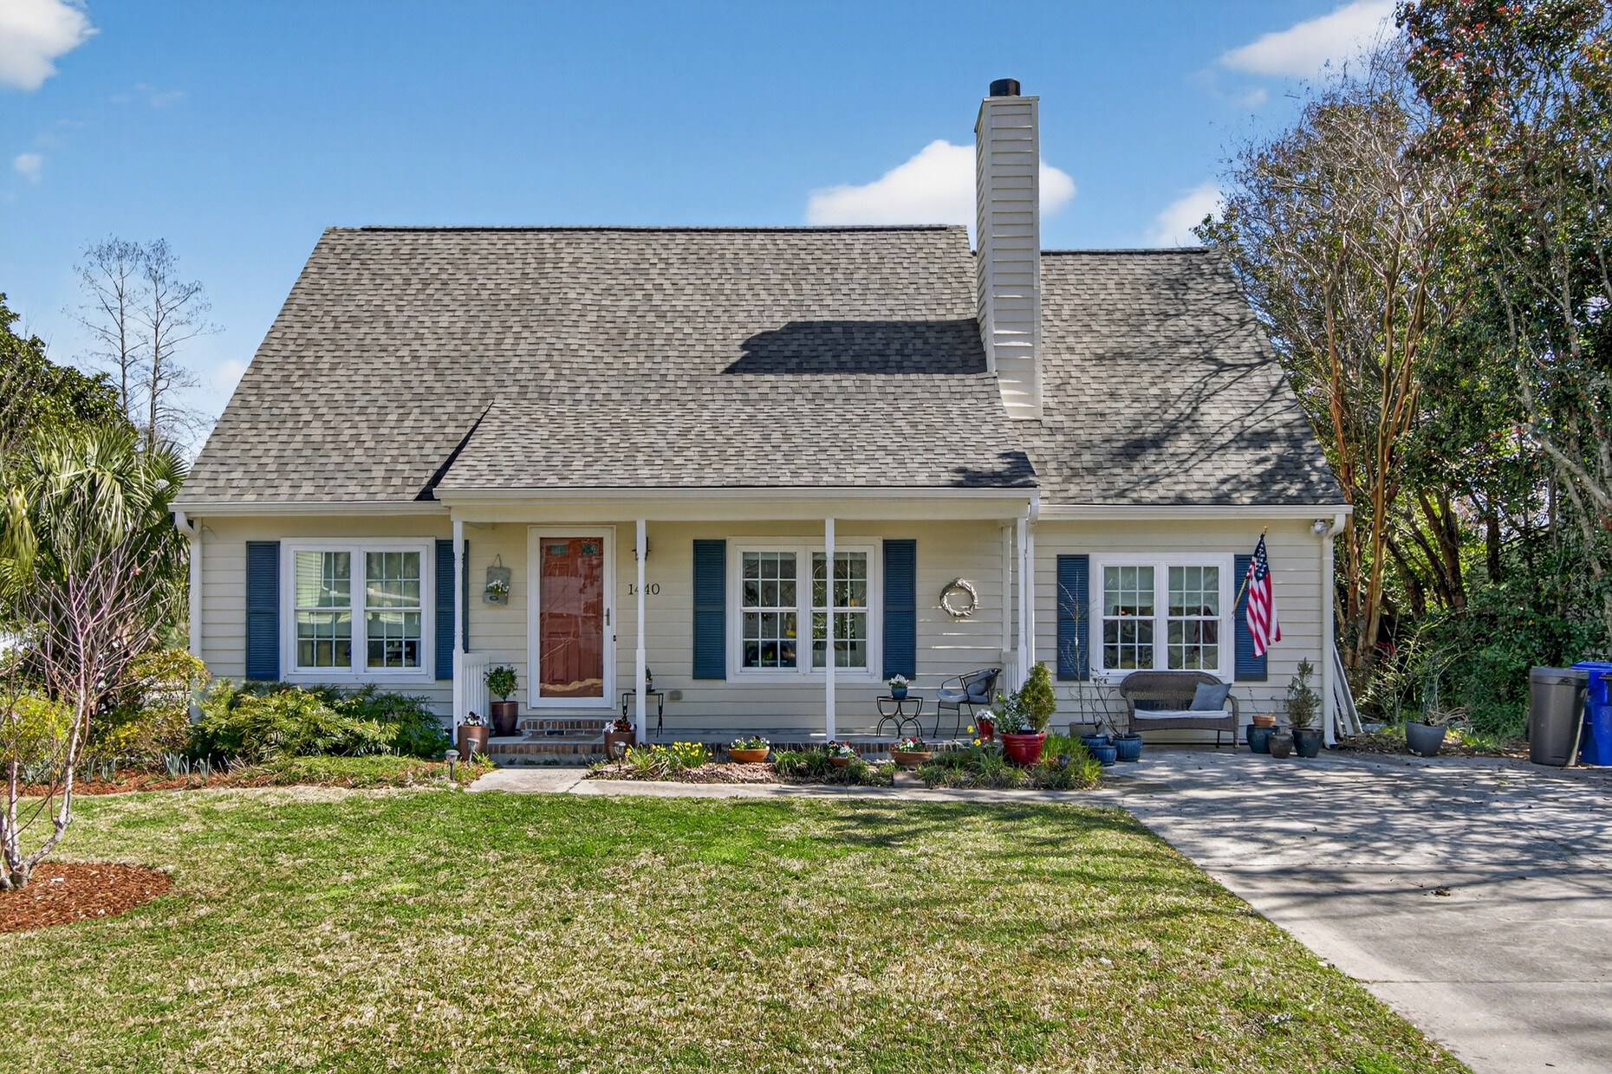
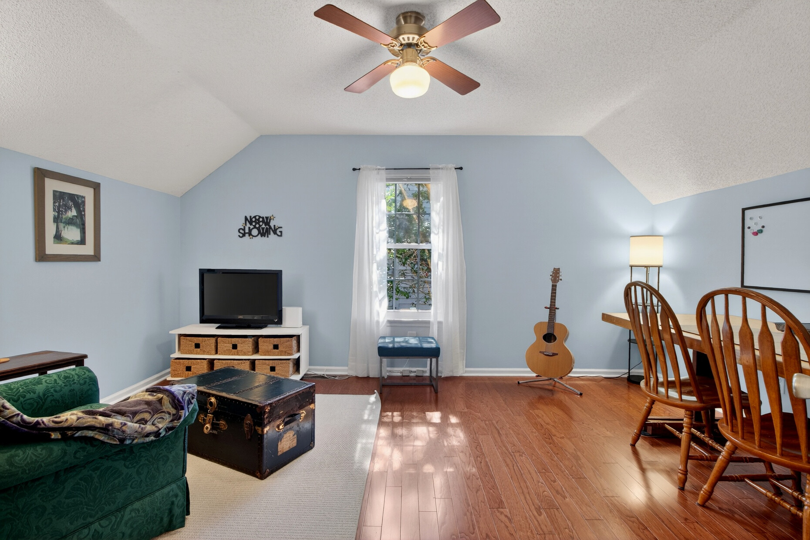
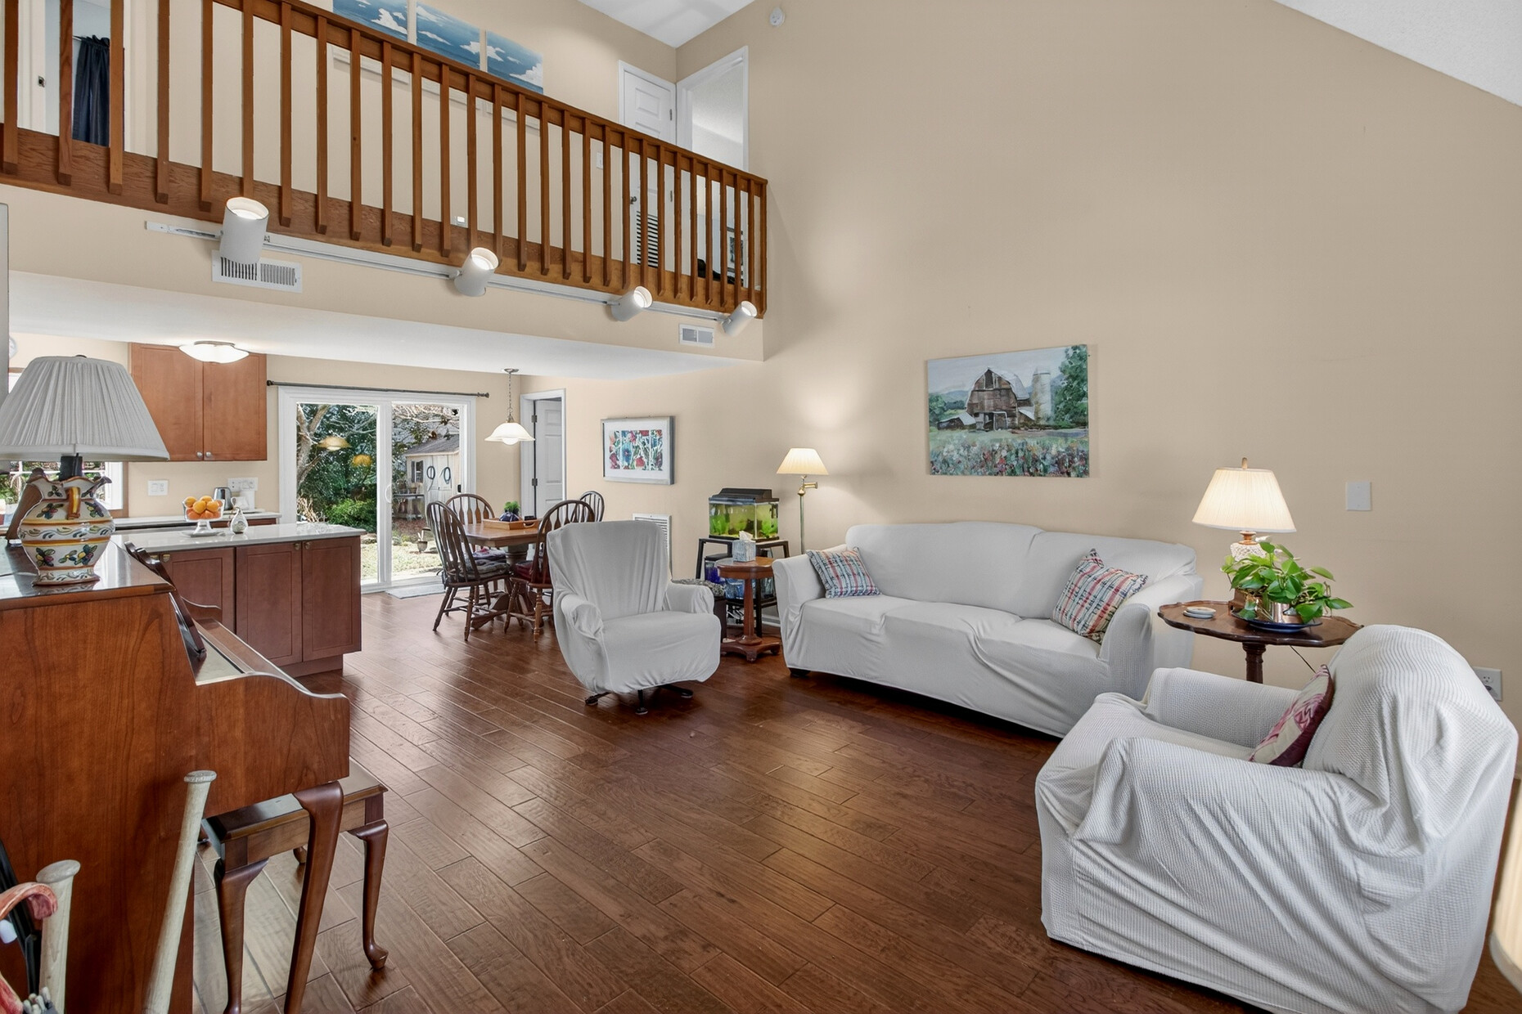
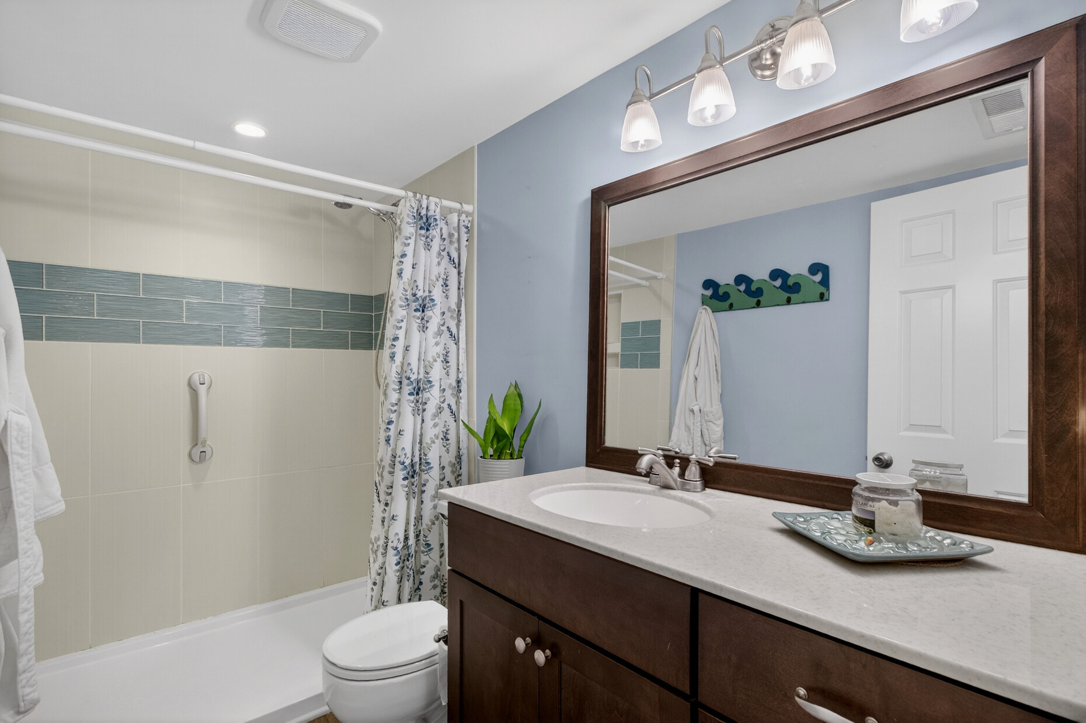
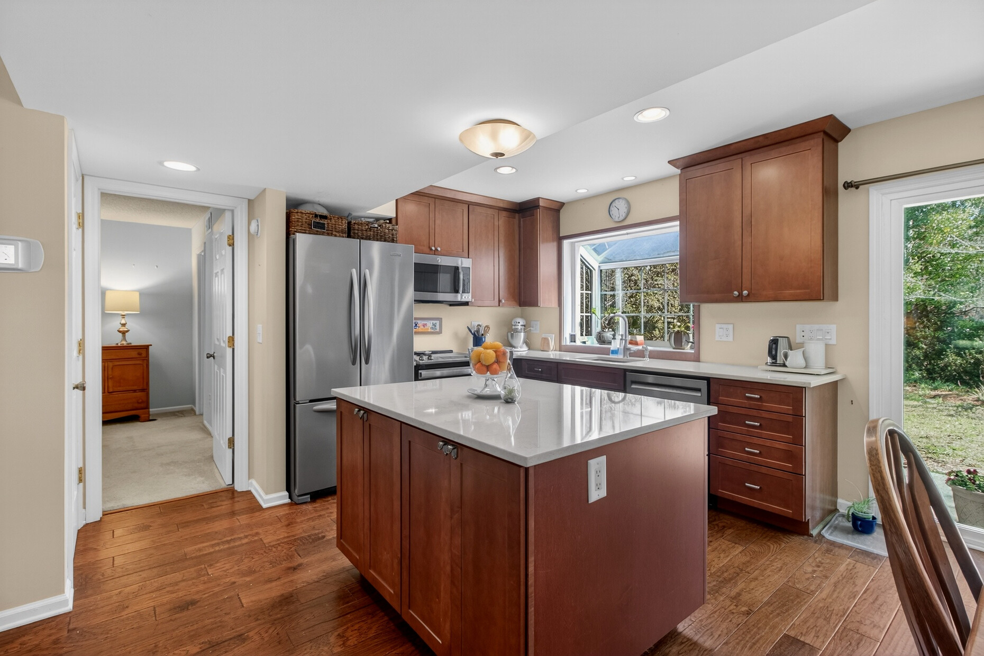







Just Listed + Open House
1440 Oak Landing Road, Mount Pleasant
Rendering with Garage
Apartment Bath
1440 Oak Landing Road
Oakhaven Plantation
Mount Pleasant, SC 29464
MLS# 26006515 | $719,900
Property Site
Video Tour
Storybook
Apartment Bedroom
Sellers are offering Buyer Agent Compensation up to 2.5% with an acceptable offer!
NEW ROOF 2025
Discover comfort and convenience at 1440 Oak Landing Road in the desirable Oakhaven Plantation community of Mount Pleasant. This inviting home features 3 bedrooms, 2 baths, and a versatile bonus room within approximately 1,755 square feet of thoughtfully designed living space.
The bright eat-in kitchen flows into a spacious family room, creating the perfect setting for everyday living and entertaining. The primary suite is conveniently located on the main level, while two additional bedrooms and a large bonus room upstairs offer flexible space for guests, a home office, or playroom.
Enjoy the Lowcountry lifestyle with a welcoming front porch and large backyard with patio and garden shed, ideal for relaxing or hosting gatherings.
Residents of Oakhaven Plantation enjoy a community pool, tennis courts, playground, and scenic walking trails, all just minutes from Isle of Palms, Sullivan’s Island, Shem Creek, and historic downtown Charleston.
Open House: Saturday, March 15 | 11:00 AM – 1:00 PM
Come tour this beautiful Mount Pleasant home or schedule your private showing today!
Property Site | Video Tour
Ellen O'Neil
Broker/Owner, ABR, e-PRO, CNE
Charleston Realtor of Distinction
843-300-8530
www.EllenONeilProperties.com

