Slide 1
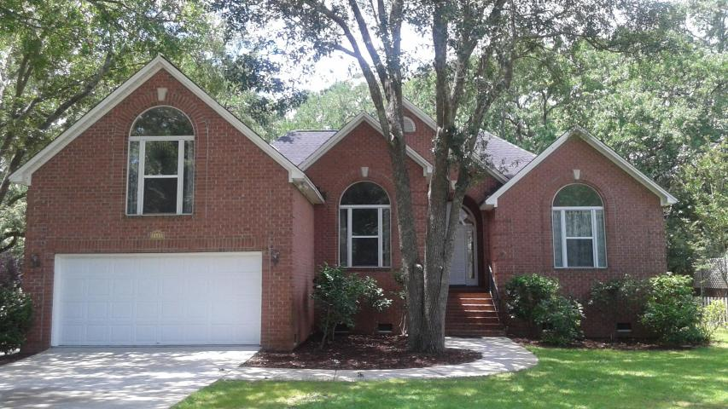
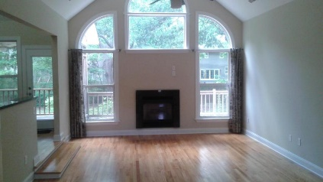
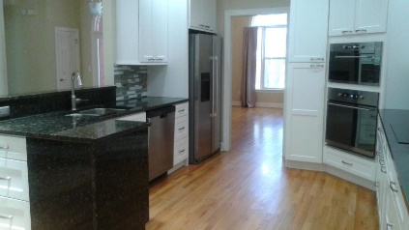
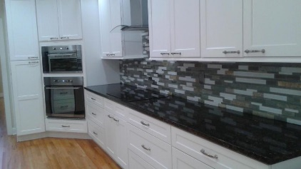
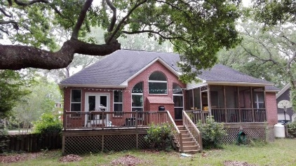


1441 Pine Island Oakhaven Plantation :: Mt Pleasant :: MLS# 17016012 :: $550,000
This home has it all and is move-in ready!
Not a detail has been overlooked!
New Listing!
Welcome home to 1441 Pine Island View located in the center of Mt. Pleasant! The home is conveniently to shopping, schools, and coastal beaches with top ranking schools. Four bedroom brick home has been renovated and move in ready. The gleaming hardwood floors are welcoming in the foyer, living room, dining area, and kitchen. With a new gourmet kitchen, the floorplan is open and perfect for entertaining guests. All appliances remain under warranty for another year and kitchen boasts stainless steel appliances, granite counter tops, and a beautiful glass tile backsplash. The private master suite is located on the main floor with fresh carpeting and total renovation to the bathroom. New soaking tub compliments the newly tiled shower with all new fixtures throughout the bathroom.
Two additional bedrooms are on the main level for mostly one level living but remains private with a thoughtful floorplan to allow for convenience of one level with privacy. The fourth bedroom is located over the garage with large closet. The fourth bedroom is perfect for the teenager or can be used as a flex space for home office or playroom.
The exterior includes a large screened in porch and open deck overlooking the oak dripped back yard. The backyard has fencing with lush landscaping for privacy. Water your lawn using the well located in the back of the home.
Two car garage has wide door with opener. There is an access door from the garage to underneath the home for easy maintenance of the crawlspace. Garage sink with hot and cold water.
All appliances convey including refrigerator, built in microwave, washer and dryer. Water heater is tankless. Updated fans in kitchen and living room. All window treatments to convey.
Tracy Meredith
M (843) 270-4800 :: O (843) 886-8110
tmeredith@carolinaone.com
Carolina One Real Estate :: 1503 Palm Blvd :: Isle of Palms, SC 29451

