Slide 1
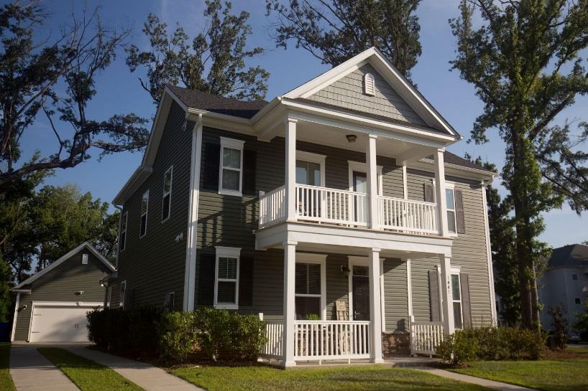
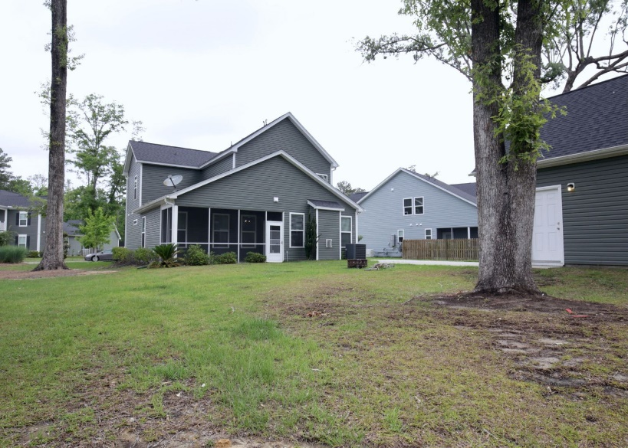


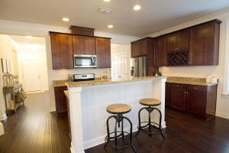


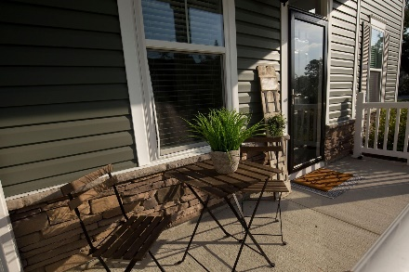
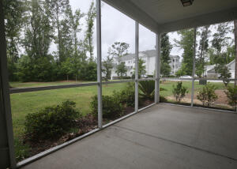
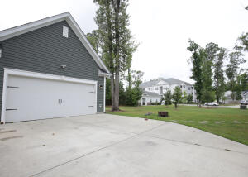


1441 Seabago Drive Boltons Landing ~ Charleston, SC 29414 MLS# 22013920 ~ NEW PRICE $515,000
NEW LOOK! COME SEE!
This is what you have been waiting for in Bolton's Landing! Beautiful Home that has been taken care of and move in ready. Open floor plan which makes it perfect for entertaining. Master Bedroom is downstairs that has a spacious bathroom with oversized shower, dual vanity and walk in closet. The other bedrooms are upstairs with a full hall bath. There is a ginormous room upstairs that can easily be made into another master suite by adding a bath room or make it a game or theater room! You can enjoy the dual porches which are up and down stairs. Out back you have a nice sized yard with a screened in porch. The two car garage is detached. Come see this home in person to appreciate!
Kelly Rozier
(843) 209-3129
kellywrozier@gmail.com
Brand Name Real Estate
4 Carriage Lane Suite 106
Charleston, SC 29407

