Slide 1
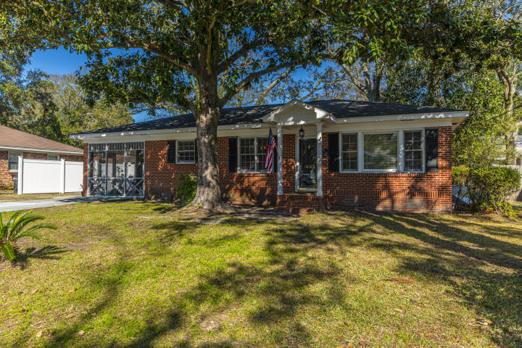
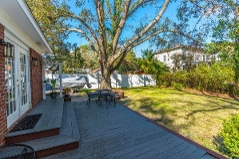
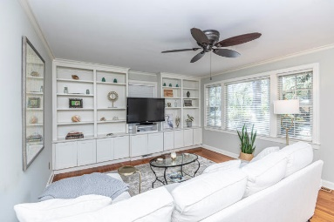
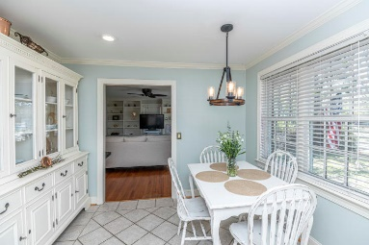
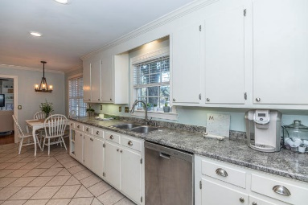
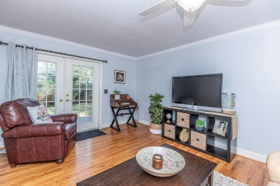
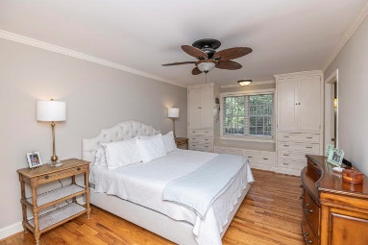
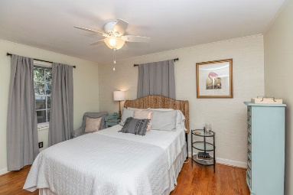
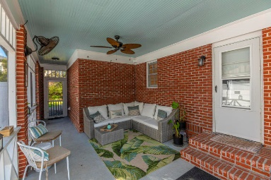
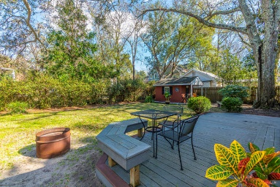


Move in Ready!
1442 Goblet Avenue
Mount Pleasant, SC 29464
MLS# 20002879 ~ $600,000
Charming brick ranch in prime location - Old Mount Pleasant! This 3 bedroom, 2.5 bath home is conveniently located to downtown Charleston or within a bike ride to Sullivans Island. Living room offers lots of natural light and custom built in cabinets. Hardwood floors throughout home with ceramic tile in kitchen and bathrooms. Large master suite features custom built in wardrobe cabinets with window seat and dual closets! White cabinets and stainless appliances in kitchen. Large laudry room with even more storage. French doors open to large deck in the back yard great for entertaining inside and out. Screened in porch. Fenced in yard and storage shed even has electricity. Crawl space is encapsulated. No flood insurance!
Jennifer Frampton Pait
843-568-9509
jenniferfp@carolinaone.com

