Slide 1
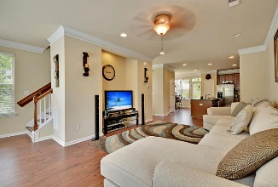
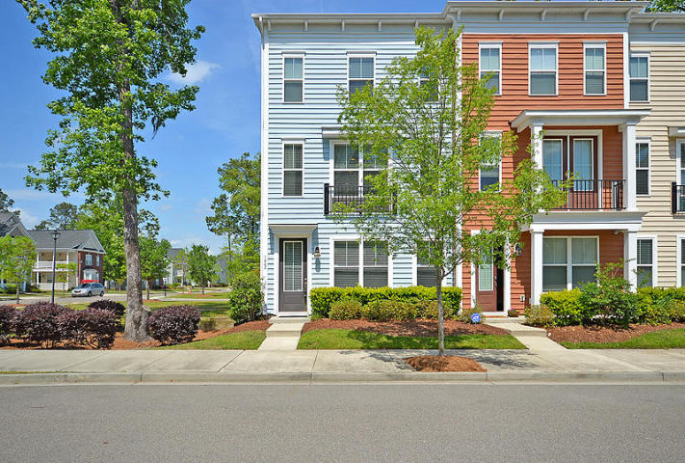
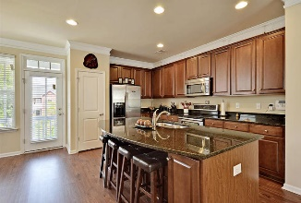
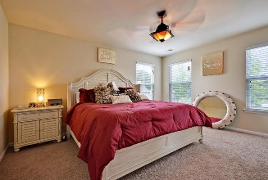
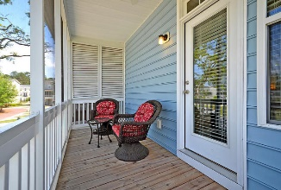
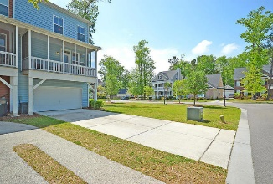
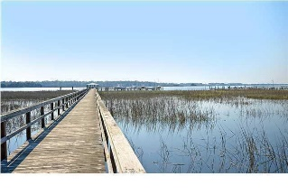

1442 Roustabout Way Boltons Landing | Charleston MLS# 16010987 | $219,999
Luxury Townhome!
Loaded with Updates
Do Not Miss Out on this Gorgeous End-Unit Townhouse in Bolton's Landing!! This 3 story luxury townhome sits on a corner lot and includes a 2-car garage, dual master bedroom suites, 2 full baths, 2 half baths, and a gourmet, eat-in kitchen with granite countertops, large kitchen island and stainless steel appliances. Additionally, this home boasts a flex/bonus room on the first floor that is ideal for an additional bedroom, office space, workout room, or a place to entertain family and friends! Off the kitchen, there is a screened-in balcony that is perfect for morning coffee before work or relaxing in the evening. Continue upstairs where there are two master suites on the third floor, each complete with a walk-in closet and a full bath. Bolton's Landing is a wonderfully landscaped community with a play park, walking trails, and community pool! The neighborhood is close to local shopping and grocery stores and is a short drive to downtown Charleston with 5-star restaurants, world class shopping and iconic history as well as a short drive to the beaches, the airport, Boeing and Daniel Island. Come take a look because you will not find another home that offers as much as this one!
Stan Huff
843-670-2835 stan.huff@agentowned.com
Jill Marcacci
843-297-5590 jill@agentowned.com
www.agentownedrealty.com
AgentOwned Realty Co. Preferred Group, Inc. | 824 Johnnie Dodds Blvd | Mt Pleasant, SC 29464

