Slide 1
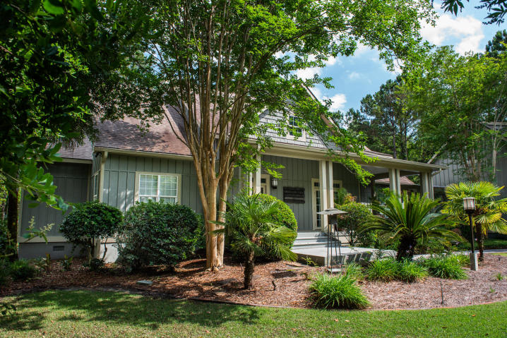
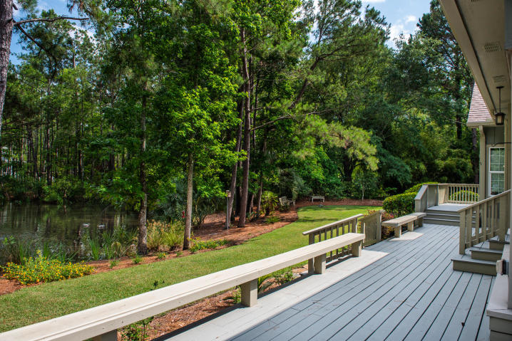
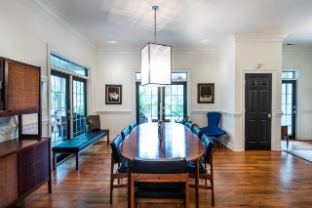
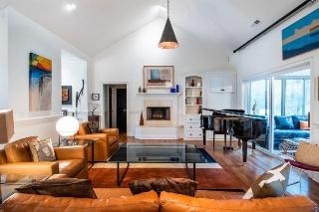
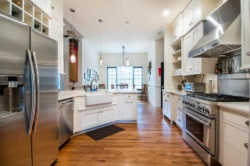
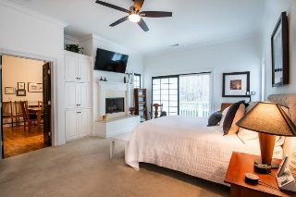
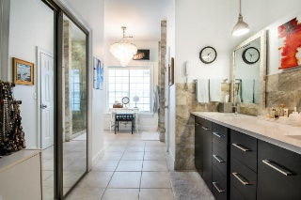
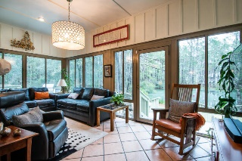
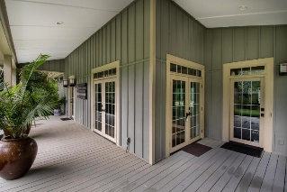
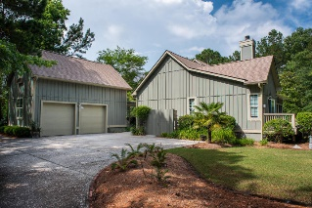
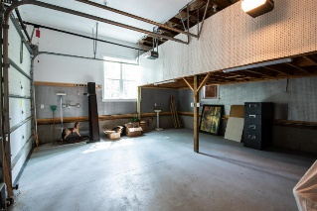
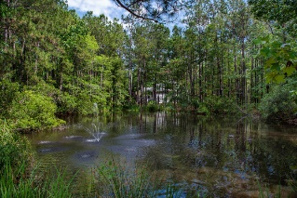

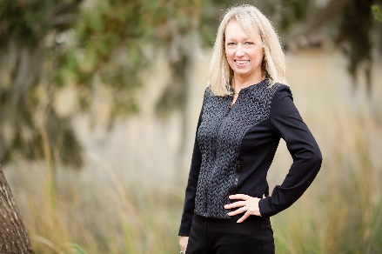
1443 N Cardinal Hill Drive Cardinal Hill | Mount Pleasant, SC 29466 | MLS# 20013521 | $795,000
Amazing Pondside Lot & Home ~ Privacy Abounds
Community Dock
Great opportunity to own a large one acre lot with nice privacy and wooded lot in the gated community of Cardinal Hill. Lovely porches on the front and the rear of the house to enjoy the great outdoors. The front porch welcomes you with lots of light and mature landscaping. The foyer welcomes you into a great open concept floorplan. The home is a one level with large master bedroom, oversized bathroom and closet. The other two bedrooms are on the the opposite of the home for privacy. Updated bathrooms. The home has a bright sunroom overlooking the pond to enjoy the abundance of wildlife. The home also has nice eat in kitchen and great room. Hardwood floors and carpet in the bedrooms. Spacious two car garage with finished room over the garage with half bath. The backyard deck also has a built in kitchen with grill and sink for ease of cooking and enjoying the outdoors. This community is very private and is gated. There is a community dock that is on Horlbeck Creek.
Charla McDonald
Cell - (843) 343-1456
cmcdonald@carolinaone.com
charlamcdonaldproperties.com
Carolina One Real Estate
628 Long Point Rd.
Mt Pleasant, SC 29464-3032

