Slide 1
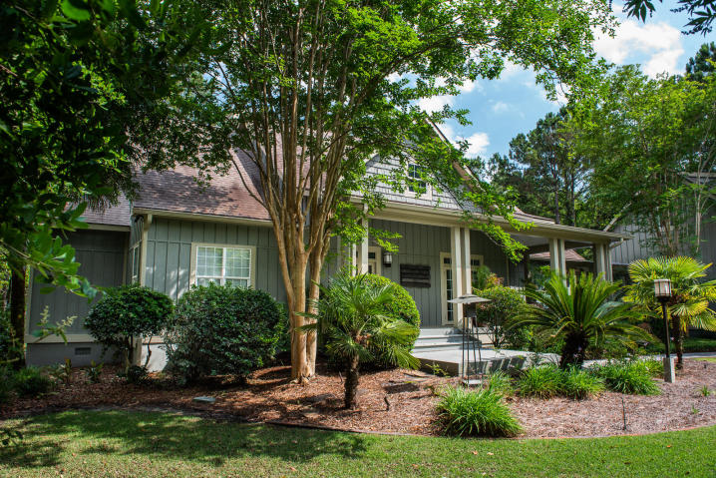
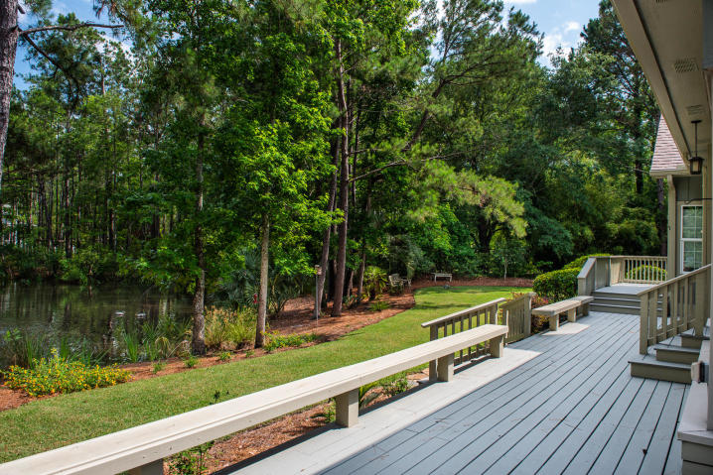
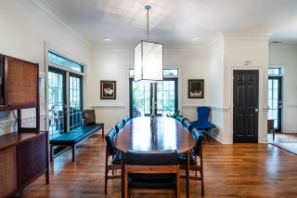
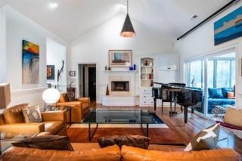
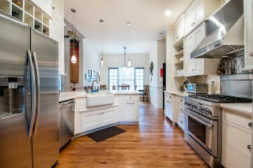
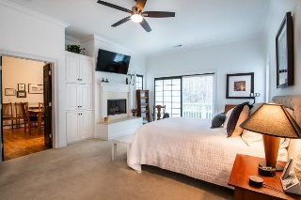
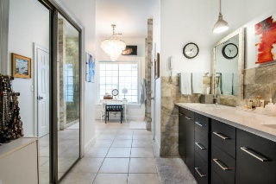
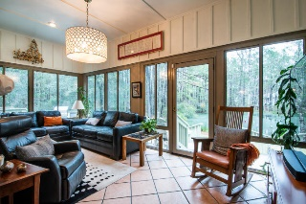
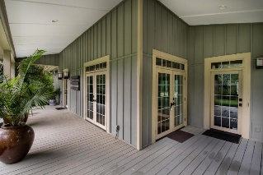
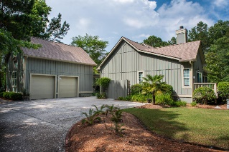
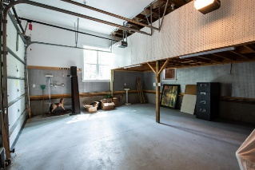
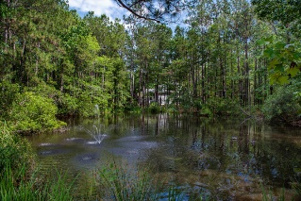

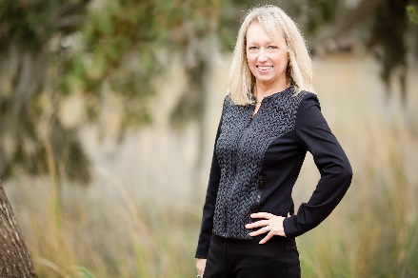
1443 N Cardinal Hill Drive
Cardinal Hill | Mount Pleasant, SC 29466 | MLS# 20013521 | $775,000
Price Improvement
Amazing Pondside Lot & Home ~ Privacy Abounds
Community Dock
Great opportunity to own a large one acre lot with nice privacy and wooded lot in the gated community of Cardinal Hill. Lovely porches on the front and the rear of the house to enjoy the great outdoors. The front porch welcomes you with lots of light and mature landscaping. The open foyer invites you into beautiful family and dining rooms with hardwoods, vaulted ceilings and fireplace. The home is a one level with large master bedroom, oversized bathroom and closet. The other two bedrooms are on the opposite of the home for privacy and has updated bathroom. The home has a bright sun room overlooking the pond to enjoy the abundance of wildlife.
The home also has welcoming eat in kitchen overlooking the great room. Hardwood floors in main living areas and carpet in the bedrooms. Spacious two car garage with finished room over the garage with half bath, which makes for a great art studio, office, or a fourth bedroom.
The backyard deck also has a built in kitchen with grill and sink for ease of cooking and enjoying the outdoors. Additionally, the home has a built in generator off the garage. This community is very private and is gated. There is a community dock that is on Horlbeck Creek.
Charla McDonald
Cell - (843) 343-1456
cmcdonald@carolinaone.com
charlamcdonaldproperties.com
Carolina One Real Estate
628 Long Point Rd.
Mt Pleasant, SC 29464-3032

