Slide 1
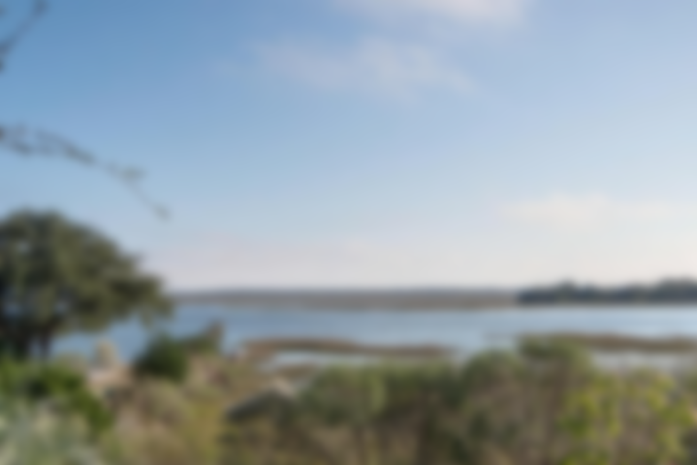
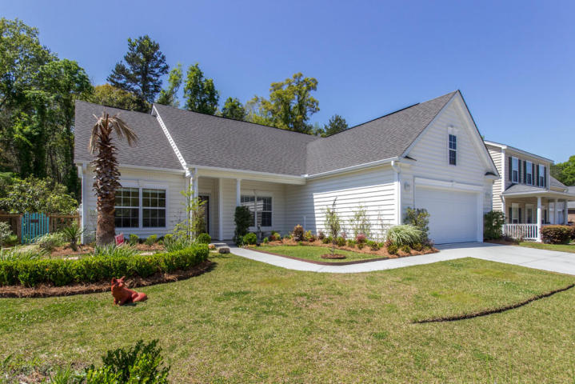
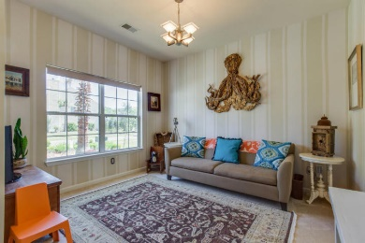
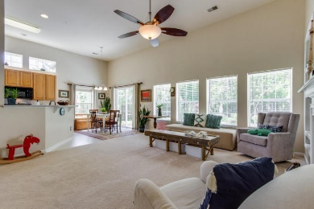
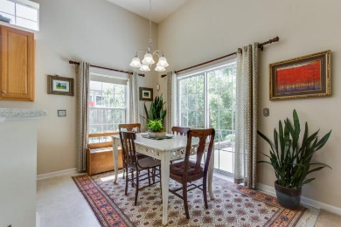
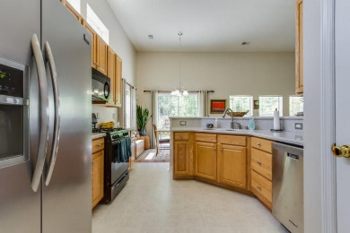
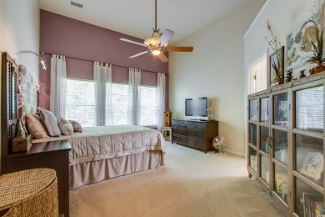
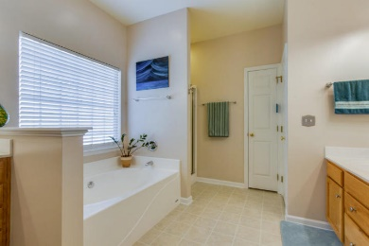
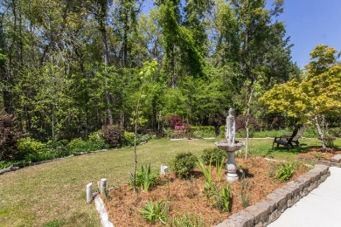
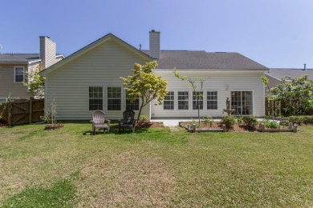

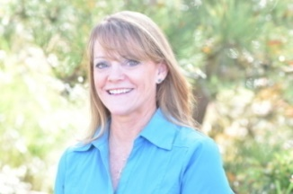
New Listing In Grand Oaks Plantation
One Story Living
1445 Ashley Gardens Blvd
Charleston, SC 29414 ~ MLS# 18010603 ~ $274,900
West Ashley convenience! Grand Oaks Plantation! One Story! Backs to wooded area. New HVAC and stove. Open plan with 12' ceiling in living area and 9' in other rooms! Welcome to this well maintained, beautifully landscaped home! From the moment you pull into the drive, you will feel the privacy envelop you. Mature landscaping offer a buffer on all sides. The front porch invites you to sit, relax and de-stress. Enter the spacious foyer with family room ahead and formal dining to the left. Dining room is being used as a casual area. Through the dining room enter the light and open kitchen with the 12' ceilings, tall cabinets, stainless steel appliances, pantry, corian counters, transom windows over the cabinets, a great place for the cook and family gatherings. The eat-in kitchen allows for family meals, or you can extend the experience to the large patio for out door grilling. The family room is so comfortable with a fireplace, built-in shelves, lots of windows, perfect for any size family. On the other side of the house find the large master bedroom, 2 nice size secondary bedrooms, the hall bath and the laundry. Master bedroom is a quiet haven located at the back of the home. You can even leave the windows open as the woods allow for privacy with no houses behind. The master bath offers dual sinks, a water closet, separate shower and garden tub, and a large walk in closet. Outside, the yard is fully fenced, but also allows for views of nature. The owner was a landscaper so you will find a variety of plantings for year round beauty. Call to today for more details and to schedule a showing. Grand Oaks has a neighborhood pool, and the Charleston recreation center is located in the neighborhood.
Laurie Loparo
(843) 442-1290 | laurieloparo@gmail.com
NV Realty Group | 91 Broad St, Ste A | Charleston, SC 29401
www.lauriesellscharleston.com

