Slide 1
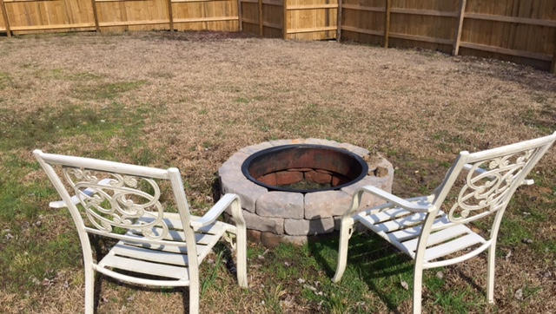
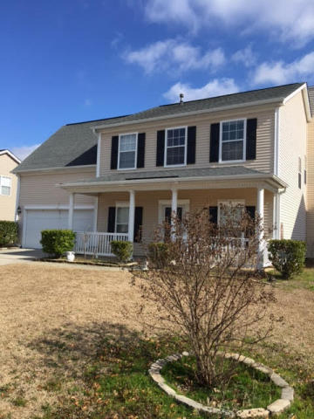
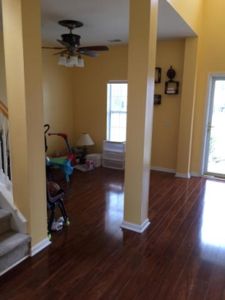
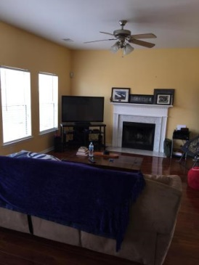
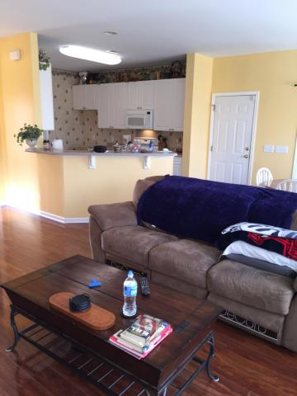
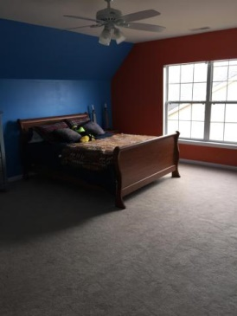
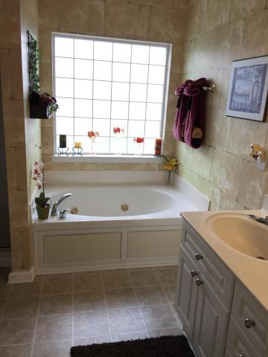

1446 Crossbill Trail
Tanner Plantation
Hanahan, SC 29410
MLS# 15004229
$239,999
4 Bedrooms | 2½ Baths | 1,972 sf
Open House Lunch ~ Friday, Oct 3 from 11 - 1
Handyman Special… Bring your hard hats!
$10,000 Price Reduction!
The Riley floor plan is offered in this four bedroom home, including the FROG as the fourth. The welcome home feeling you get when you enter the open foyer as you turn the key makes you forget about your long day. As soon as you walk in you will enjoy the warm feeling of home with the high ceilings, the living area downstairs, a separate dinning room, large eat-in kitchen, half bath and an open family room with a fireplace. A screened in winterized porch can be used as an office or exercise room. Upstairs you have a large master suite and 3 nice bedrooms and a bathroom. The fourth bedroom, which is the FROG, could be used as a family play room. You will love the large private fenced in backyard with a brand new fire pit for your family bonding time after a long day. Get the marshmallow ready for some smores! Don't forget the amenity center with Jr. Olympic swimming pool, clubhouse and play park and all this close to shopping, dining, Boeing, and area beaches. Hurry and schedule your appointment today.
Susan & Greg Day
843-900-0477 | 732-757-2904
charlestonbyday@gmail.com
www.charlestonbyday.com
AgentOwned Realty Co. Premier Group, Inc. | 824 Johnnie Dodds Blvd | Mt Pleasant, SC 29464

