Slide 1
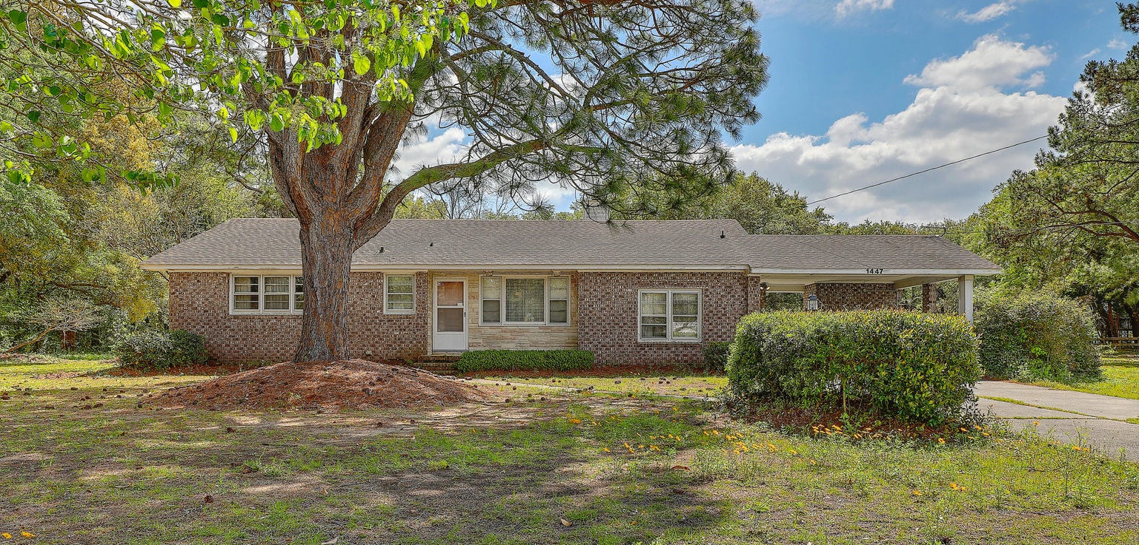
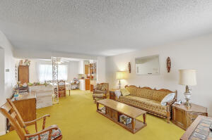
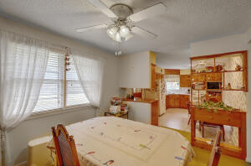
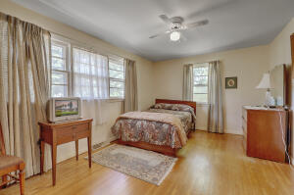
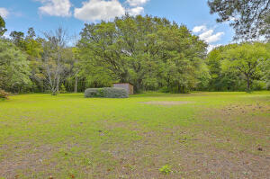


1447 Fort Lamar Road
Secessionville | Charleston, SC 29412 | MLS# 23007907 | $950,000
Home on Beautiful 2.3 Acre Subdividable Lot
What a rare find on James Island! Welcome to a very well maintained brick ranch that is fully functional to where you can move on in and update along the way if you choose. This home sits on a beautiful 2.3 acre lot that is subdividable! Less than 10 min to Folly Beach! If you like vintage this is the home for you. Great floor plan with endless possibilities. Hardwoods are under the carpet. Bedrooms are nice sized and the master has a dressing area with a half bathroom. Ceilings are flat and there is vintage tile in the bathrooms. There is a living room that flows nicely with the dining room and eat in kitchen so entertaining is easy. Off of the kitchen is another den with a cozy wood burning buck style stove. Outside is the laundry area under the carport. Now lets talk about this little piece of serenity. This extra large lot is almost park like with the beautiful trees front and back. There has been many years of gardening on these grounds in the past. The sandy soil has made a wonderful garden that has grown delicious vegetables. The live oaks are very shading and large enough to set a swing or hammock to relax and catch the breeze. The property is cleared to walk it all. If you don't want all of the property talk to your friends and family and see if they would like to build close to you and subdivide them a piece! You may even want to make the main a house a rental and build your dream home towards the back. Again so many opportunities. Don't forget to bring your boat, there are a couple of landings very close by! Schedule a showing today to appreciate the beauty and character of this home and property in person.
Video tour: https://vimeo.com/813351121
Kelly Rozier
(843) 209-3129
kellywrozier@gmail.com
Brand Name Real Estate
4 Carriage Lane Suite 106
Charleston, SC 29407

