Slide 1
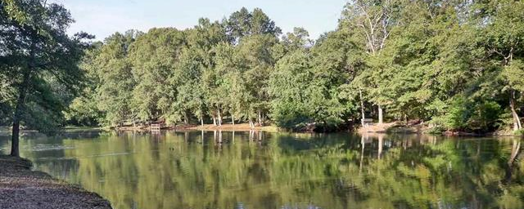
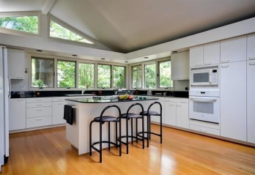
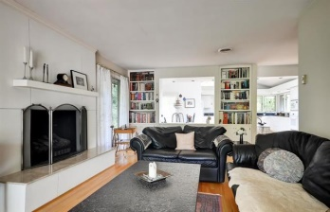
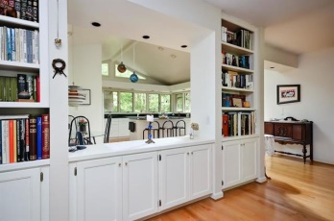
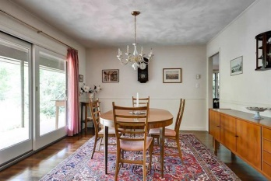
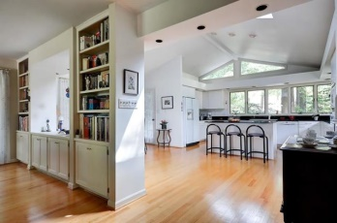
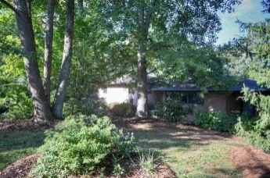
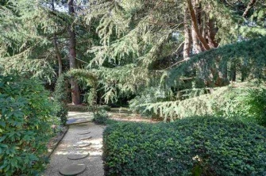
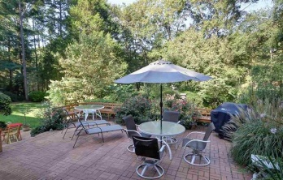
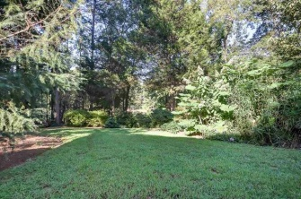
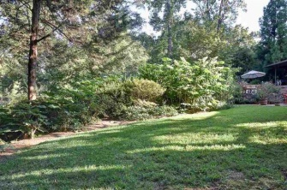


Priceless Treasure!
144 Edgecombe Road, Spartanburg, SC 29307
Imagine waking up to this every day. From sunrise to sunset it could all be yours. Your own private estate tucked away in Calhoun Lake estates just minutes from downtown Spartanburg. You will look forward to occasions to entertain when you see this absolutely stunning kitchen surrounded with windows and a skylight bringing all the natural light to brighten every day. Only positive energies are allowed. From the outside as you walk to the entrance of this lovely home you will notice a very attractive and cleverly designed drain to protect your property when the heavy rain falls. This drain will look like a lazy river when filled with rain water. From the cheerful kitchen with the dining area and breakfast bar (notice beautiful hardwood floors throughout) you will appreciate the family room, dining room, combination music room and library. All this leads out to the covered porch and patio's. El fresco dining at it's best in your own private estate. Take a stroll through the gardens and relish in the beauty of nature. Relax and enjoy the feeling of serenity and tranquility of your almost an acre of surroundings and you are in paradise. On a cold or rainy day you will have the lower level retreat with fireplace and sauna. This could serve as additional entertainment or hobby space. Just use your imagination. On the lower level retreat there is the fourth bedroom which the current owner uses as an office. If you need a private bedroom for guest or family member for separate living quarters this is the answer. Spartanburg is a vibrant international community with an abundance of art, theatre and cultural activities. For day trips there are endless opportunities, the mountains, Greenville, Charlotte, Asheville, Atlanta, Tryon horse country. How about a long weekend to the beach or mountains, Charleston, Hilton Head, Savannah, Kiawah Island. High Hampton in Cashiers, NC, Highlands, NC. The opportunities to explore are endless. Until then, you will have the best of all right here at 144 Edgecombe Road in Spartanburg, SC. You are within minutes of all the conveniences of Spartanburg, the GSP International Airport and the neighboring city of Greenville.
MLS# 221981 ~ $325,000
Peggy Wilson
Realtor, Broker, GRI, ABR
864 415-3958
peggy@realtysc.com
www.realtysc.com

