Slide 1
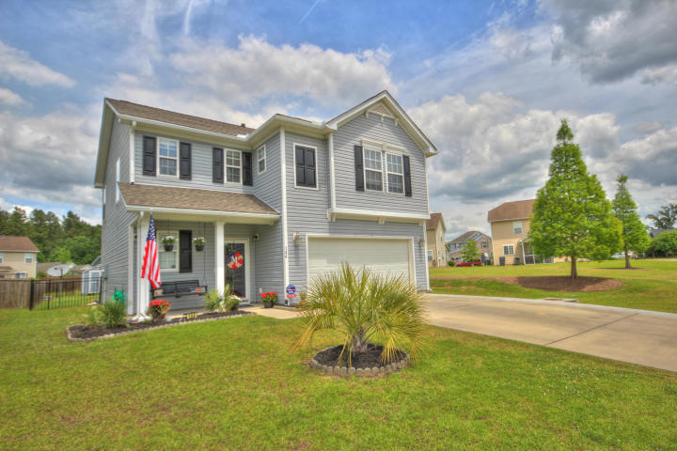
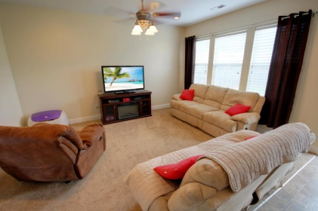
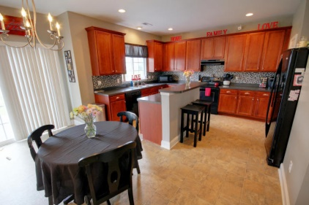
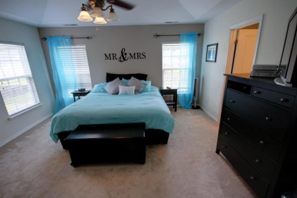
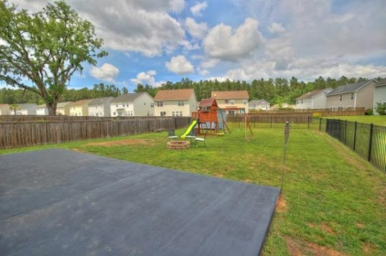

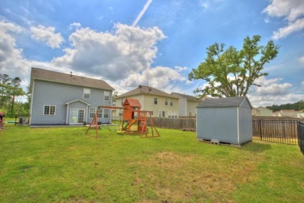
144 Kimberton Ave
Foxbank Plantation
Moncks Corner
MLS# 15012068
$179,990
3 Bedrooms
2 ½ Bathrooms
1,820 Sq Ft
144 Kimberton Ave is a meticulously maintained home in Moncks Corner's popular community, Foxbank Plantation! The floor plan is open and very functional. As you enter the home, you will find a true foyer with a private powder room which includes a custom vanity and a reclaimed wood wall! The family room (brand new carpet) is open to the spacious eating area and kitchen with an island where you'll have plenty of room for extra seating. The kitchen has upgraded 42'' cabinets with hardware and crown molding. The custom backsplash adds a lot of detail to this kitchen as well! Upstairs, there are three huge bedrooms and an awesome loft which is perfect for a play area, office or TV room! The master suite is private and located on the back of the home and includes a dramatic tray ceiling. The master bathroom has a wide vanity, a soaking tub, a linen closet and an enormous walk-in closet! There's also a niche that's perfect for a desk or large armoir! The garage is currently used as a man-cave and is equipped with an awesome bar that can be yours with a suitable offer! The backyard is fenced with an enormous patio that's the width of the home and the homesite is adjacent to an HOA space, giving a sense of more land and privacy! This home is move in ready! The community pool is gorgeous and overlooks a 67 acre lake where you can kayak or fish! Foxbank Plantation offers a lifestyle that you do not want to miss! A new, 2,400-square-foot fitness center opens soon in the Shops at Foxbank. Featuring state-of-the-art, Vision Fitness cardio equipment, the facility is opening in response to overwhelming homeowner request.
Meg Hopkins Kandik
Cell - 843-814-5137
meg@holycityre.com

