Slide 1
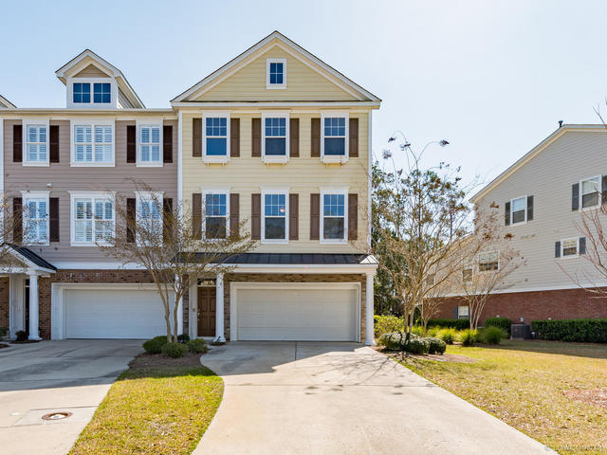
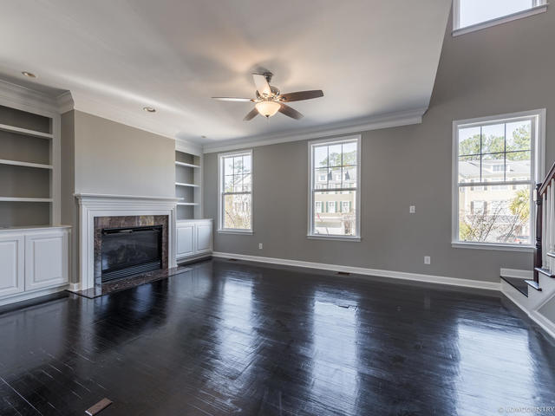
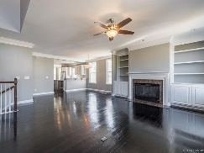
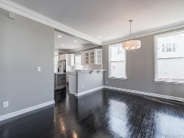
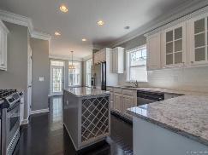
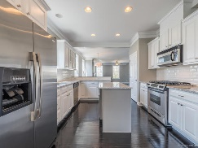
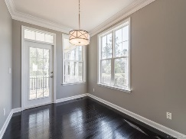
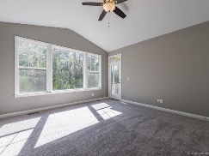
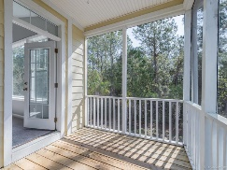
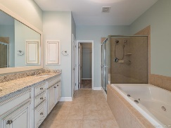
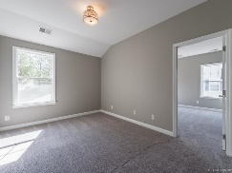
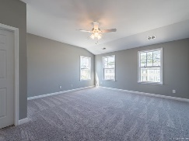
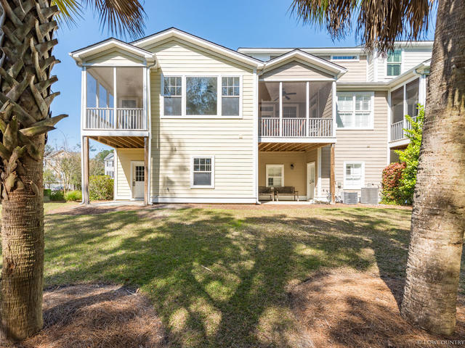

Open House Saturday, April 29, 1-3
144 Palm Cove Way
Dunes West ~ Mount Pleasant, SC 29466
MLS# 17008318 ~ $454,900
Recipe for success: Start with a gated golf course community in one of the most desired locations in the Southeast. Build a well-designed John Wieland luxury townhouse, add numerous tasteful quality custom after-market improvements and enhancements...This is 144 Palm Cove Way! Truly better-than-new, it is meticulously improved and ready for your discerning approval. The main living level flows beautifully from the open living room w/fireplace, through adjacent dining space, and on to the spacious gourmet kitchen, featuring new custom granite countertops, backsplash, and more! End unit with tons of windows brighten the kitchen's breakfast nook while also framing an inviting screened porch deck. Just beyond that, a serene green copse of wooded wetlands. Inside, the ground level has a large bedroom, separate den, full bathroom, and of course, the oversized garage with storage and plenty of room for additional work space. The Master Bedroom suite is on the main living level with a luxuriously appointed bath with separate jacuzzi style tub and walk-in shower, custom granite dual vanity, Italian tile and more. Two additional large bedrooms with Jack and Jill bath upstairs, large walk-in laundry room and open loft all await you. This home is highly improved with granite in kitchen and bathrooms, all new paint (walls, trim and ceilings) brand new upgraded carpet, lighting fixtures, fans and more! Schedule your private showing today!
Open House hosted by Deborah Meuli ~ (843) 822-0133 ~ dmeuli@comcast.net
Wendy Deitsch
O - (843) 491-1445
M – (843) 270-0433
wendy@lifetreeliving.com
LifeTree Real Estate, LLC
3094 Hwy 17 North
Mt. Pleasant, SC 29466
www.lifetreerealestate.com

